Slide 1
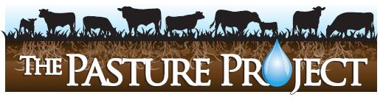
Adaptive High Stock Density Grazing
Allen Williams, Ph.D. GFI, LLC
John Zinn, USDA NRCS

Slide 2
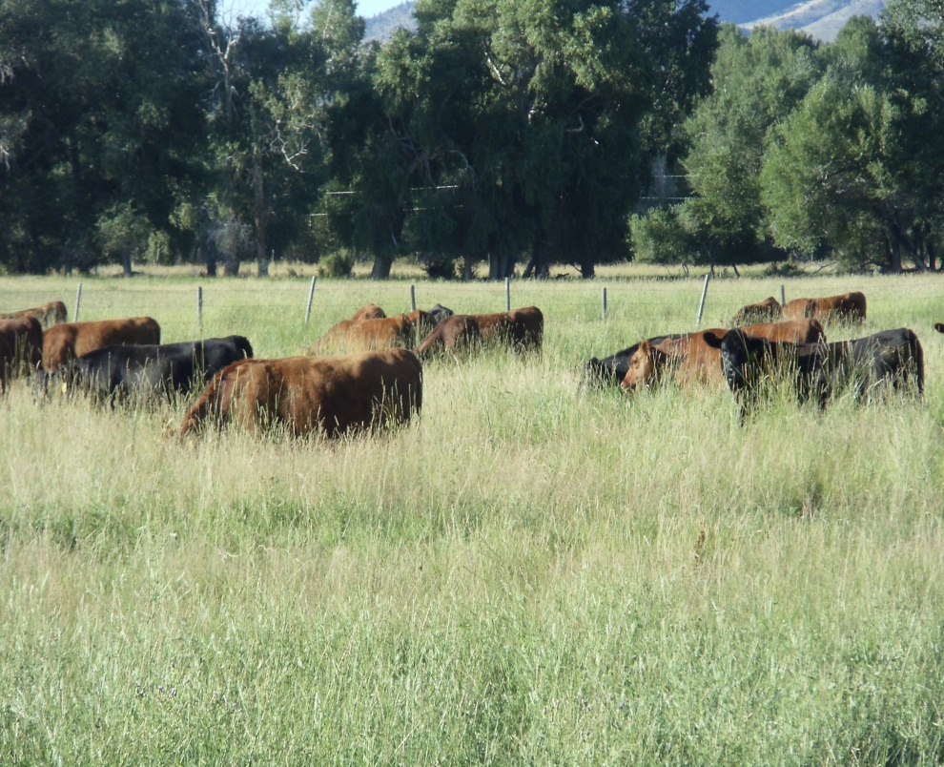
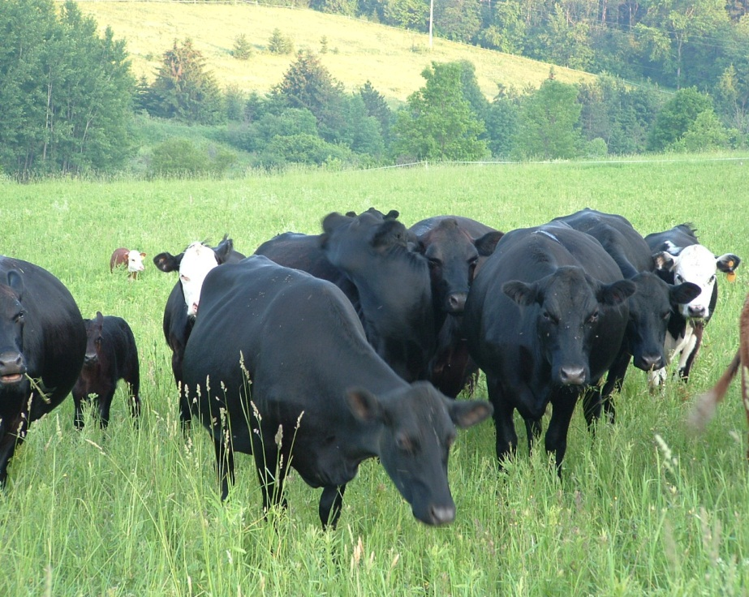
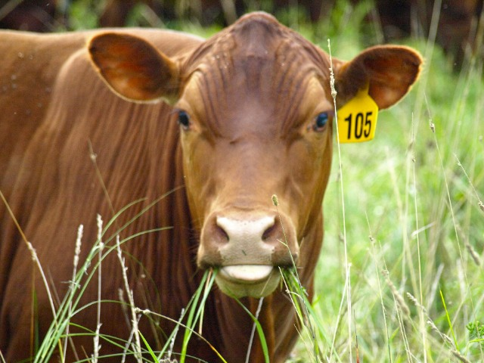

Slide 3
Importance of Grass
Covers 40% of Earth’s surface.
Covers 70% of world’s agricultural area.
4th largest plant family in the world.
More than 11,000 different species.
90% of grass’ bulk is underground.
“Grass prevents erosion by binding to the soil”.

Slide 4
Importance of Large Ruminants
Ruminants have a unique gift of being able to covert cellulosic vegetation into nutrition.
Microbes in gut of ruminants work similar to microbes in the soil.
Ruminants do not digest grass, microbes do.
Large ruminant impact on land is vital.

Slide 5
What is AHSD Grazing?
Adaptive High Stock Density (AHSD) Grazing is defined as:
  A uniquely flexible grazing system designed to facilitate maximum flexibility in land use and forage utilization, while optimizing animal performance and soil health goals.
Also known as Adaptive Multi-Paddock (AMP) Grazing.

Slide 6
AHSD grazing relies on the basic tenets of keen observation and fencing portability.
Stock densities and animal movement frequency can be altered throughout the annual grazing cycle in order to adjust to changes in climate, forage dry matter (DM) production, animal performance and soil health objectives.

Slide 7
Key Benefits
Increased forage dry matter production on a seasonal and annual basis.
Enhanced animal performance.
Significant improvements in soil health, including:
Increased water infiltration rates and soil water retention.
Increased soil aggregation, improved soil tilth, and reduction in soil compaction.
Reduced erosion and runoff.
Increased soil microbial population and microbial balance.

Slide 8
Key Benefits, Con’t.
Greater plant diversity through “tapping” of latent seed bank.
Increased atmospheric nitrogen fixation through plant legumes and N-fixing soil bacteria – nodulating and non-nodulating.
Reduced reliance on inorganic fertilizers.
Incremental increases in soil organic matter and CEC.

Slide 9
Key Benefits, Con’t.
Natural soil pH buffering capacity.
Incremental increases in livestock carrying capacity.
Greater plant species and wildlife species diversity.
Improvement in earthworm, soil level arthropods, and pollinator insect populations.

Slide 10
Research Results
Frequent livestock rotations increase forage biomass production and improve soil & environmental health (Savory, 2008).
Increased stock density results in greater soil OM ( Schuman et al. 1999; Conant et al. 2003).
Extended periods of rest between grazing periods allows for optimum recovery of forages and increases overall forage dry matter (DM) production (Montazedian & Sharrow, 1990).

Slide 11
Research Results
Overgrazing reduces forage regrowth and biomass both through repeated grazing of the same plant in a short amount of time and through excess removal of plant material in the same grazing event (Cullen, et.al. 2006; Phillip, et. al., 2001).

Slide 12
Research Results
With increased grazing intervals, plants have more time to recover from prior grazing events and more effectively restore leaf area and root reserves, thus increasing forage biomass production (Phillip, et.al, 2001).

Slide 13
Research Results
Improved grazing management strategies also had positive impacts on soil biota, soil chemical and physical properties, water infiltration and retention, soil aggregation and soil carbon fractions (Teague, et.al, 2011; Conant, et.al, 2003; Leake, et.al, 2004).

Slide 14
AHSD Methodology
Involves first determining goals and objectives of your grazing program and then designing and implementing an annual grazing strategy that allows goals and objectives to be optimally achieved.
The primary purpose of AHSD grazing is to utilize variable high stock densities throughout a grazing season to effectively realize accomplishment of key benefits.

Slide 15
Stock densities will vary depending on soil and forage conditions, management constraints, and goals.
Practitioners should strive to achieve stock densities of at least 250,000 pounds per acre at least once annually.
Many current AHSD grazers have effectively used stock densities exceeding 500,000 lbs. /acre, followed by long rest periods, to rapidly build soil organic matter (OM), increase soil water infiltration rates, tap into the latent seed bank, and apply “natural” fertilizer in the form of animal manure and urine.

Slide 16
The key to successful implementation of such high stock densities is to allow the livestock to consume no more than 40-50% of total available forage DM before moving forward into a fresh grazing paddock.
Temporary grazing paddocks can be constructed (using electrified polywire and tread-in posts) that contain the appropriate amount of forage dry matter needed to support the stock density desired.

Slide 17
Stock Density Calculations
If you have 3000 lbs per acre of available forage DM and want to utilize 50% and leave 50% trample:
3000 x 50% = 1500 lbs DM available for 24 hour period.

Slide 18
Stock Density Calculations
Assume 100 head of 1200 lb lactating beef cows.
Assume 3.5% DM consumption needed daily.
1200 x 3.5% = 42 lbs forage DM/hd/day.
100 x 42 = 4200 lbs DM needed daily for herd.

Slide 19
Stock Density Calculations
If you have 1500 lbs DM available per acre and need 4200 lbs DM daily, then average paddock size:
4200/1500 = 2.8 acres needed per day.
Stock density = 1200 x 100 = 120,000 lbs
120,000 lbs/2.8 = 42,857 lbs/acre.

Slide 20
Stock Density Calculations
No. Moves Per Day | Stock Density Per Acre (lbs/ac) | Paddock Size (acres)
1 | 42,857 | 2.8
2 | 85,714 | 1.4
3 | 128,571 | 0.93
4 | 171,428 | 0.7
5 | 214,285 | 0.56
10 | 428,570 | 0.28

Slide 21
What Do Higher Stock Densities Look Like?

Slide 22
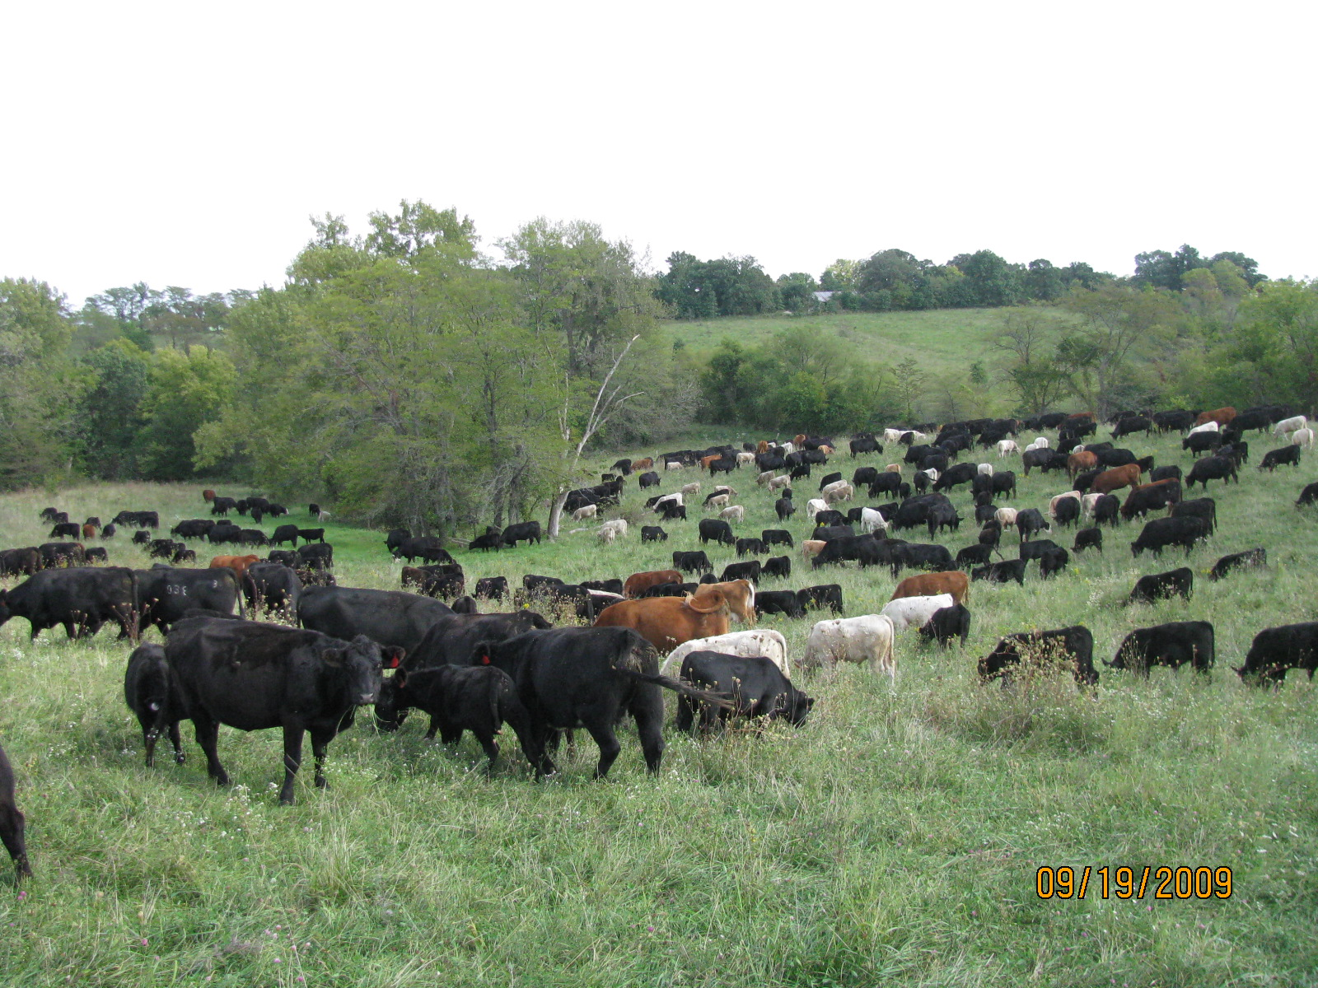
Adaptive High Stock Density Grazing
250,000 lbs per Acre
Notes:
Here is a set of cows at almost 150,000 stock density. Actually the photo appears to be a little higher than that because the 250 pair have access to 3 acres but they are standing on only about 2 acres of the field. Again, we are taking a look at how closely they are spaced. When I talk to people about putting that many cattle on 2-3 acres they always ask “can they even fit on that small of an area”? Do they look smashed together to you? To they look stressed to you?

Slide 23
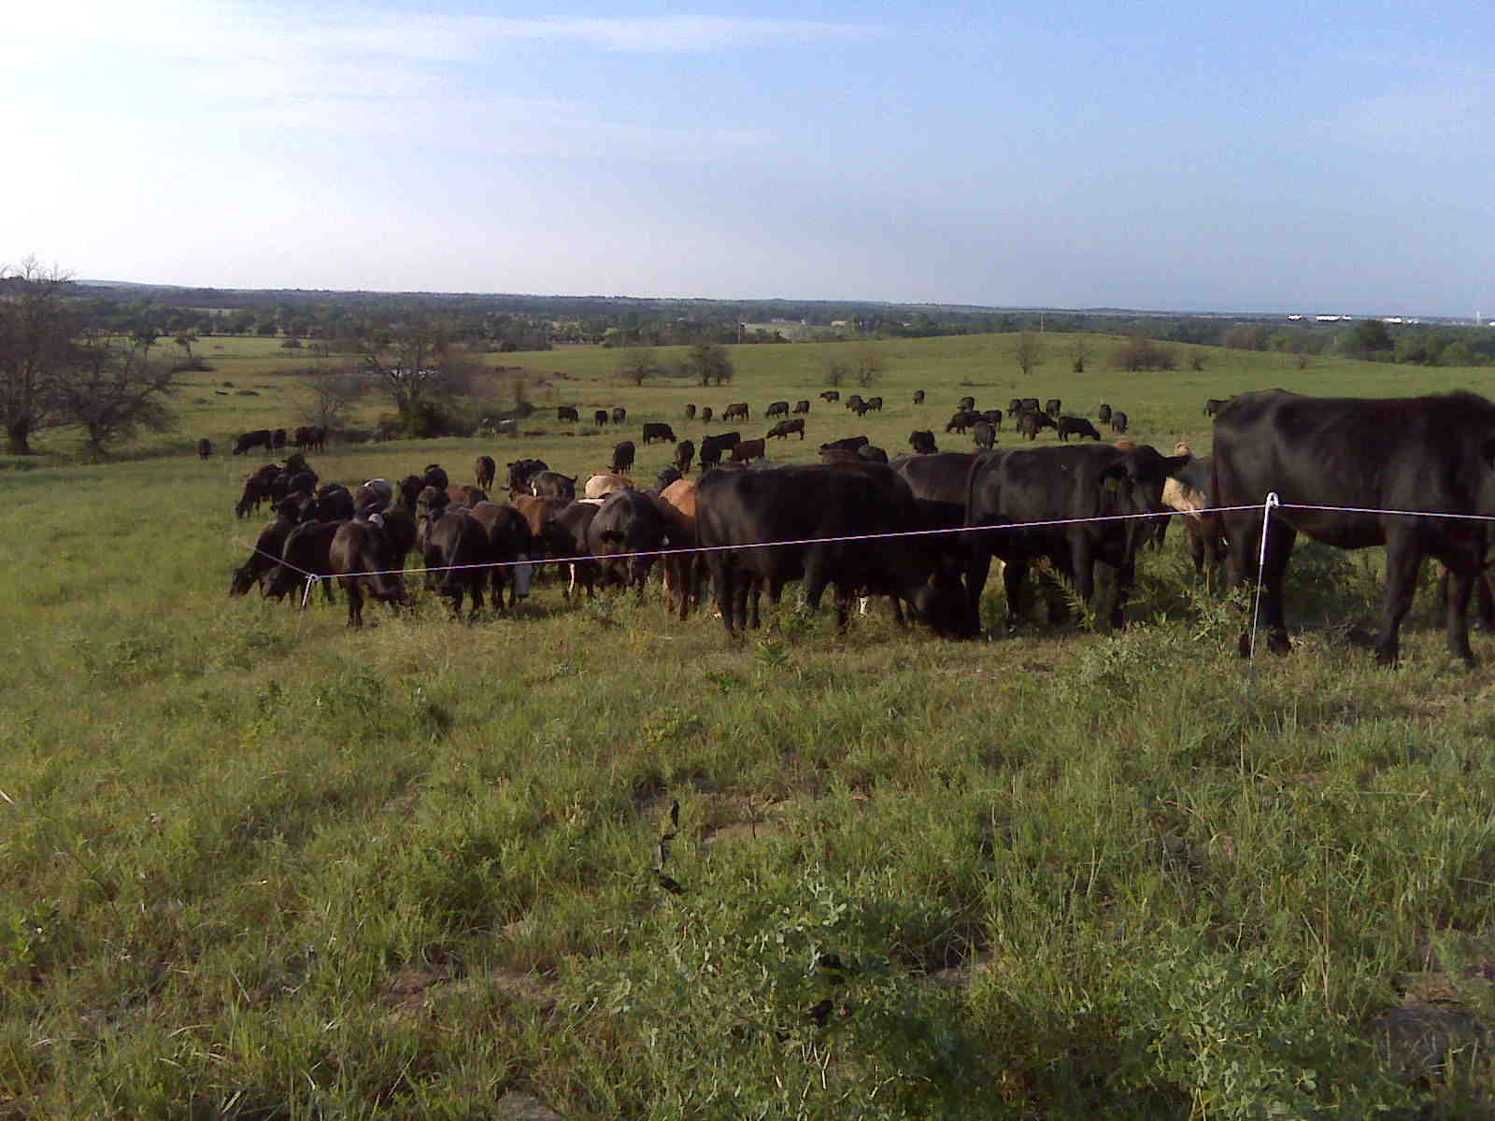
150,000 lbs per Acre

Slide 24
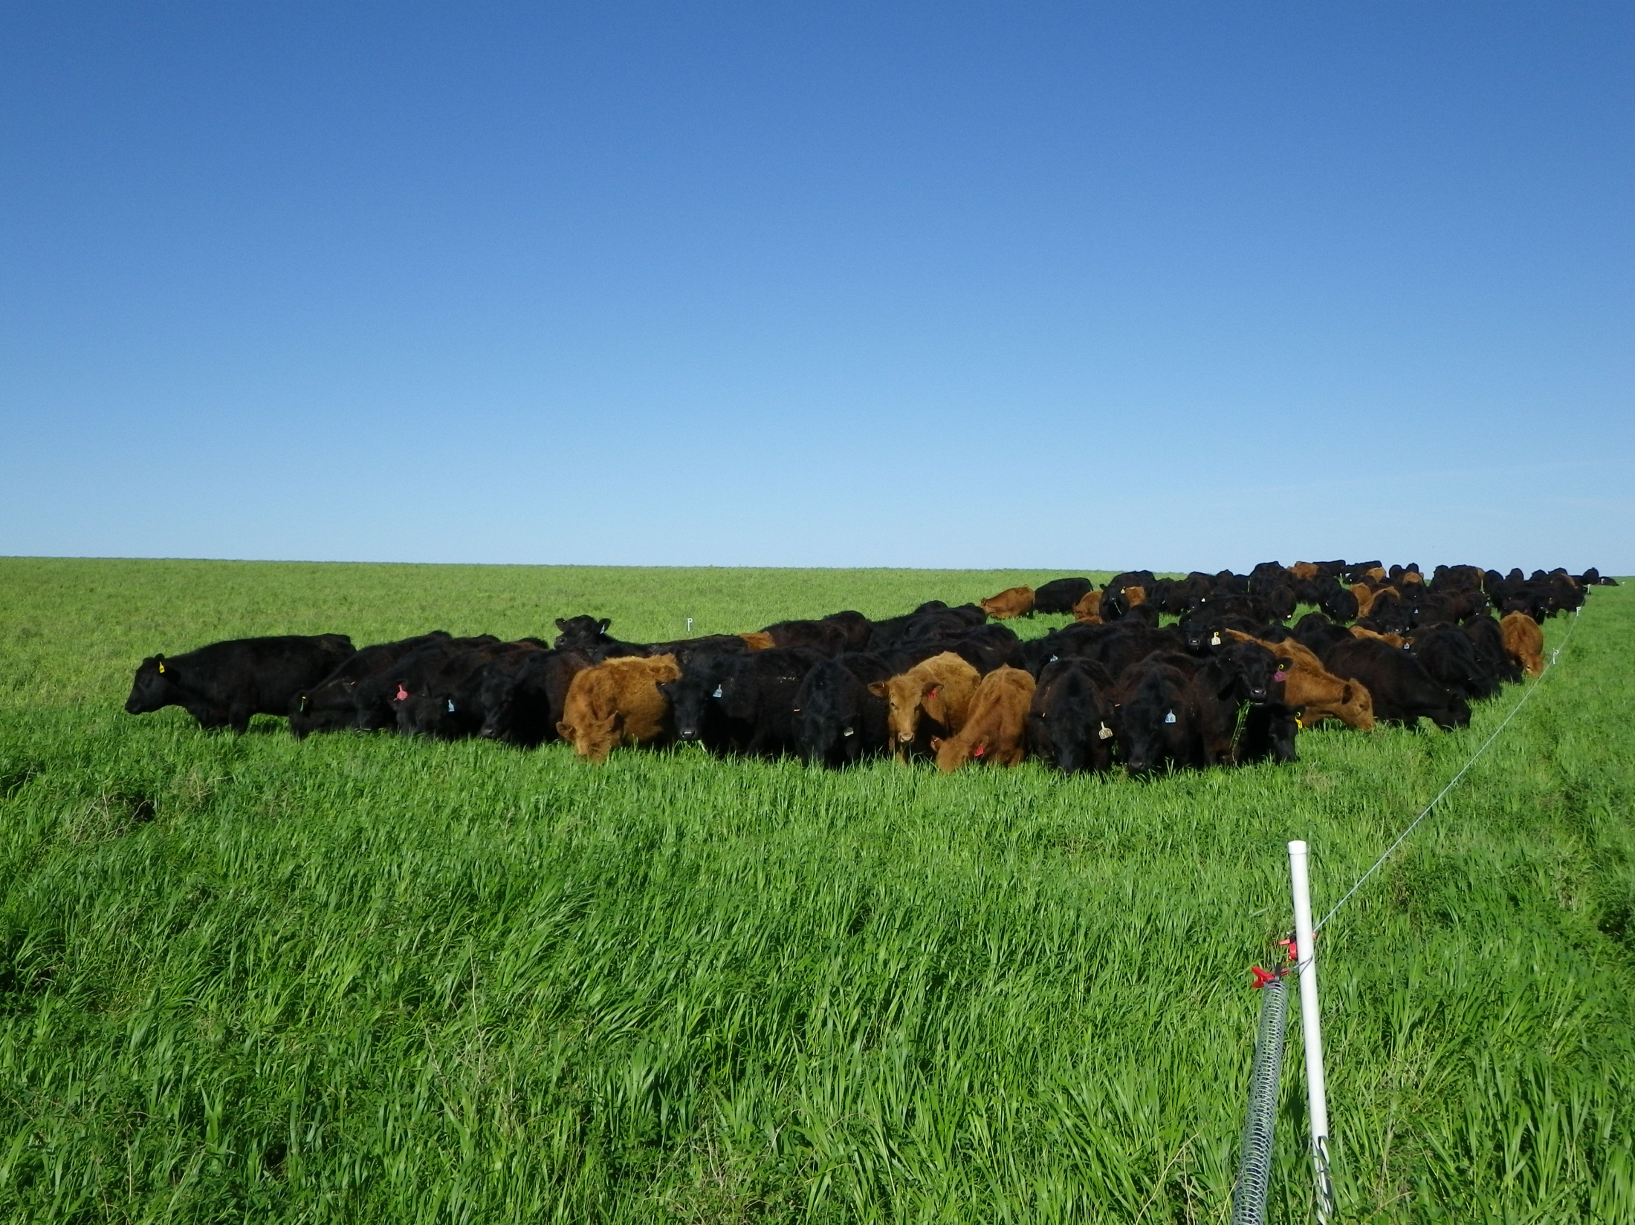
500,000 lbs per Acre

Slide 25
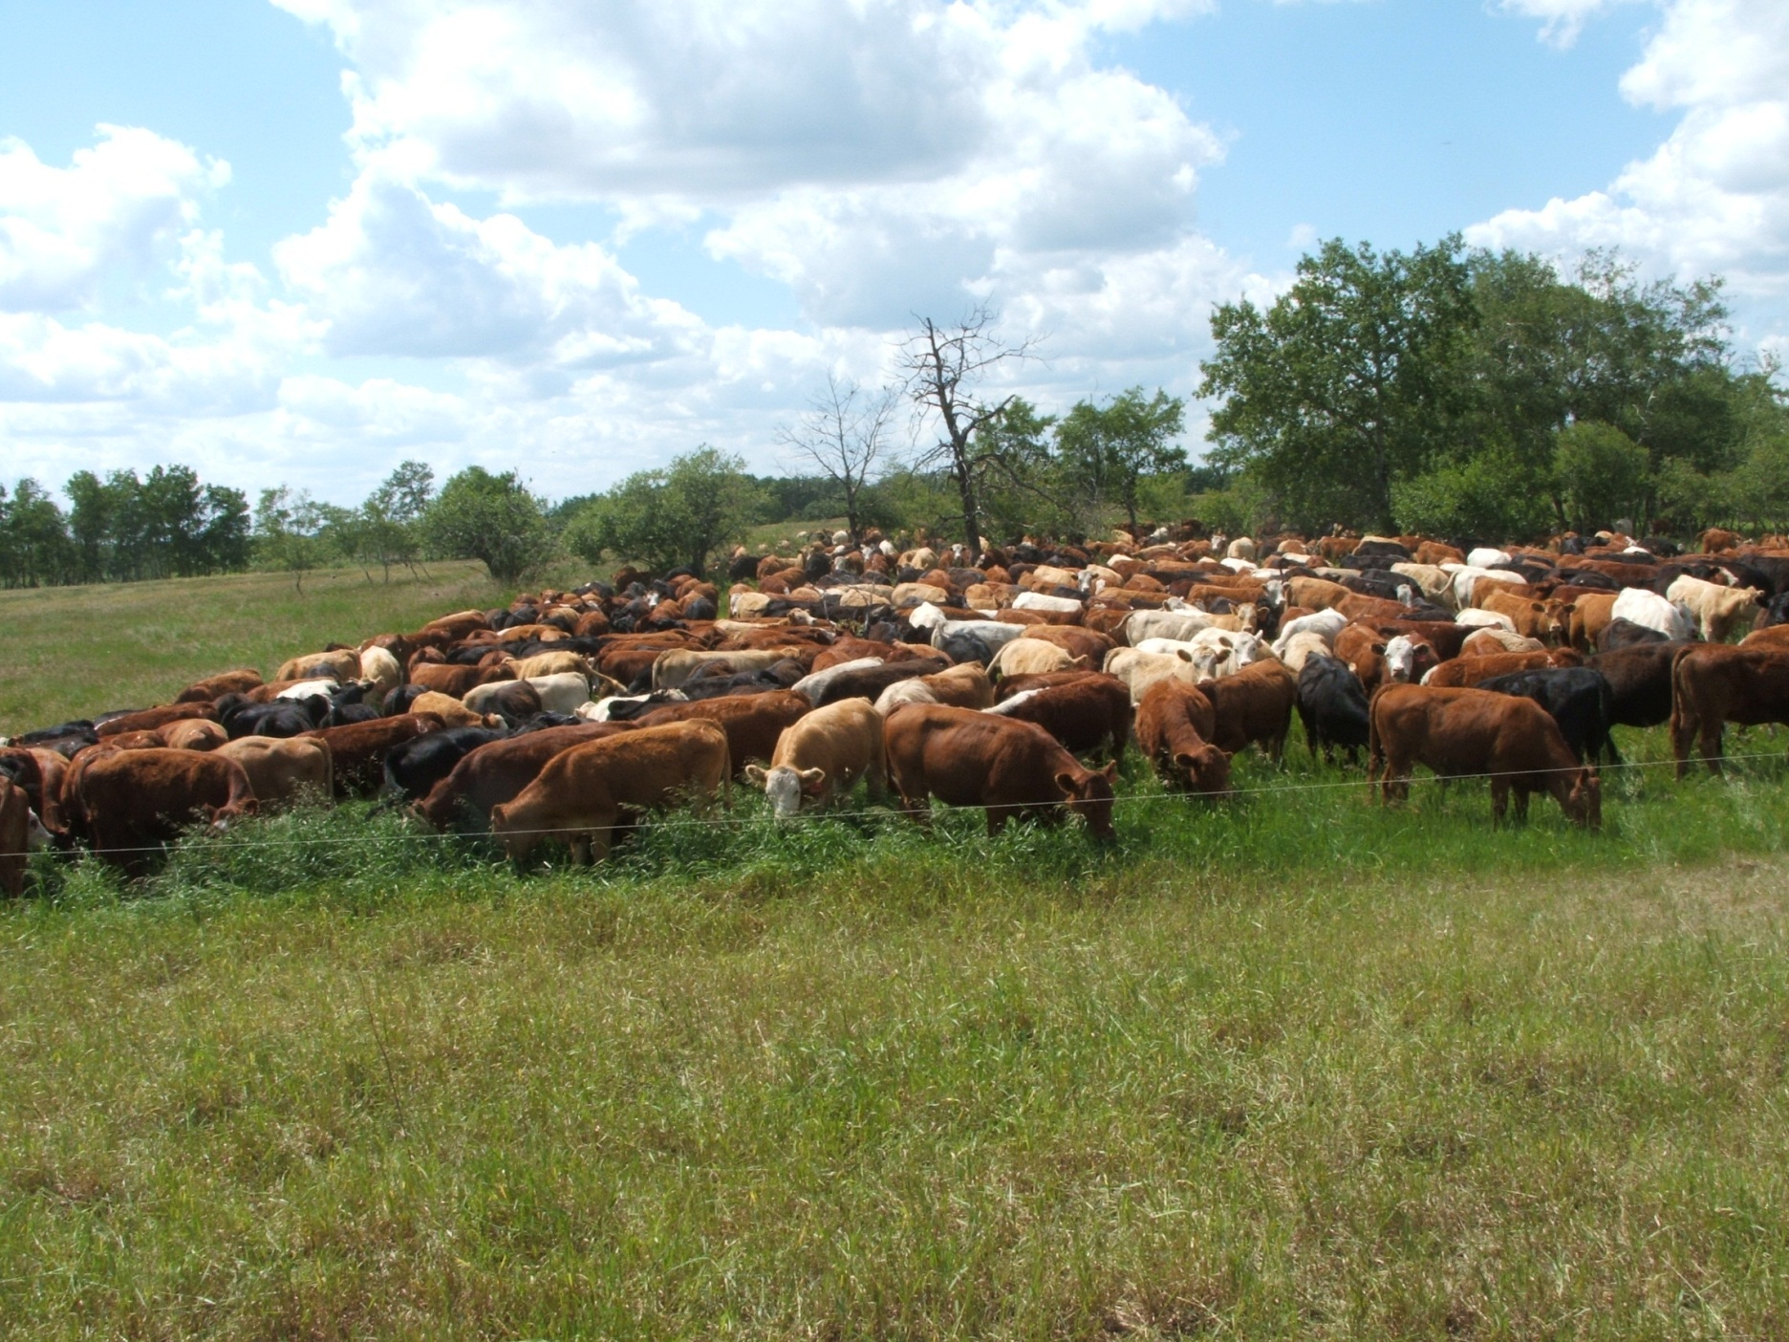
1,000,000 lbs per Acre

Slide 26
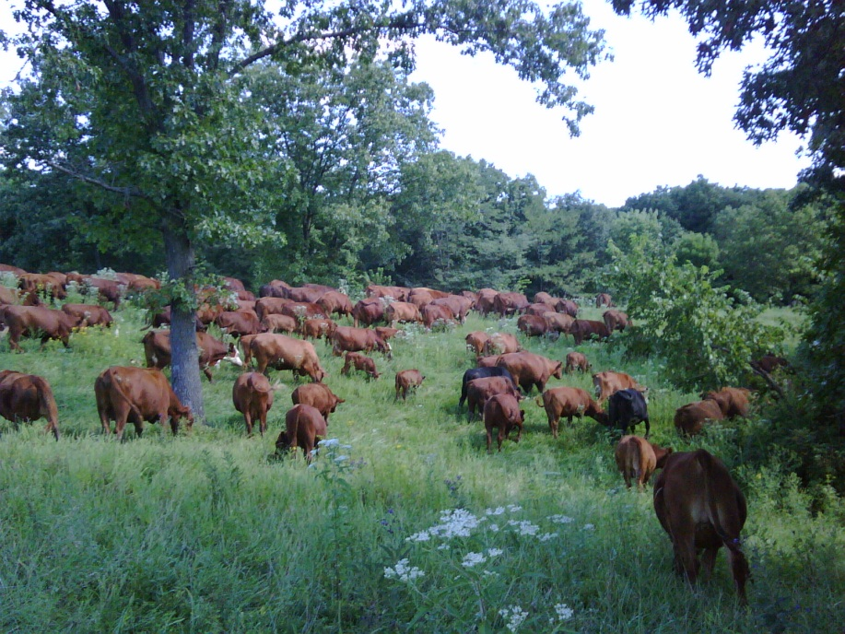
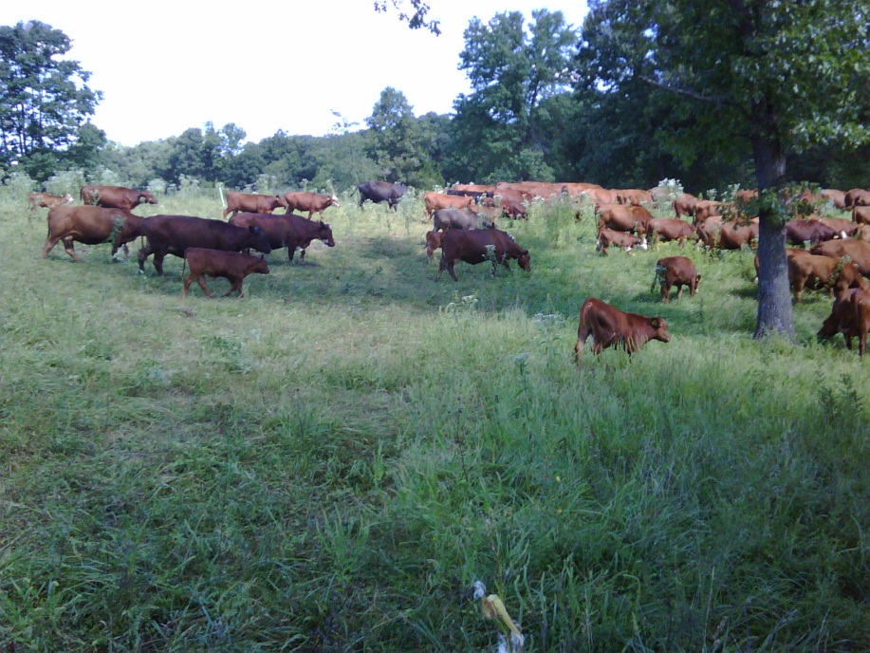
Moving the “Mob”

Slide 27
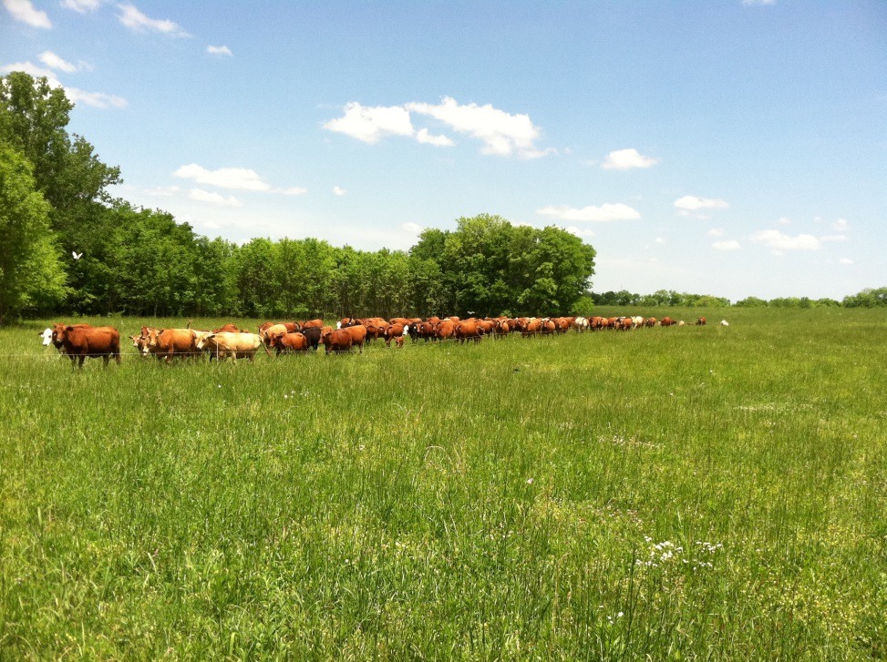
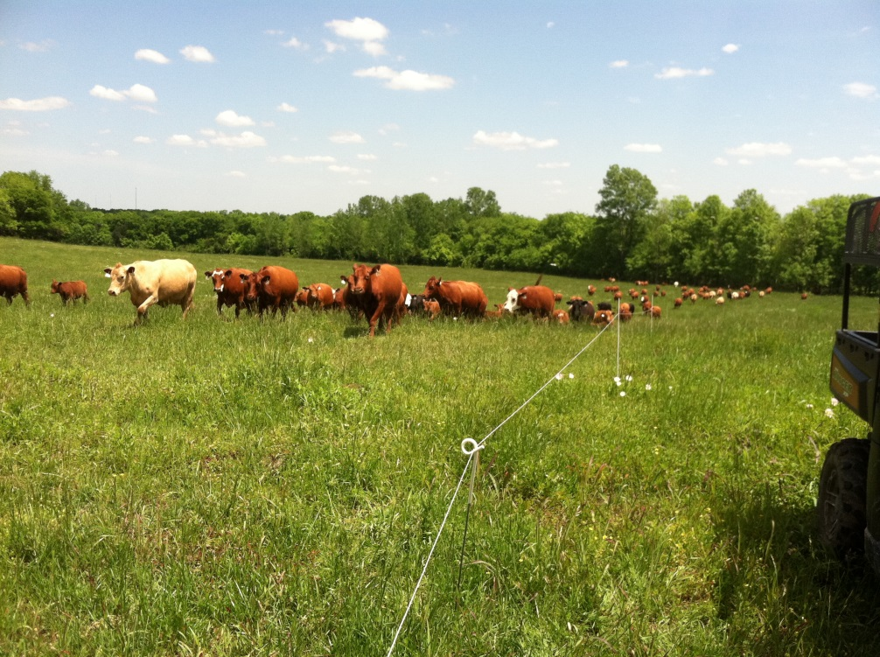
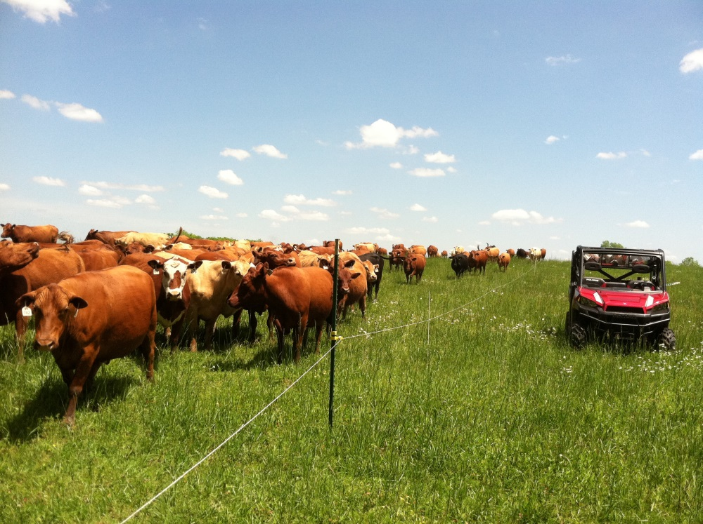
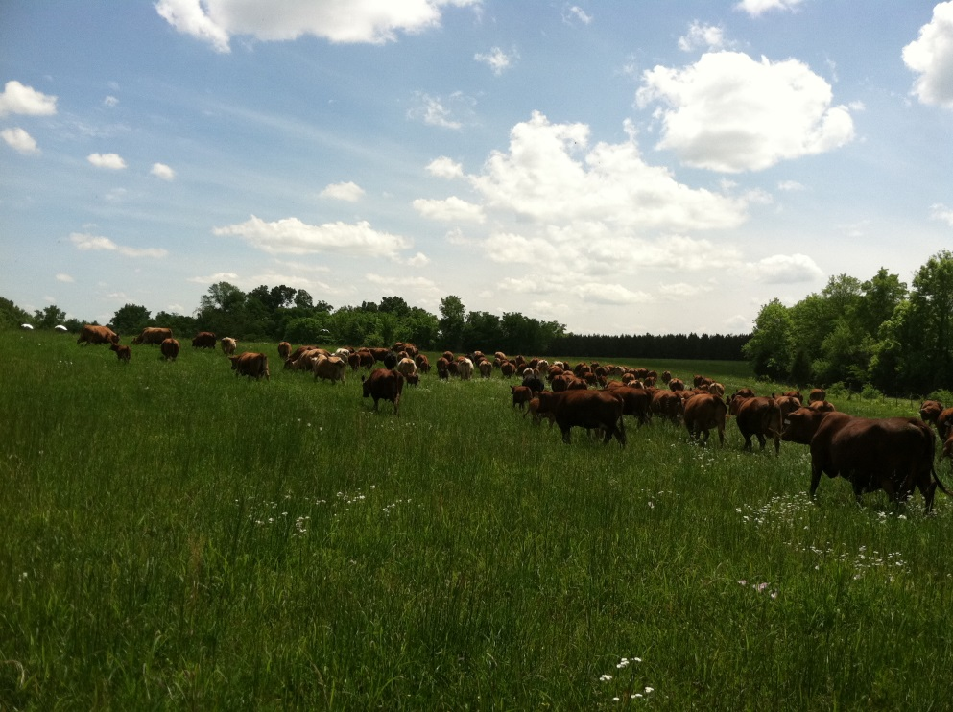

Slide 28
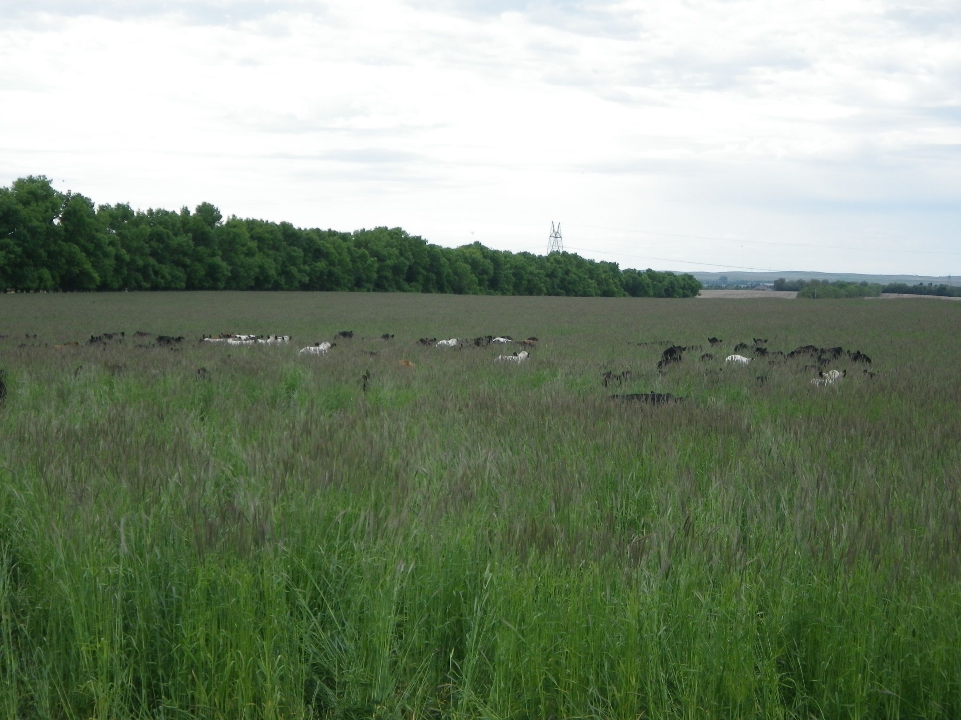
New Move

Slide 29
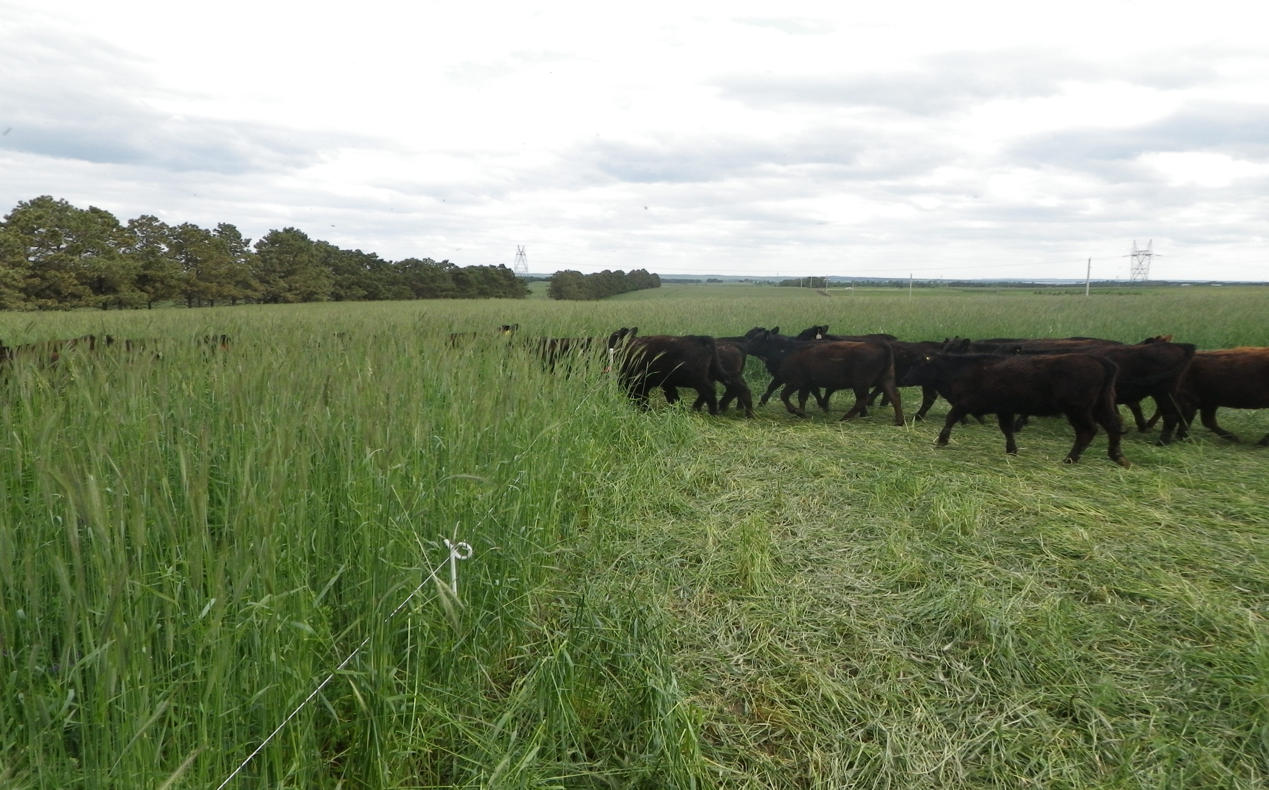
Next Move

Slide 30
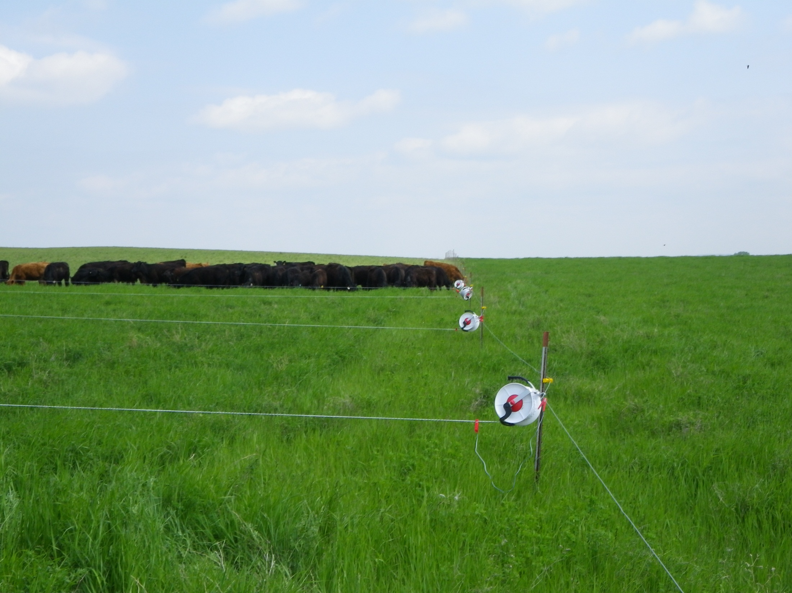
Multi-Paddock Construction for Multiple Daily Moves

Slide 31
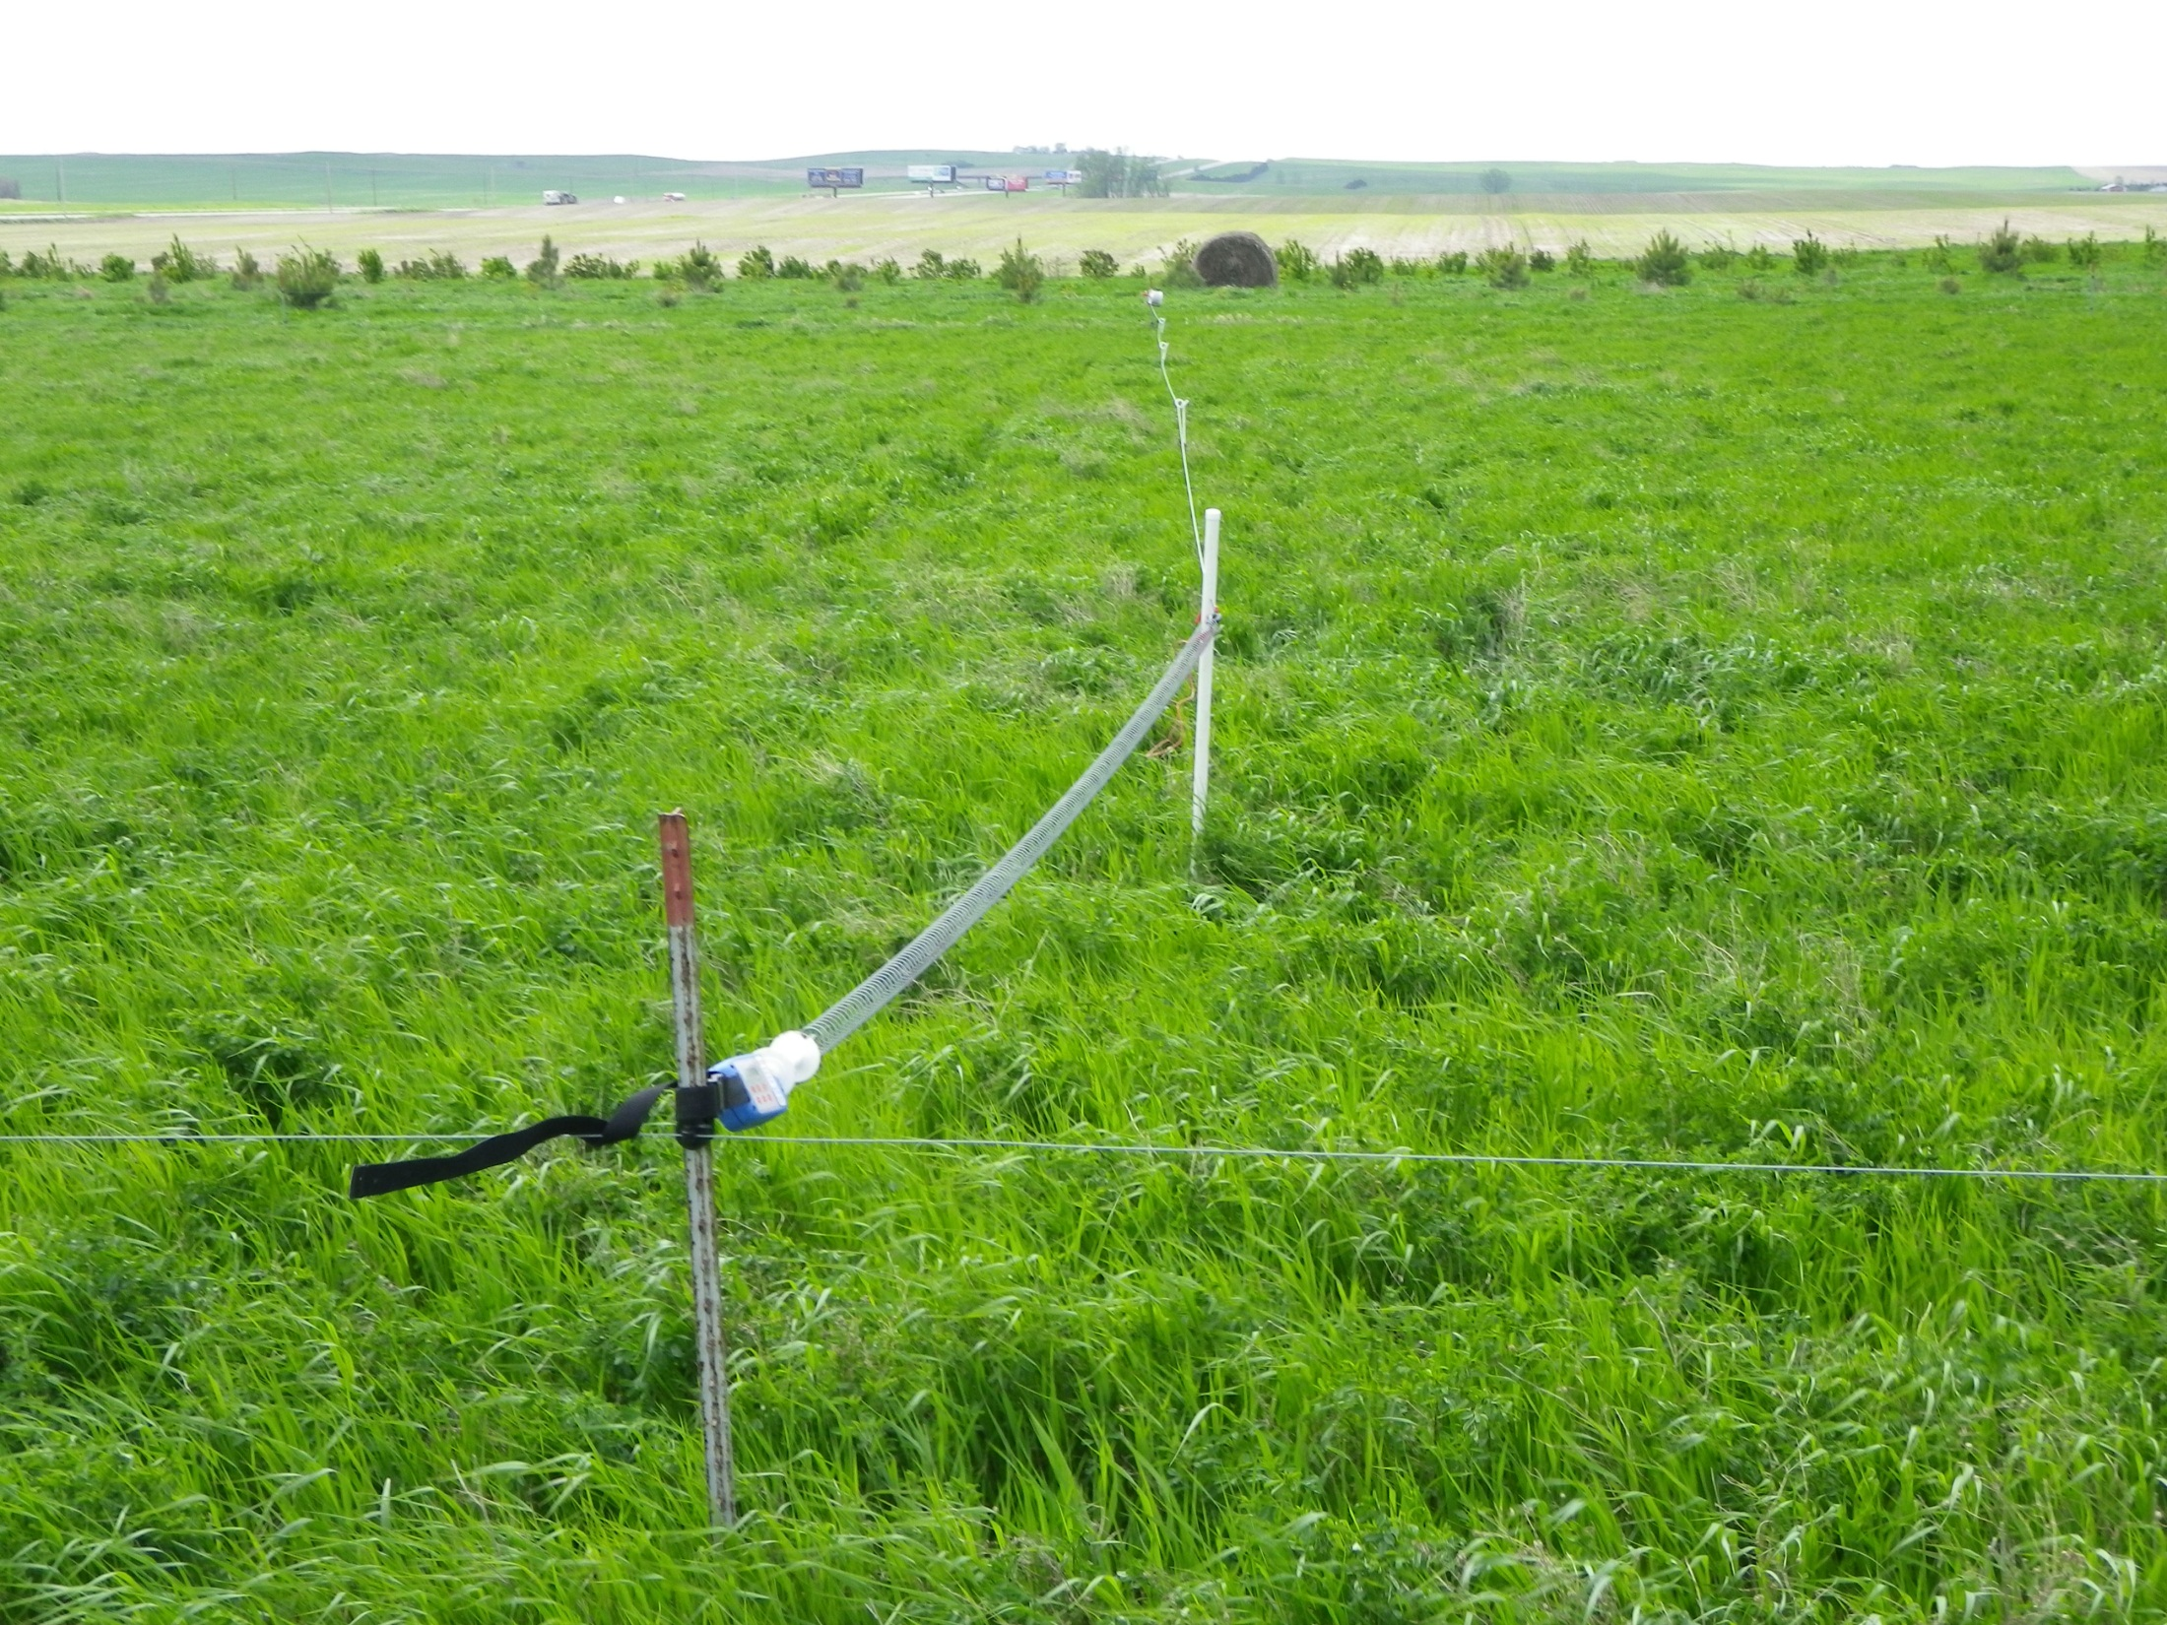
Spring Gate with Batt Latch

Slide 32
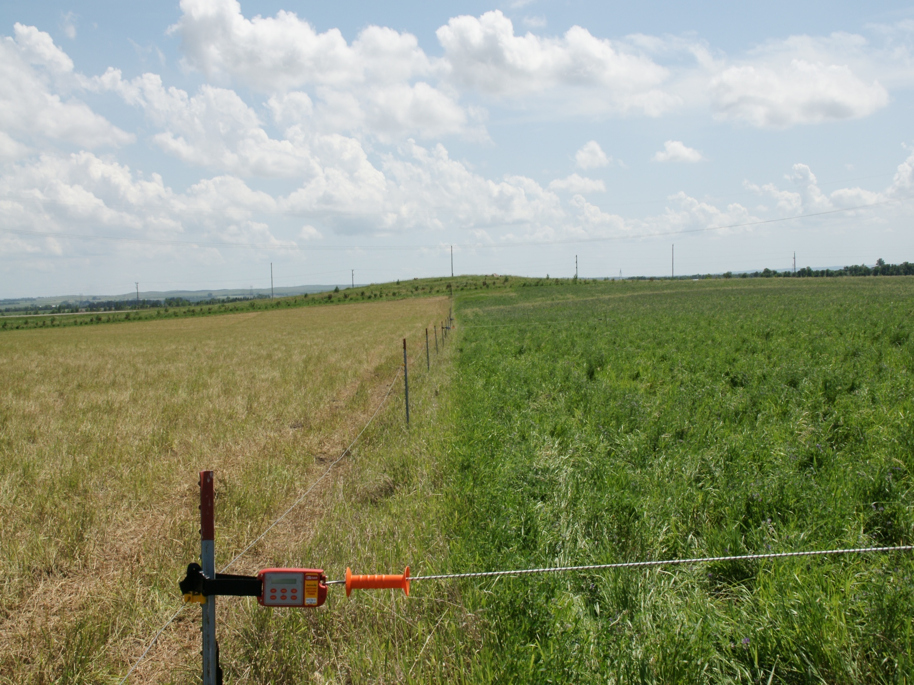
Batt Latch

Slide 33
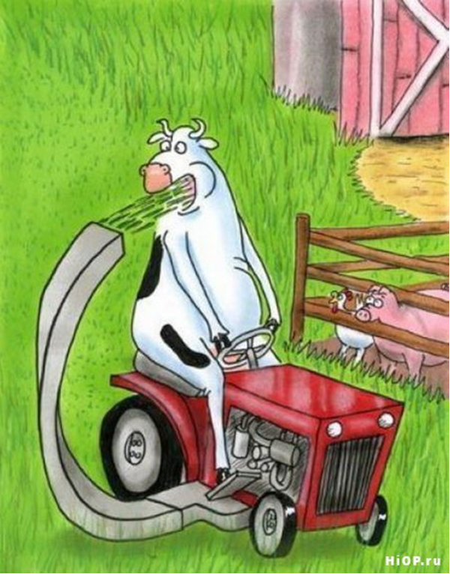
Livestock Impact

Slide 34
Keys to Effective AHSD Grazing
Determine a starting point
Be FLEXIBLE!!!
Make frequent moves all year
At least once a year, use Ultra High Stock Density grazing to improve critical areas
Start at water source and move out
Keen observation….

Slide 35
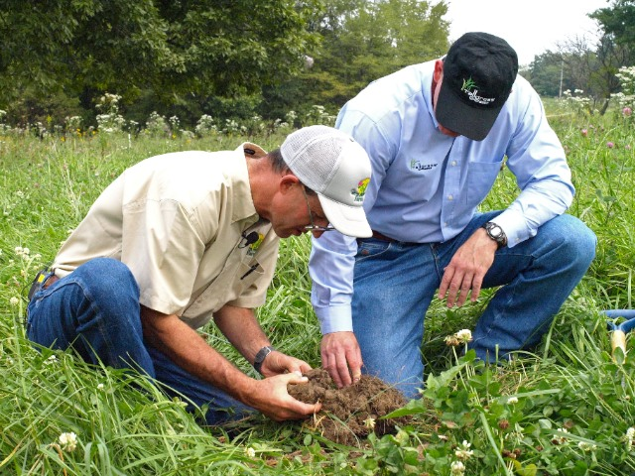
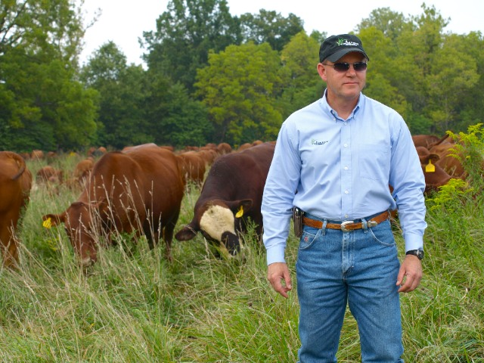
Constant Observation

Slide 36
Paddock Designs & Layout

Slide 37
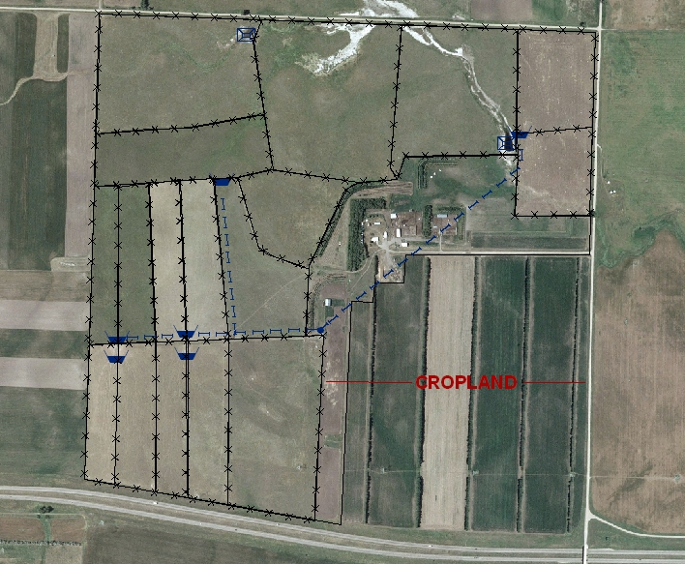
Have a Good Plan

Slide 38
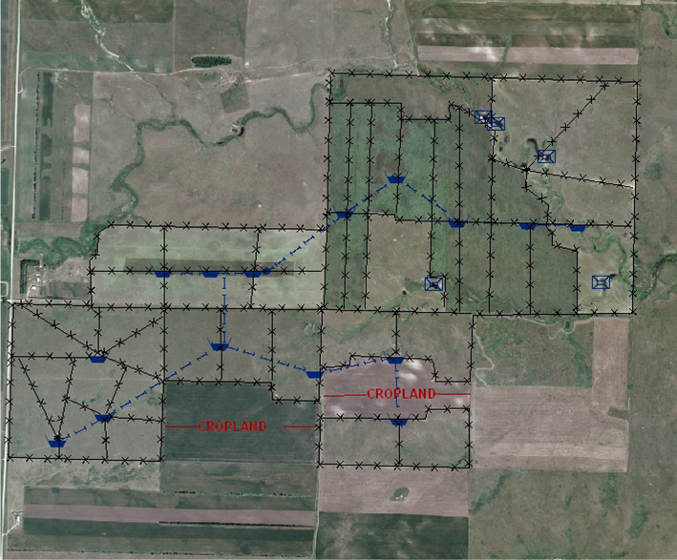
Water Resource Layout

Slide 39
Planned Multi-Paddock Grazing

Slide 40
Fencing Cost Estimates
Fence Type | Construction Costs (per foot) | Annual Maintenance Costs (per foot)
Woven Wire | $1.93 | $0.33
Barbed Wire (5-strand) | $1.48 | $0.25
Hi-Tensile (8-Strand) | $1.24 | $0.16
Polywire (1-strand) | $0.20 | $0.07

Slide 41
Equipment

Slide 42
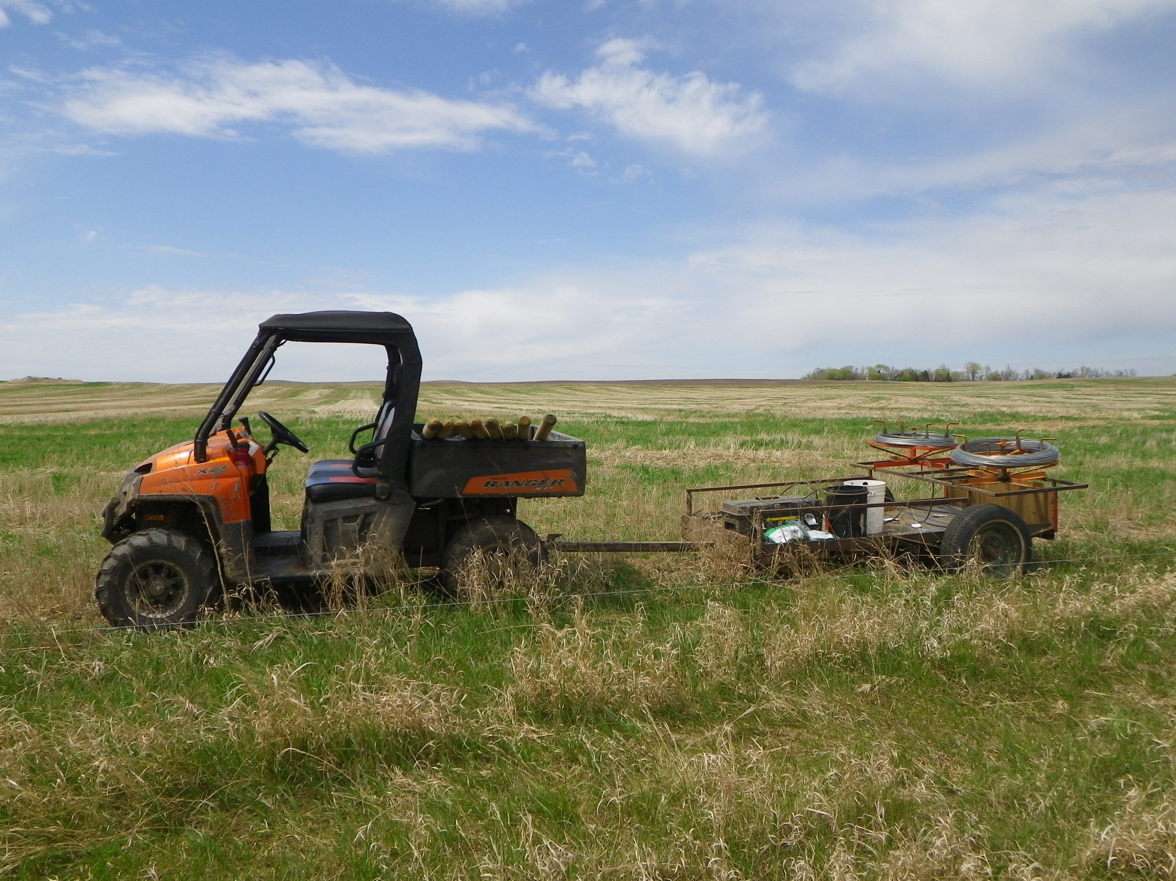
Variety of Ways to Get Job Done

Slide 43
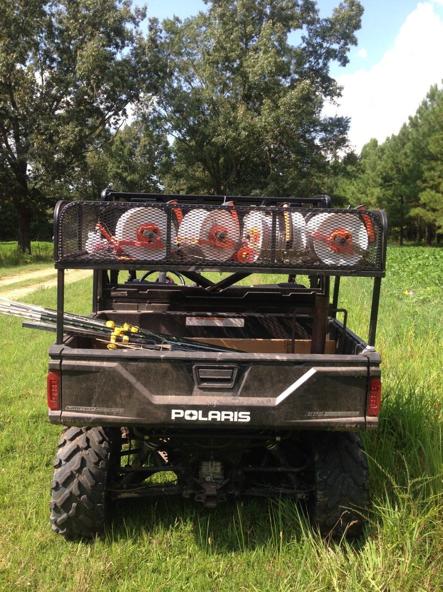
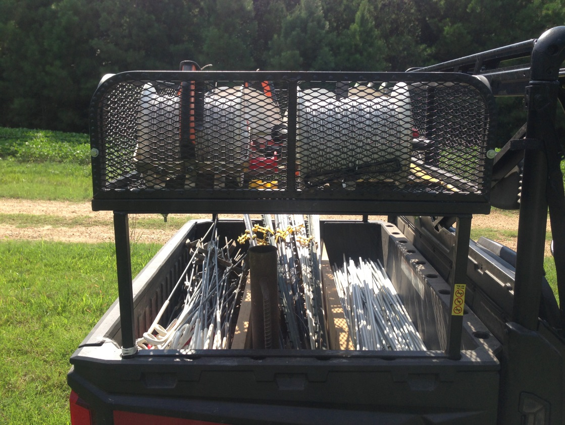
Allen’s Fencing Rig

Slide 44
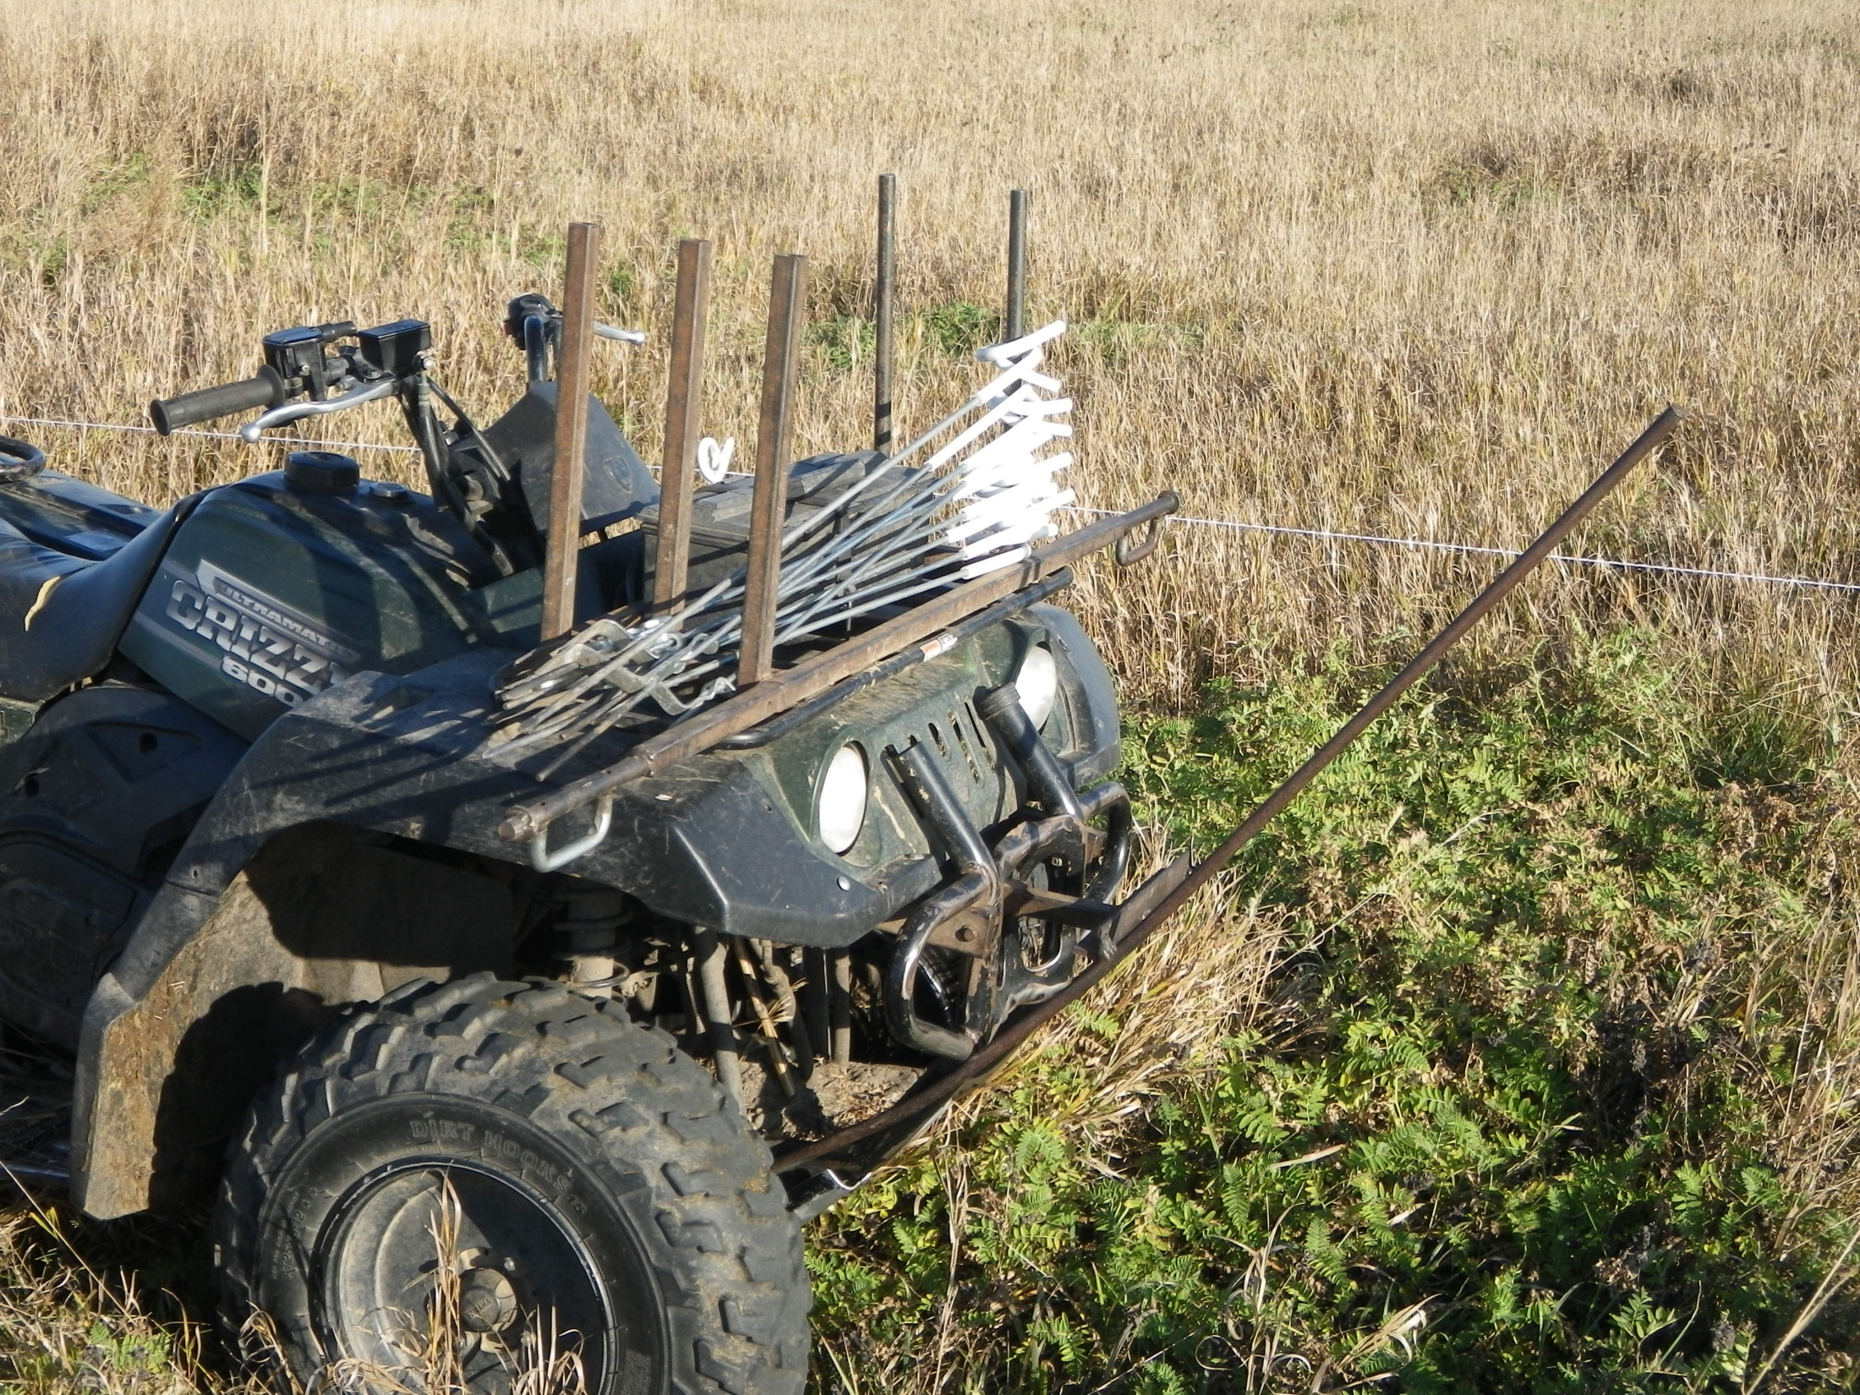
Pigtail Post Rack
Wire Crossing Bar

Slide 45
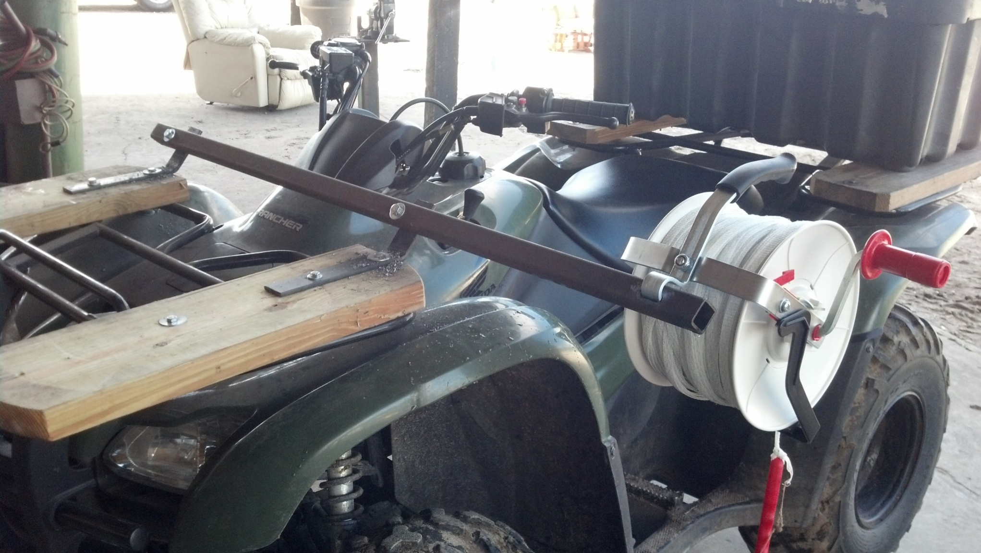

Slide 46
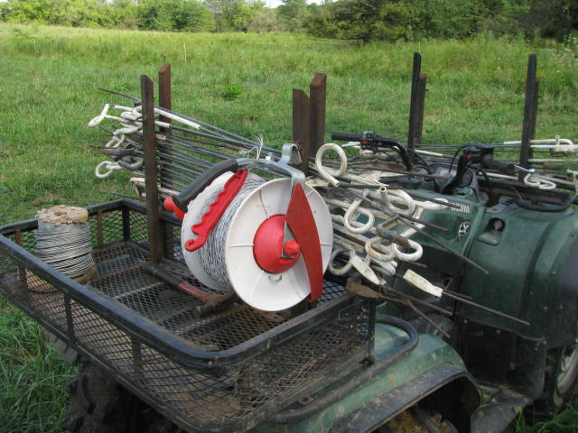

Slide 47
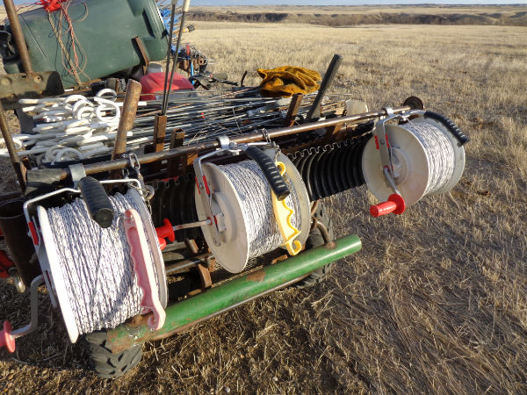
Multiple Strands

Slide 48
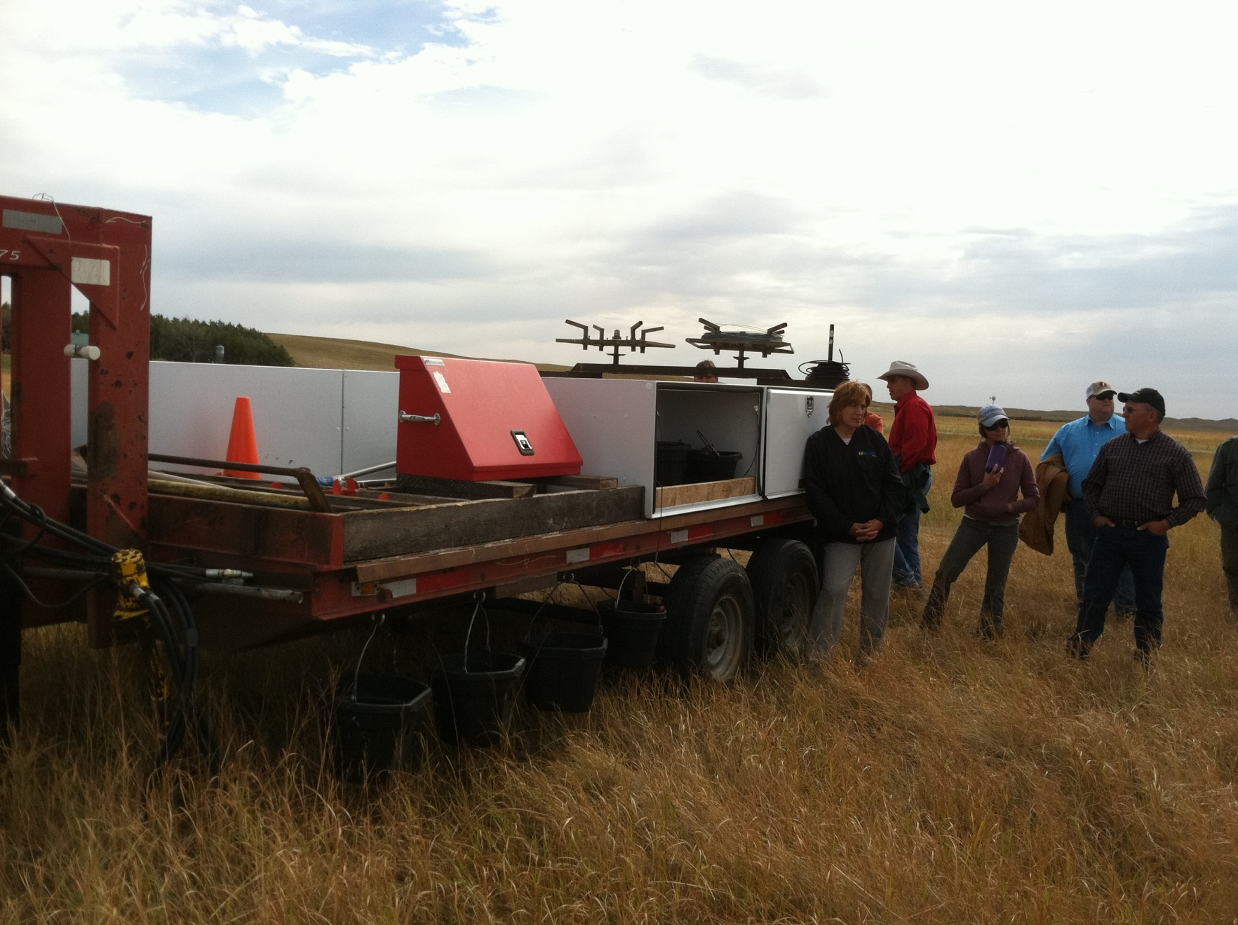
Getting Serious in the Sandhills

Slide 49
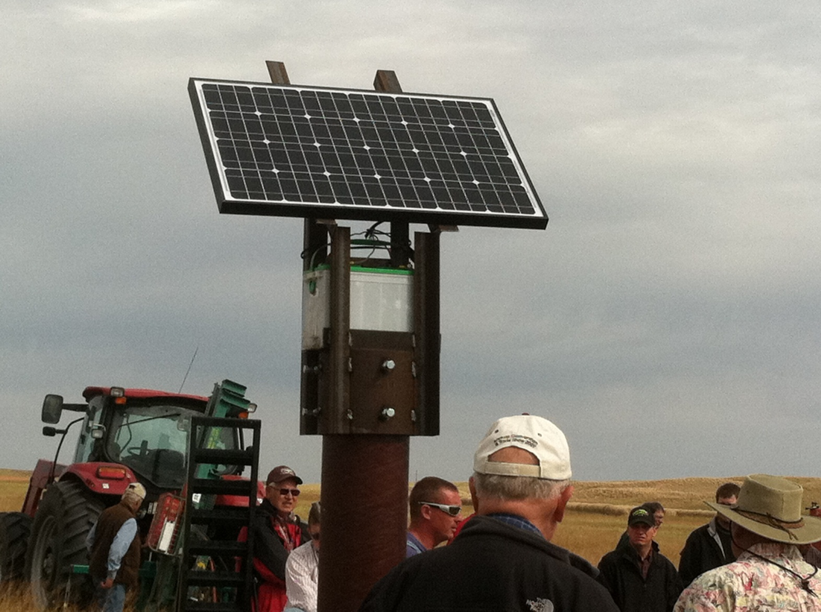
Solar Power Fencing

Slide 50
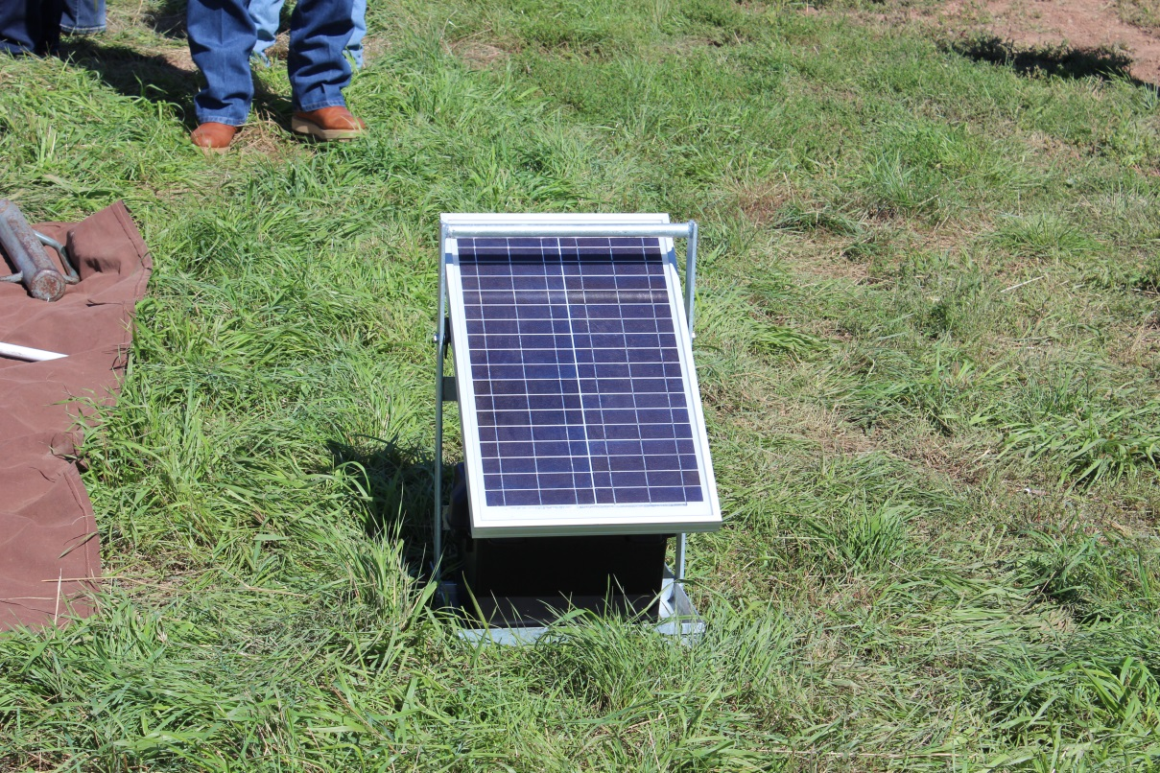
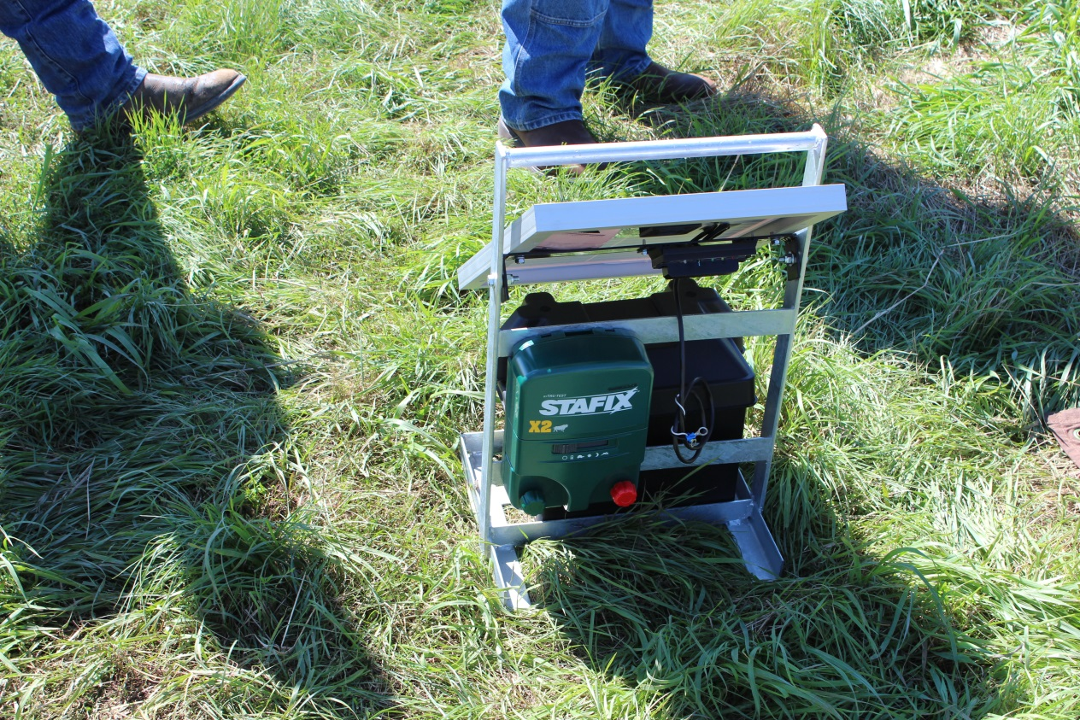
Solar Power Fencing

Slide 51
Research

Slide 52
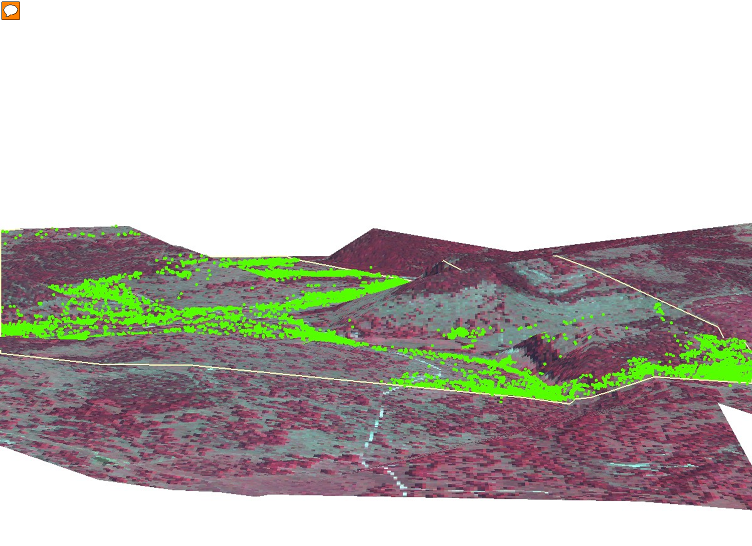
GPS Collared Cows – Grazing Study
West Texas Ranch
Continuous Grazing
Courtesy: R. Teague, TAMU

Slide 53
Planned Multi-Paddock Grazing

Slide 54
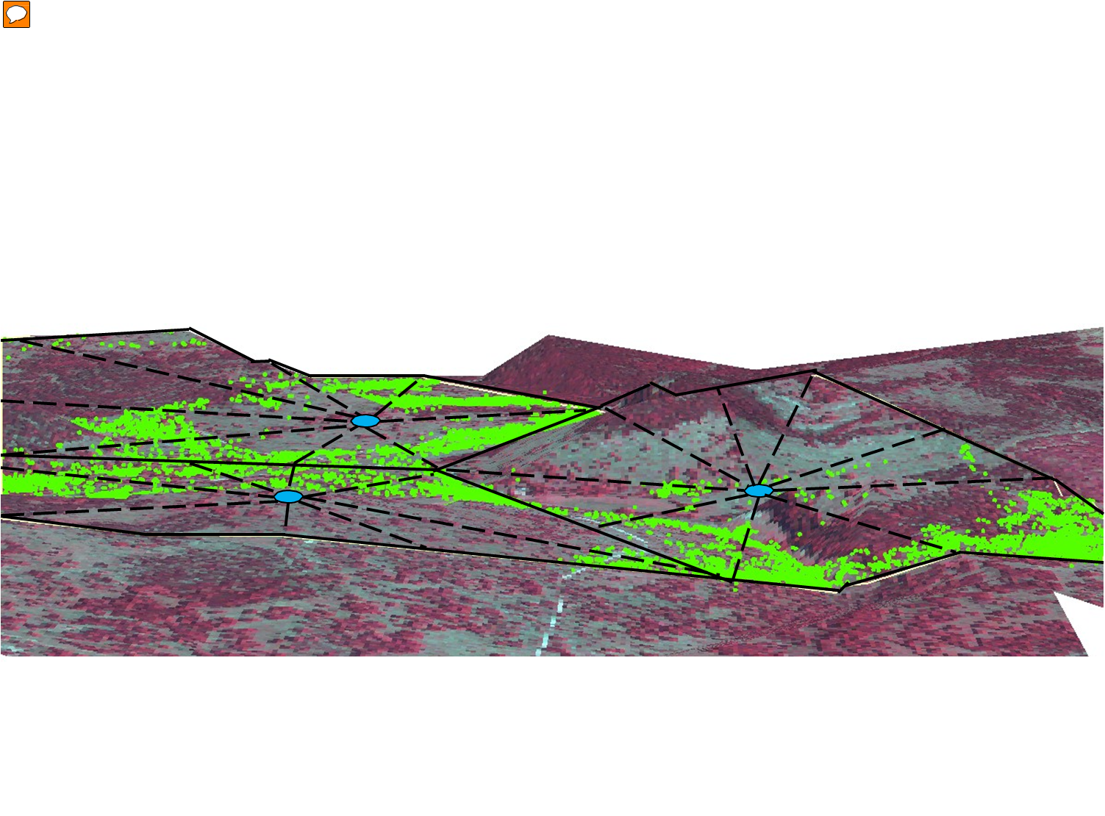
Planned Multi-Paddock Grazing
Under Planned Multi-Paddock Grazing Practices Carrying Capacity Increased from 21 ac/cow to 9 ac/cow.
Courtesy: R. Teague, TAMU

Slide 56
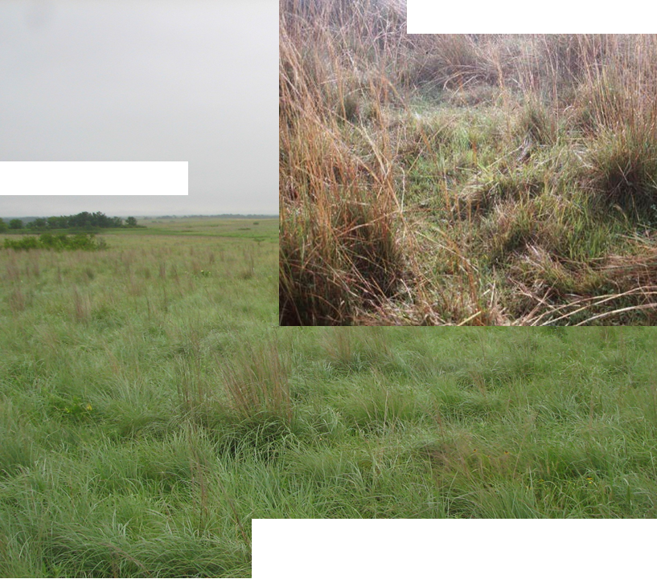
Light, Continous Graze
High Density Grazing
Teaugue, et al. 2013

Slide 57
Pasture Cover Impacts
Infiltration and Runoff
3 inches of rainfall in 90 minutes, 10% slope, silt loam soil
(University of Nebraska & USDA-SCS, 1937)
Excellent pasture 95% ground cover
Fair pasture 75% ground cover
Poor pasture 50% ground cover
8 7 6 5 4 3 2 1 0 10 20 30 40 50 60 70 80
Soil loss (tons/A) Percent runoff

Slide 58
Courtesy: R. Teague, TAMU

Slide 59
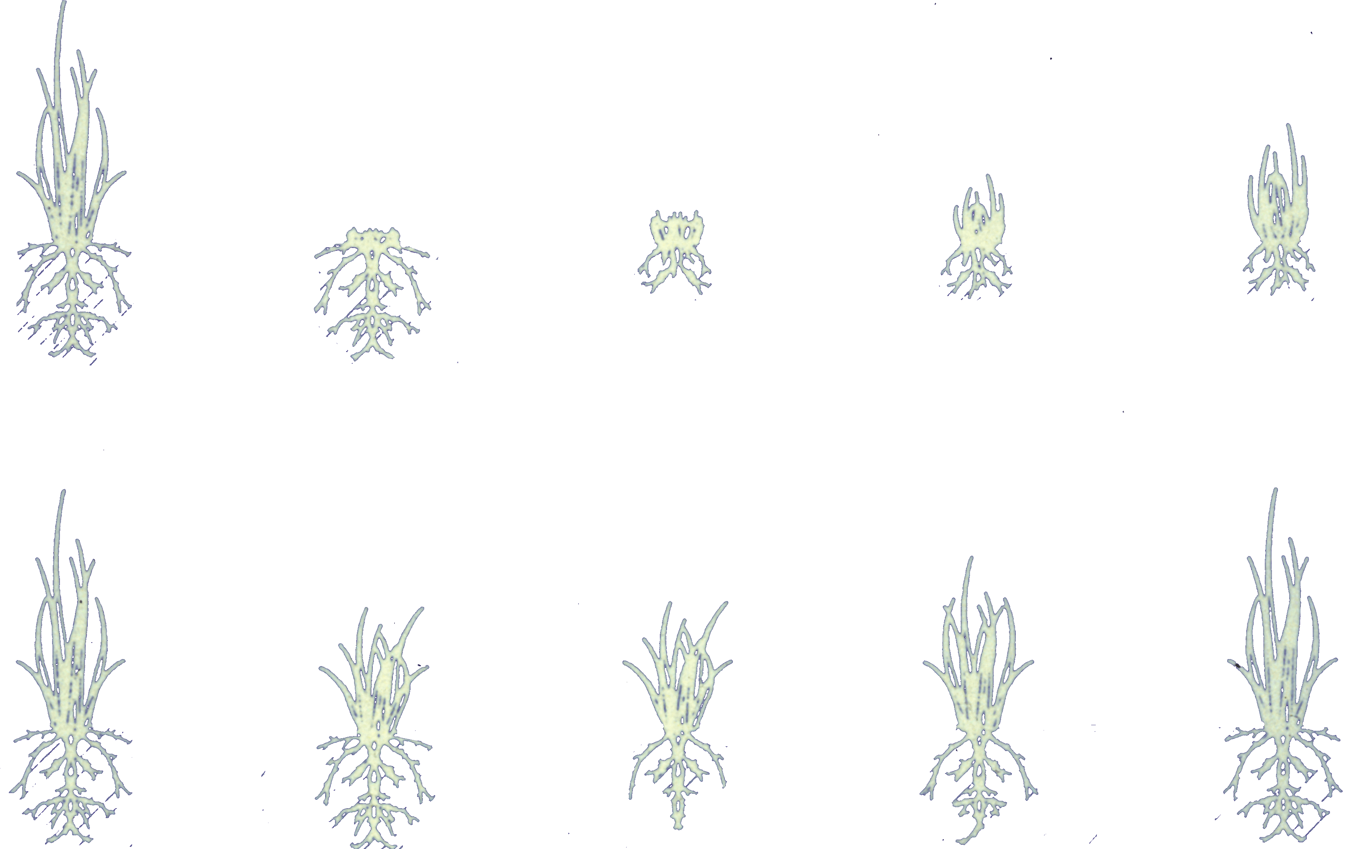
A
B
PLANTS
AT START
EXTENT OF
GRAZING
5 DAYS
RECOVERY
10 DAYS
RECOVERY
15 DAYS
RECOVERY

Slide 60
Soil Carbon Data
Three farms sampled in Mississippi:
  Fall 2014
  Farm Descriptions:
    AHSD Grazing for 5 years
    High Level Conventional Grazing Management
      CG – Good - 50+ years
    Low Level Conventional grazing management
      CG – Poor - 30+ years
    All same soil types

Slide 61
Soil Carbon Data
Soil pits dug in random locations at each farm. Same topography.
Each pit 3 feet deep and 3 feet square.
Collected soil samples within every 6 inch section.
Noted root growth and structure.
Noted soil life, texture, aggregation.

Slide 62
Soil Carbon Data – Soil pH
Horizon | AHSD | CG - Good | CG - Poor
1 | 7.9 | 5.9 | 5.5
2 | 7.9 | 5.8 | 5.6
3 | 7.9 | 6.2 | 5.3
4 | 7.8 | 6.3 | 5.1
5 | 7.8 | 6.8 | 5.1
6 | 7.9 | 7.0 | 4.9

Slide 63
Soil Carbon Data – Total Soil Carbon
Horizon | AHSD | CG - Good | CG - Poor
1 | 4.67 | 1.64 | 1.36
2 | 4.00 | 1.88 | 1.37
3 | 2.95 | 1.03 | 0.40
4 | 2.04 | 1.02 | 0.54
5 | 1.71 | 0.38 | 0.40
6 | 1.42 | 0.41 | 0.34

Slide 64
Soil Carbon Data – Soil Organic Matter
Horizon | AHSD | CG - Good | CG - Poor
1 | 4.26 | 3.28 | 2.72
2 | 3.22 | 3.76 | 2.74
3 | 3.10 | 2.06 | 0.80
4 | 2.98 | 2.04 | 1.08
5 | 2.80 | 0.76 | 0.80
6 | 1.98 | 0.82 | 0.68

Slide 65
Soil Carbon Data – Carbon Assessment Per Acre
Farm Descrip | Carbon (kg/sq meter | Carbon (Ton/ac) | Carbon (Ton CO2 Equiv)
AHSD | 12.69 | 51.41 | 188.13
CG – Good | 7.09 | 28.71 | 105.07
CG - Poor | 5.47 | 22.16 | 81.09

Slide 66
Case Studies

Slide 67
Gabe Brown - ND
1991 – Purchased land in ND that was heavily tilled for decades.
Synthetic fertilizers & herbicides used regularly.
Starting SOM – 1.7% - 1.9% with water infiltration rates of only ½ inch per hour.
Now – SOM of 11+%. Water infiltration rates exceed 10+ inches per hour.

Slide 68
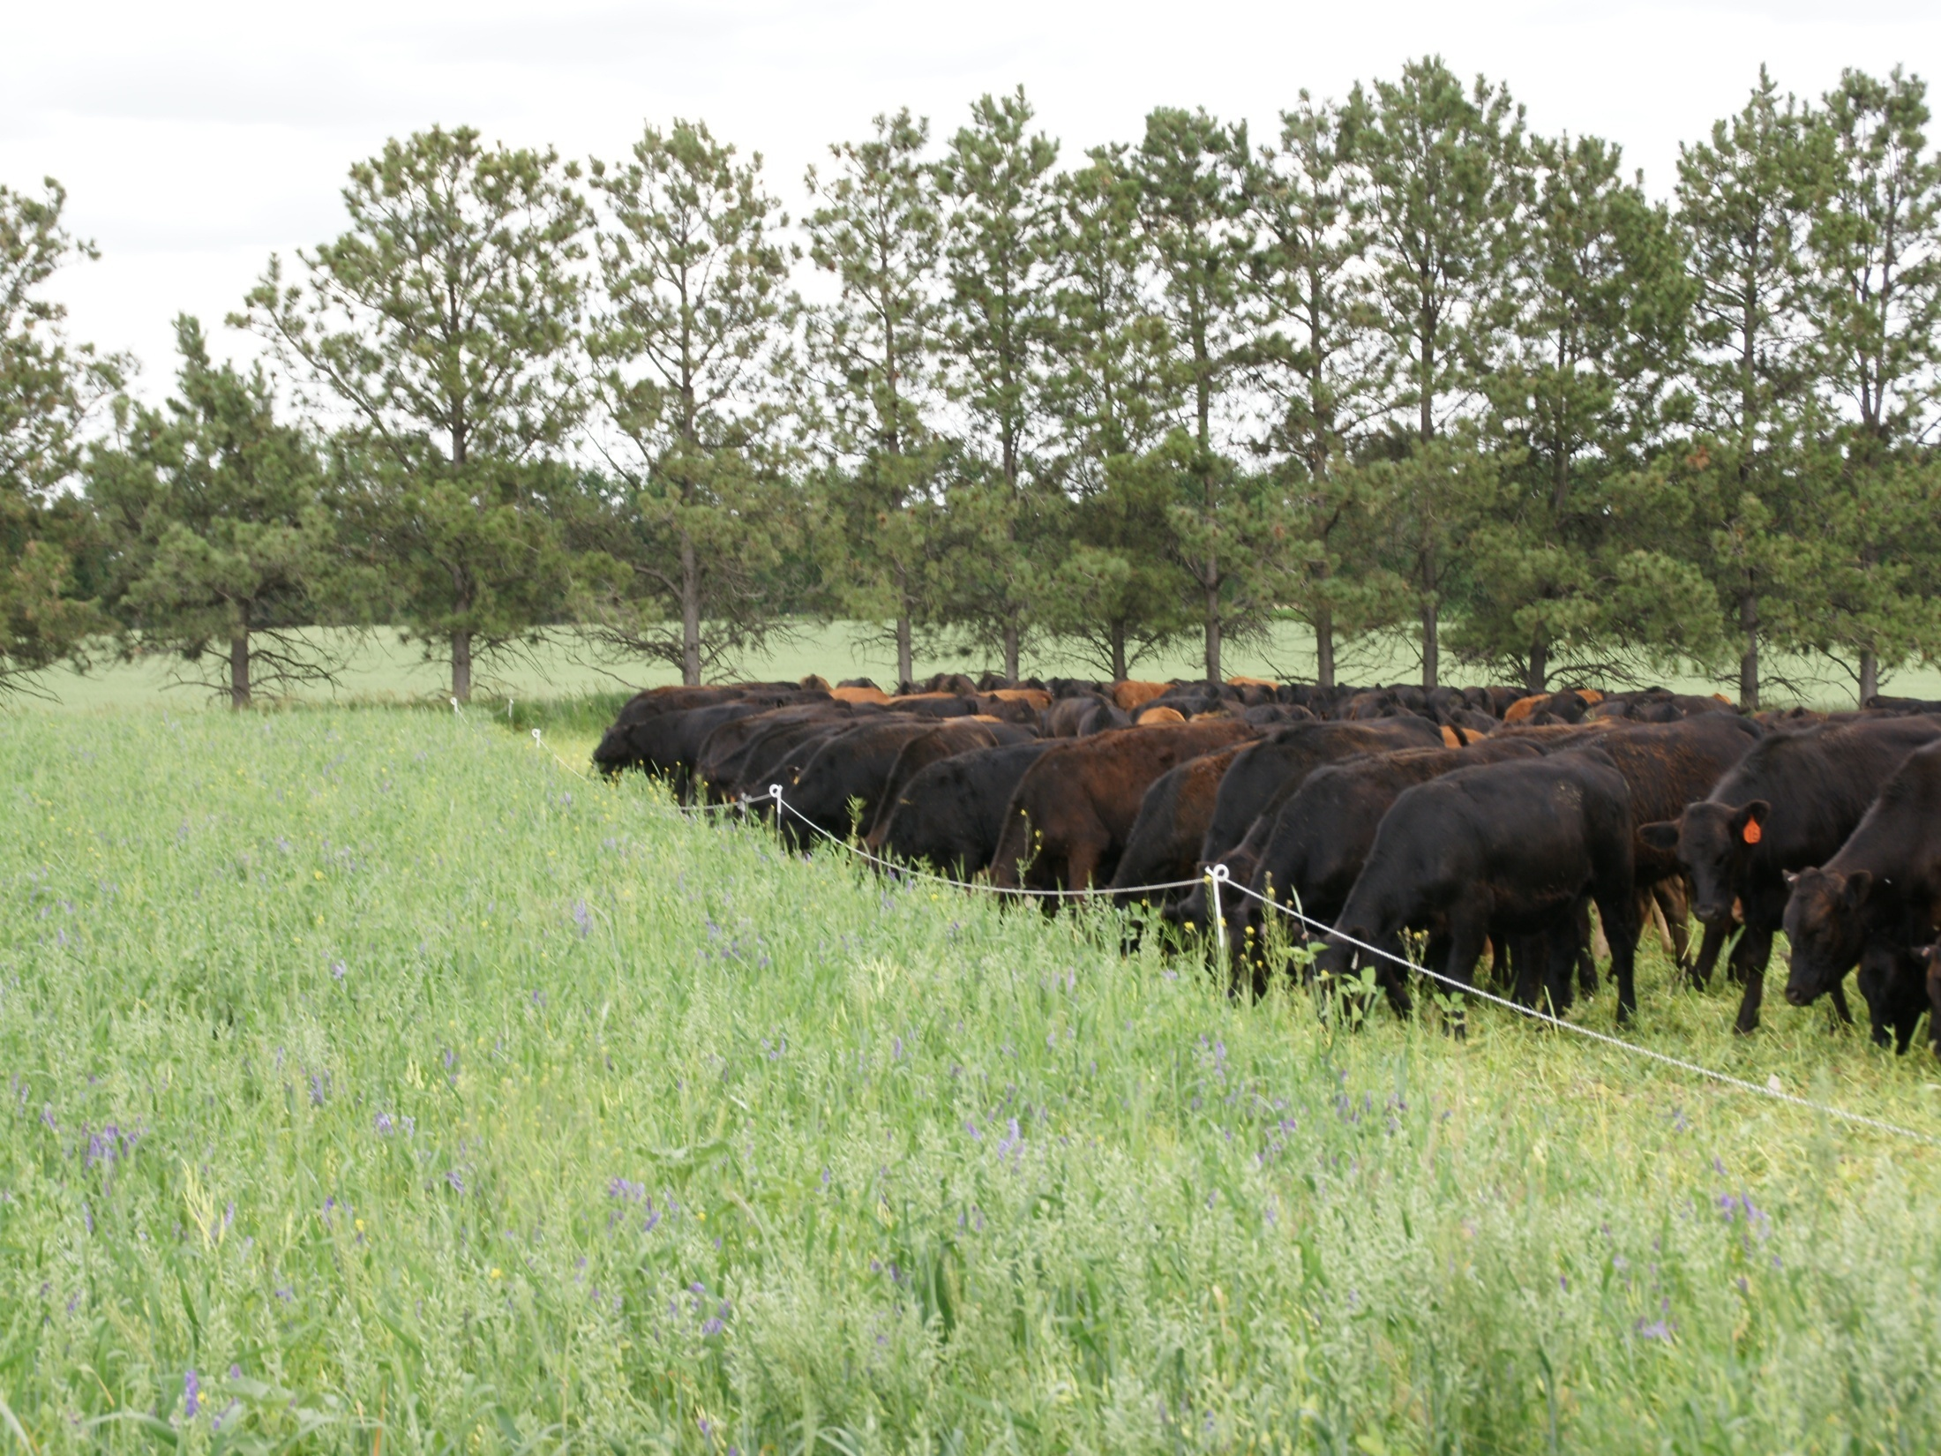
Livestock and Cocktail Cover Crops Used As Tool for Land Improvement

Slide 69
Forage DM Yield in High vs. Low Microbial Activity Fields
Variable | High Microbial Activity | Low Microbial Activity
Dry Matter (lbs/ac) | 8573 | 2559
Crude Protein (%) | 11.9 | 7.9
TDN (%) | 69.4 | 55.7
Source: USDA NRCS Mandan, ND.

Slide 70
Mississippi Farm

Slide 71
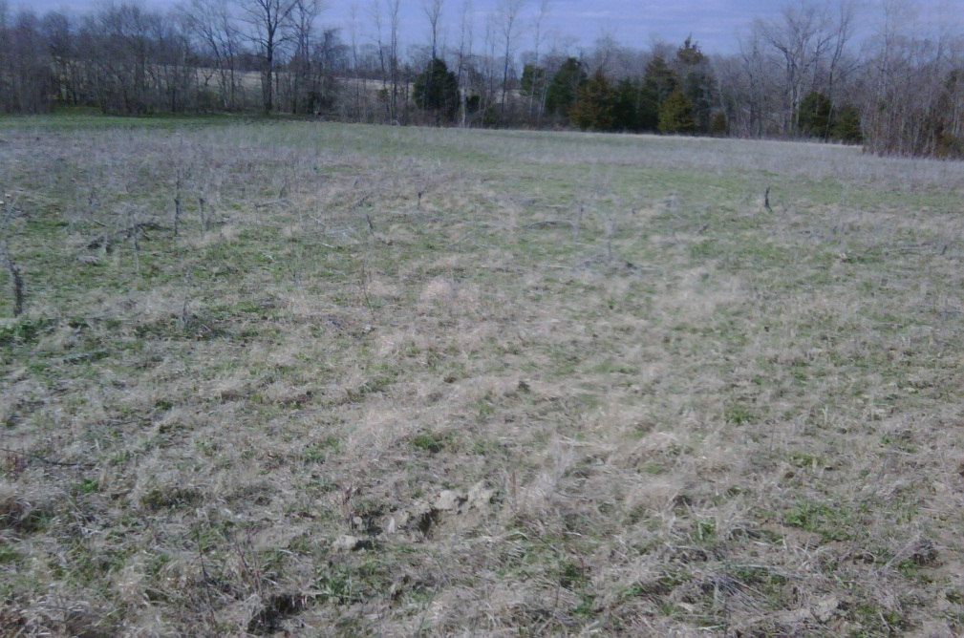
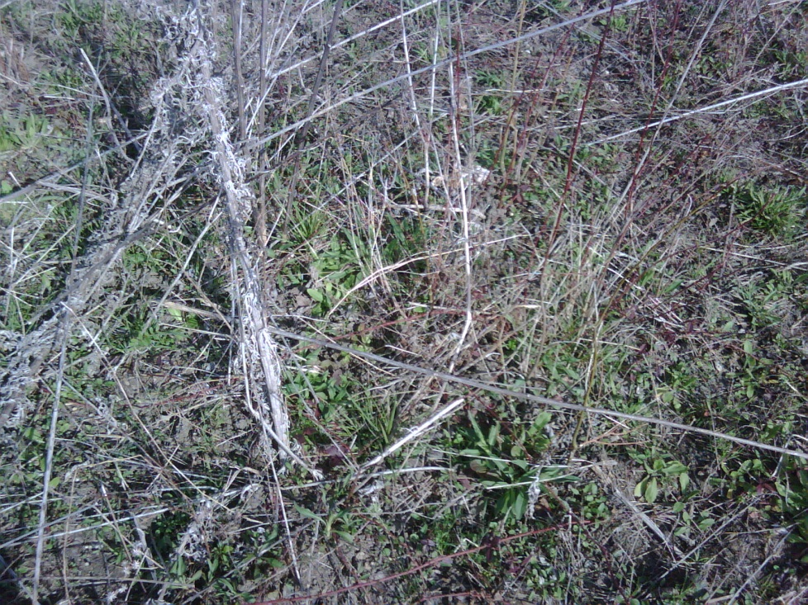
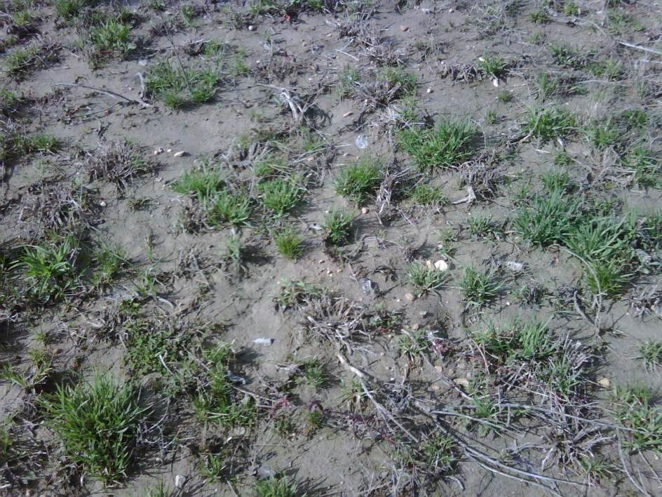
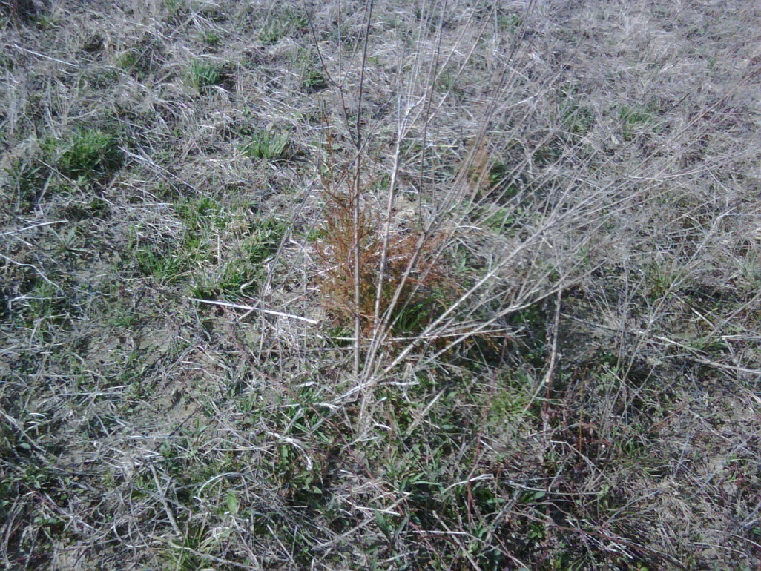
Condition at Purchase

Slide 72
Implemented Strategy
Bale Grazing 1st winter.
High Stock Density/Short Duration Grazing.
Long rest periods.
Strategic use of soil microbials.

Slide 73
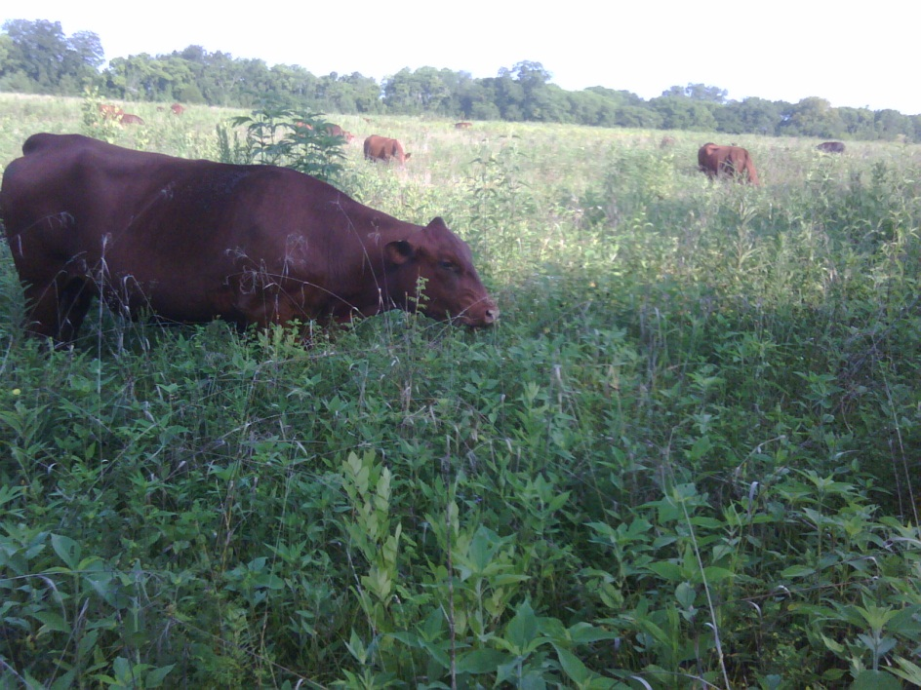
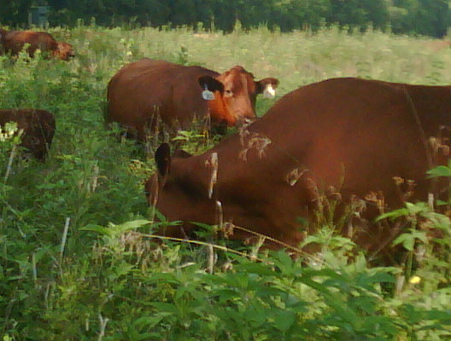
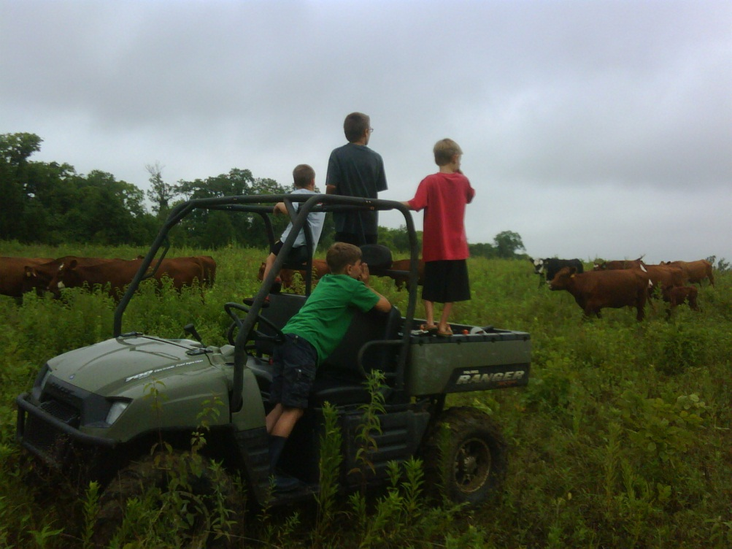
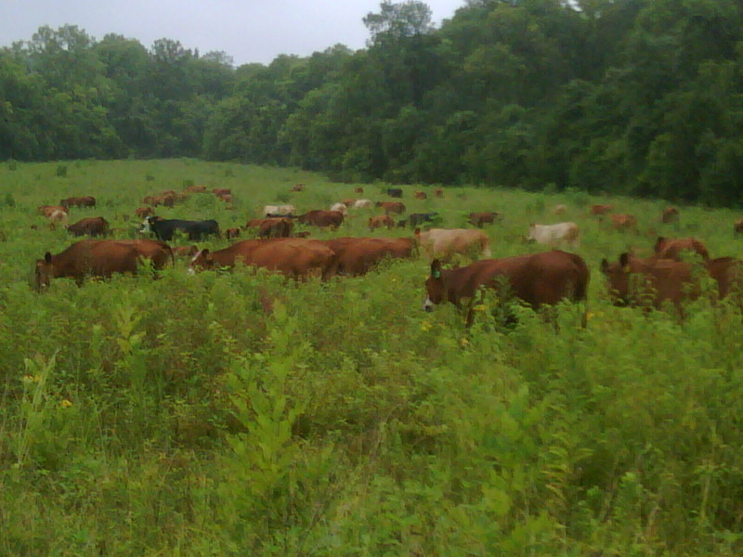
Year 1 Grazing Season

Slide 74
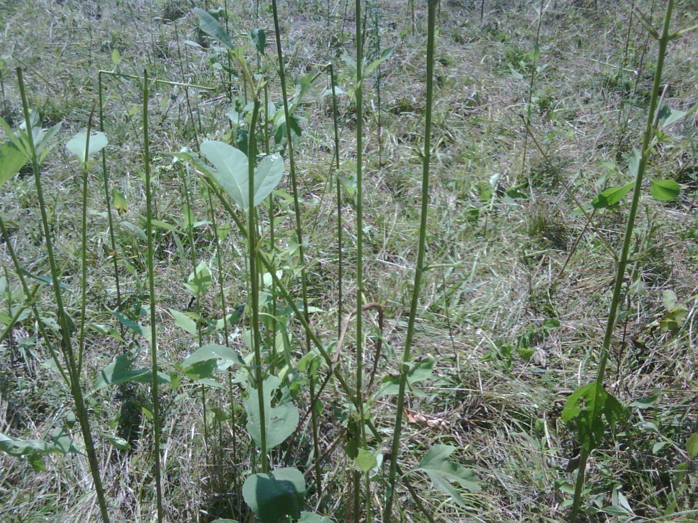
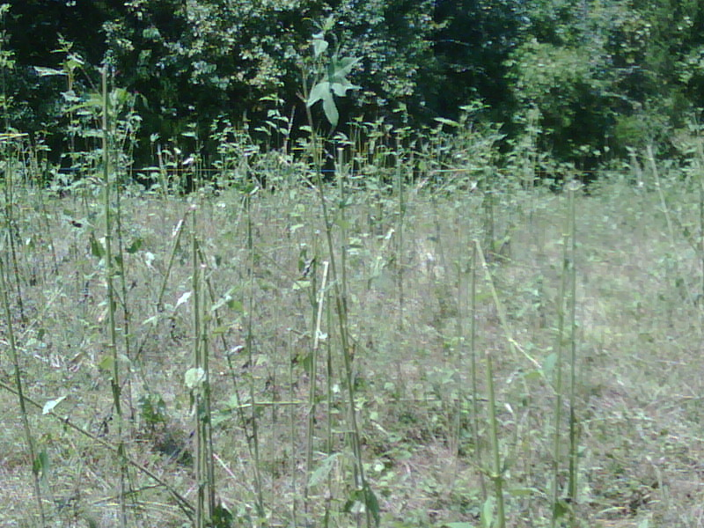
Grazing Weeds

Slide 75




Year 2 Grazing Season

Slide 76




Year 3 Grazing Season

Slide 77



Year 4 Grazing Season

Slide 78
Progress
Tripled Stocking Rate.
Forage species increased from less than 3-4 major species to more than 35.
Soil OM increased from 1.5% to 4.3%.
Brix increased 400%+.
Water infiltration and retention increased.
Increase in earthworms, soil level insects, pollinators, and wildlife.

Slide 79
Las Damas Ranch

Slide 80

Neighbor’s Pasture
Las Damas Ranch

Slide 81

Las Damas Ranch

Slide 82
Background
Typical 11 inch rainfall region.
  Last 4 years – 10”, 9”, 8”, 5” inches.
5 years ago – monoculture of tobosagrass
  Now = side-oats grama, blue grama, green spangletop, …..
Run 1 cow/calf per 40 acres.
Neighbor ranch runs 1 cow/calf per 200 acres.

Slide 83

California – Regenerative Grazing

Slide 84
Effects of Stage of Maturity on Pasture Composition
7
33
Protein
3
Lipid
25
10
Sugars
10
5
Minerals
23
12
Hemicellulose
14
30
Cellulose
18
3 Lignin 7
Early Maturity
Mid Maturity
Late Maturity

Slide 85
Effects of Stage of Maturity on Pasture Composition
7
33
Protein
3
Lipid
25
10
Sugars
10
5
Minerals
Sweet Spot
23
12
Hemicellulose
14
30
Cellulose
18
3 Lignin 7
Early Maturity
Mid Maturity
Late Maturity

Slide 86
Measurable Benefits

Slide 87
Optimum Soil Health
Type of Organism number/acre lbs/acre
Bacteria 800,000,000,000,000,000,000 2,600
Actinobacteria 20,000,000,000,000,000 1,300
Fungi 200,000,000,000,000 2,600
Algae 4,000,000,000 90
Protozoa 2,000,000,000,000 90
Nematodes 80,000,000 45
Earthworms 40,000 445
Insects /arthropods 8,160,000 830
Soil Food Web
Notes:
88
15 zeros Quadrillion 18 zeros Quintrillion 21 zeros Sextillion
Here is how much soil “livestock” there is in a healthy soil. 8000 lbs. What do they all do? I am pretty sure I can’t tell you what they all do. I don’t even know if I can tell you how many there are.
Can you tell me how many there are? 800 Quintrillion Bacteria. I chopped off 3 zeros so it shows 20 Quadrillion Actinomycetes but it really was 20 Quintrillion . I didn’t figure you could pronounce the name so I didn’t figure you would miss 3 zero’s.
I can tell you they are ALL critical to the soil health. For example Fungi act as root extensions. They attach to the roots and can extend 30-40 feet. Some of the others make minerals more available to plants. In effect they make the plant roots 40 feet long. Each one is like a link in a chain. If one is killed or destroyed the entire chain will not work.
So if we all have soil do we all have these microorganisms?????

Slide 88


Slide 89
90% of soil function is mediated by microbes.
Microbes depend on plants.
So, how we manage plants is critical.

Slide 90
How Rapidly Can We Build Soil Microbial Population?
TLMB - Start | TLMB - End | No. Years
987 ng/g | 6748 ng/g | 4
1231 ng/g | 8901 ng/g | 5
2214 ng/g | 11342 ng/g | 5
1575 ng/g | 9657 ng/g | 4
1898 ng/g | 8431 ng/g | 4
TLMB = Total Living Microbial Biomass

Slide 91


Earthworms

Slide 92


Dung Beetles

Slide 93


Pollinators

Slide 94


Slide 95
The Value of Soil Organic Matter

Slide 96
Can we control runoff with Organic Matter (OM)?
2% OM will hold 32,000 gallons of water
or 21% of a rainfall.
5% OM will hold 80,000 gallons of water
or 53% of a rainfall.
8% OM will hold 128,000 gallons of water
or 85% of a rainfall.
Notes:
What do most NRCS structural practices do? Terraces, Grade Stabs, Waterways? Pl566 Watershed structures? They all try to get water off the field safely to prevent erosion and prevent flooding.
What if all of our soils were back to presettlement levels of organic matter? Would we have the flooding and erosion problems?
It is no wonder we have to build things to control runoff. Even with perennial grass and great ground cover to slow the runoff down our soils just won’t hold the water.

Slide 97

Improved Organic Matter = Reduced Runoff and Clean Water

Slide 98
Organic Matter and Available Water Capacity (inches water/one foot soil)
Percent SOM | Sand | Silt Loam | Silty Clay Loam
1 | 1.0 | 1.9 | 1.4
2 | 1.4 | 2.4 | 1.8
3 | 1.7 | 2.9 | 2.2
4 | 2.1 | 3.5 | 2.6
5 | 2.5 | 4.0 | 3.0
Source: J. Soil and Water Conserv. B. Hudson. 49 (2) 189-194.

Slide 99
How Rapidly Can We Build New Soil Organic Matter?

Slide 100
Building Soil OM – How Long Does It Take?
Mississippi – 1.0% - 4.2% (4 years)
New York – 1.5% - 4.1% (5 years)
Kansas – 1.6% - 3.9% (5 years)
Nebraska – 2.1% - 5.5% (6 years)
Michigan – 2.2% - 6.1% (6 years)
Wisconsin – 2.3% - 5.0% (4 years)

Slide 101
Value of Plant Species Diversity

Slide 102

Diversity Is Key

Slide 103

Monoculture
Diversity/Complexity

Slide 104
Where Do Majority of Soil Microbes Live & Function?

Slide 105

Microbe “Home” – Soil microbes live and function in root zone.

Slide 106
Value of Ground Cover

Slide 107


Soil Temperature

Slide 108


Soil Temperatures

Slide 110
Value of Manure Distribution Through Multi-Paddock Grazing and Frequent Moves

Slide 111

Manure Distribution
Notes:
In the 3-paddock system (analogous to continuously grazed pastures) very few manure piles are deposited in the main paddock area. There is a concentration of manure near shade and water. I frequently ask the audience to identify the areas of the field where manure piles are most densely concentrated (shade, east end; water, southwest corner).
In the intensively grazed 24-paddock system there is a much more even distribution of manure piles in the pasture creating a higher density of manure piles in the main paddock area. There is still a concentration of nutrient near water but the trends are less pronounced.

Slide 112
Manure Distribution
Rotation Frequency | Years to Get 1 Pile/sq. yard
Continuous | 27
14 day | 8
4 day | 4 – 5
2 day 1 time a day | 2 ??
Notes:
But what can an even more intensive system do?

Slide 113
Higher Plant Brix
.

Slide 114
What is Brix?
Dissolved plant solids include sugars (such a sucrose and fructans), minerals, amino acids, proteins, lipids and pectins.
About 50-80% of the Brix measurement represents plant sugars, with the remaining portion representing the other plant solids.

Slide 115
Brix Index of Common Forages
Forage | Poor | Avg | Good | Excellent
Alfalfa | 4 | 8 | 16 | 22
Ryegrass | 6 | 10 | 14 | 18
Sorghum | 6 | 10 | 22 | 30
Fescue | 2 | 4 | 7 | 12
Bermuda | 2 | 4 | 6 | 8

Slide 116

Why High Brix in Forages?
Research shows that High Brix forages increase animal gains and milk production.
High Brix Forages also are more drought resistant, freeze tolerant, and more resistant to plant disease and pests
  (Moorby, 2001).
  (Moller, 1996).
  (Downing & Gamroth, 2007; Miller, et al, 1999).
  (Allison, 2007).
  (McKenzie, 2007).

Slide 117
Brix Advantage
Brix 5.0% or less = ADG in low 1’s.
Brix 8-12% = ADG in low to mid-2’s.
Brix 12 – 15% = ADG in mid-high 2’s.
Brix > 15% = ADG in high 2’s to 3’s.
Every 1.0% increase in Brix adds 0.1 to 0.3 ADG.

Slide 118
Better Beef

Slide 119


Grass Fed Potential

Slide 120

USDA Prime Grass Finished Beef

Slide 121
Value of Grazing for Wildlife

Slide 122






Grazing Improves
Wildlife Habitat

Slide 123


Bird-Friendly Grazing
New paddock with over
20 documented species
Pasture after hard grazing with cover remaining for birds
Images courtesy of Dr. Allen Williams

Slide 124
Grazing Improves Grassland Bird Habitat
Bird-Friendly Grazing
Courtesy of Laura Paine
Notes:
Here is evidence that grazing enhances habitat for grassland birds. Within the cadre of 15 to 20 species of ground nesting birds are many species that are adapted to grazed or burned vegetation. They seek out grassy habitats of varying heights and densities. Grazing does a good job of creating the habitat variation that is attractive to many species.

Slide 125

Improving Fish Habitat
Trout Unlimited: Driftless Area Initiatives
  Trout Unlimited (TU) is partnering with state & federal agencies, conservation groups and farmers to promote managed grazing
  Recreational fishing in the Driftless generates over
  $1.0 billion annually
  TU is a leader in The Kickapoo Grazing Initiative, promoting grazing to increase SOI and reduce nutrient runoff in streams and rivers
  Improvements in fish populations are so dramatic that WI DNR is removing brown trout from some streams

Slide 126


Grazing Spring Coulee Creek
Grazing in Spring Coulee
Ungrazed, unrestored stretch
Images Courtesy of Willow Creek Ranch

Slide 127
Important Grazing Tips
Know DM availability and allow 3.0% - 3.5% DM per head daily.
Take no more than 30%- 50% available DM in a single grazing.
Move forward rapidly to not allow too many bites of the same plant.
Know the brix content.
Turn into new paddocks in early to mid-afternoon (peak brix or plant sugars).
Stage of forage maturity critical – Mid-stage to slightly beyond…

Slide 128


More of This and Less of This

Slide 129


Building for Future Generations

Slide 130

Thank you!

