Slide 1
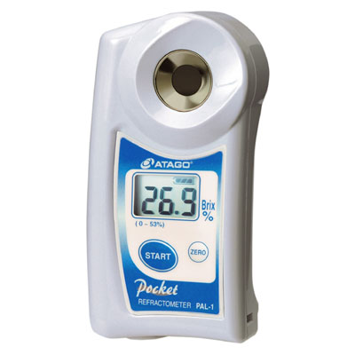
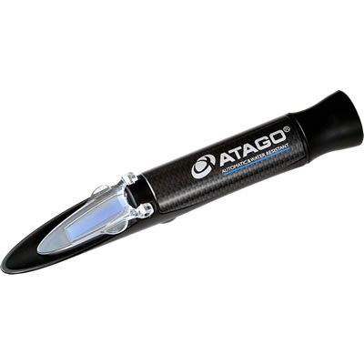
What is a Refractometer?
A simple optical instrument that measures that amount of light refracted in a liquid.
Standard piece of equipment for many agronomists and commonly used in the fruit and vegetable industries.
Digital
Optical
Slide Source: Allen Williams

