Slide 1
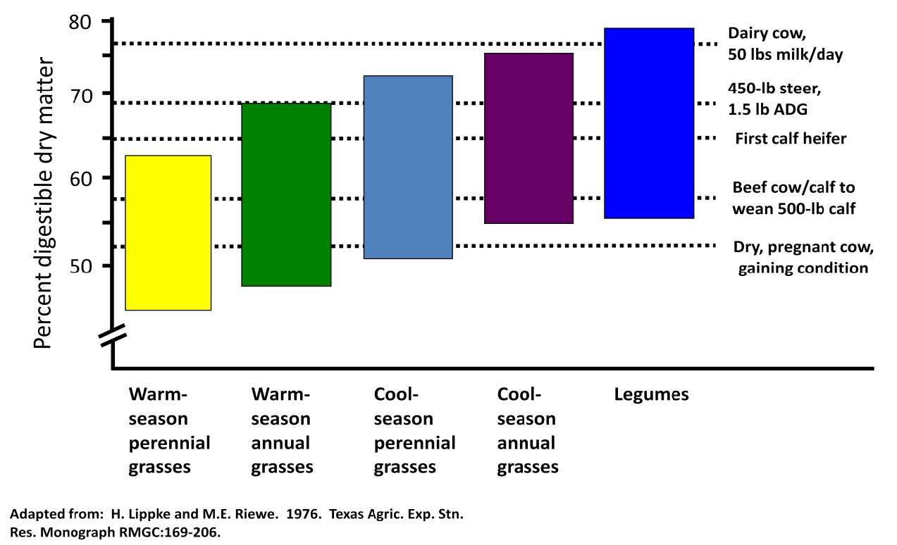
What is Our Goal?
Depends on Class of Livestock & Production Goals
Slide Source: Rhonda Gildersleeve

