Slide 1
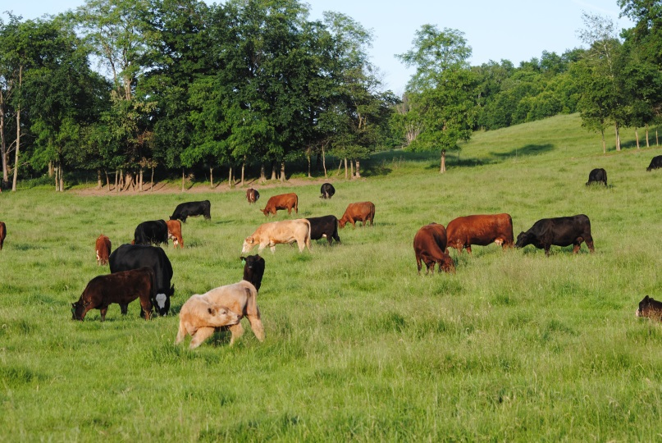
Use Livestock Husbandry Skills to Monitor the Grazing Animal
We have several tools available to monitor animal performance on pasture:
Production parameters: milk production, livestock weight gains, reproduction success, etc.
Body condition scores
Animal behaviors
Manure consistency

