Slide 1
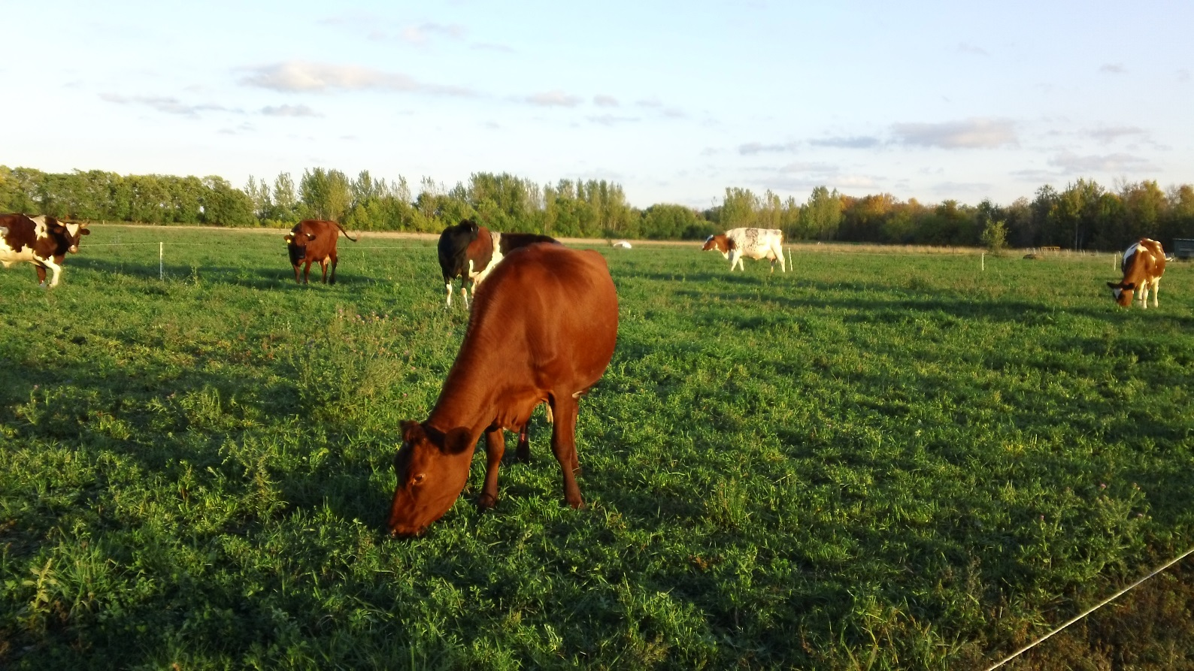
Stocking Rate = total number of animals your pasture will support.
Slide Source: Kent Solberg

