Slide 1
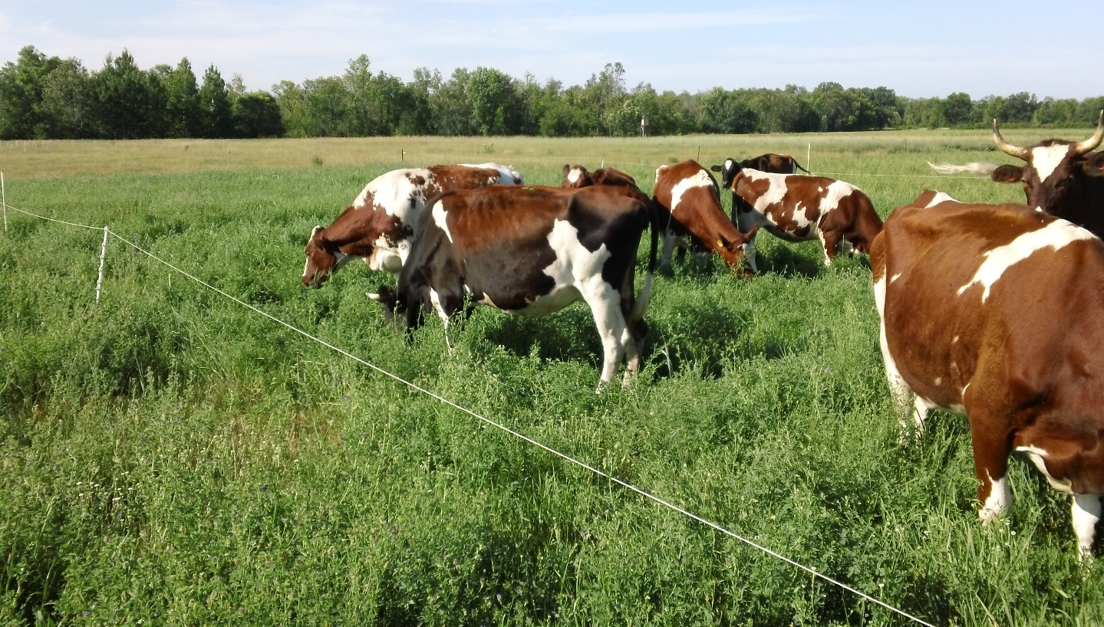
Stocking Density = pounds of livestock on a given unit of pasture at one time (e.g. concentration)
Slide Source: Kent Solberg

