Slide 1
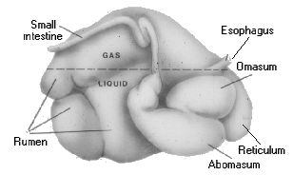
Ruminant: Any hoofed animal that digests its food in two stages
Image source: Colorado State University
Ingests forage
Regurgitates semi-chewed forage (cud)
Chews cud
Ingests cud
Ruminants evolved to consume cellulose-based roughages
Consume forages rapidly and complete chewing process later
Digestive system includes a fermentation process by microbes that converts fiber to useable nutrients
Slide Source: Rhonda Gildersleeve

