Slide 1
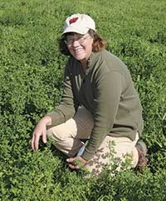
Rhonda Gildersleeve
UW Extension Grazing Specialist Rhonda Gildersleeve has worked with agricultural producers in California and Wisconsin on profitable and environmentally sound grazing-based production systems for beef, sheep, and dairy cattle.
A native of Grant County, Wisconsin, Rhonda received a B.S. Agriculture in production agronomy from UW-River Falls, and also holds M.S. (University of Florida) and Ph.D. (Texas A&M University) degrees with emphasis on management of pasture and rangeland ecosystems.
In her spare time, Rhonda manages her own organic dairy farm near Boscobel, WI.

