Slide 1
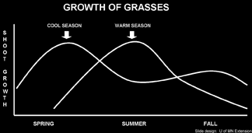
Pasture Forage Types
Slide Source: Kent Solberg

