Slide 1
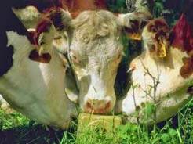
Nutrients Needed by Grazing Animals:
Water:
Crude Protein:
Content and digestibility of protein is generally adequate to high in managed pasture systems, but need adequate energy to utilize
Energy:
In pastures, CHOs are the primary energy source:
Non-structural CHOs: soluble sugars and starches: readily digested energy
Structural CHOs (fiber): cellulose, hemicellulose, lignin
Lignin is basically 100% indigestible, even by the rumen microbes
More mature plants = higher lignin content = lower digestibility
Species | Gallons /day
Beef cattle | 6 - 18
Dairy cattle | 10 - 30
Sheep, goats | 1 - 4
Horses | 8 - 12
Salt & Minerals:
Slide Source: Rhonda Gildersleeve

