Slide 1
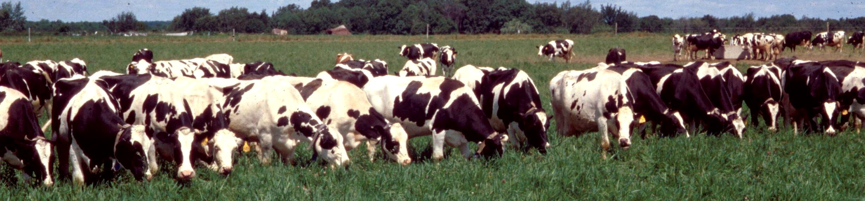
Managing Pasture for High DMI?
Grazing animals will always select the highest quality diet possible from the pasture forage available to them
Challenges:
Too little forage available — limits dry matter intake
Too mature — limits nutritive value of dry matter intake and slows rate of passage
Slide Source: Rhonda Gildersleeve

