Slide 1
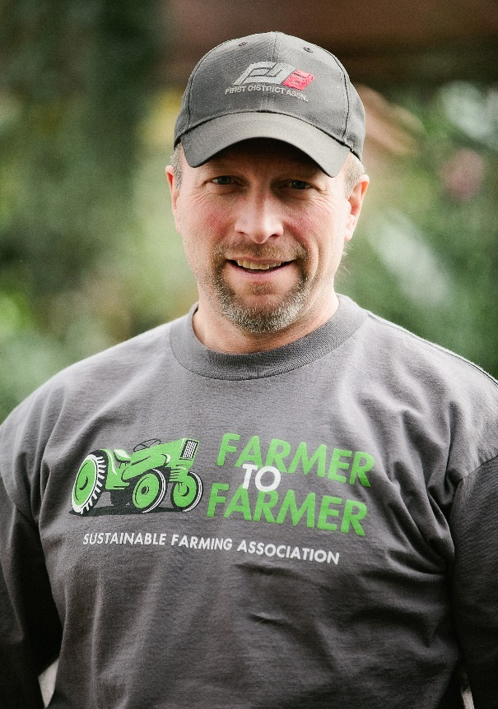
Kent Solberg
Kent currently serves as the Livestock and Grazing Specialist for the Sustainable Farming Association.
Kent and his wife Linda own and operate a grass-based livestock farm near Verndale, MN.
Kent has been involved in planned grazing and pasture based livestock systems 25 years.
For the past 7 years he has used cover crops and seeded annuals to extend the grazing season and improve soil health.
He has taught college courses and presented at numerous workshops on forages, fencing, grazing, soil health and livestock management.

