Slide 1
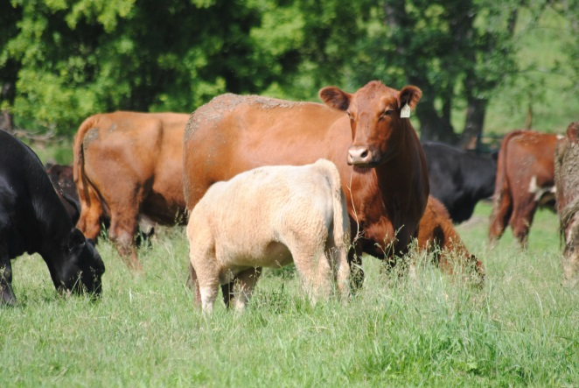
Grazing Animal Basics That We Need to Know
Definitions
Diet preferences
Digestive physiology
Nutrient needs of grazing livestock
Dry matter intake (DMI) factors
Relationships with pasture management

