Slide 1
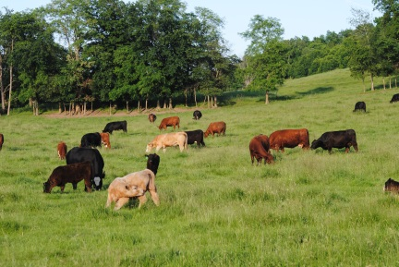
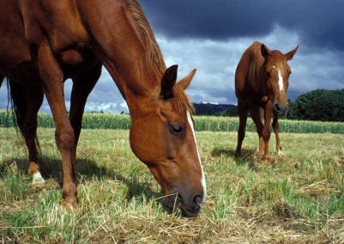
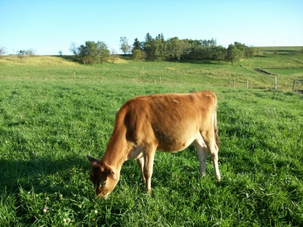
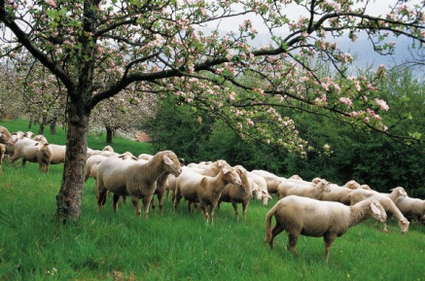
Definitions
Grazing animals co-evolved with their natural diets and developed digestive systems to optimize their food resources
Herbivores: plant-based diets
Ruminants: type of herbivore that has a 4 compartment stomach designed for “batch-processing” forages (cattle, sheep, goats)
Some herbivores are not ruminants (rabbits, horses)
Slide Source: Rhonda Gildersleeve

