Slide 1
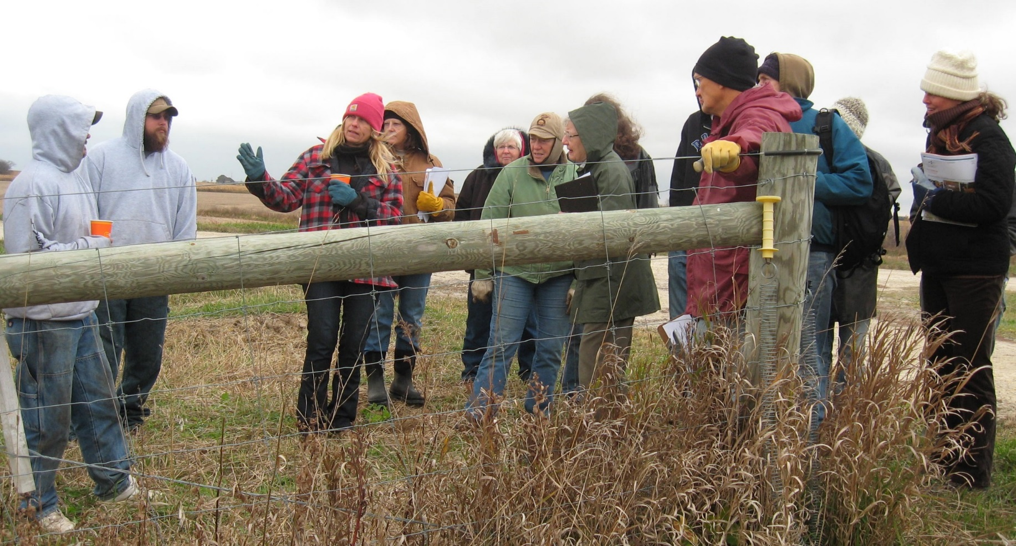
Slide Source: Caroline van Schaik
Notes:
And then there are the nitty-gritties: …
Does she have conservation plan?
…startup costs (incl transition from row crops to pasture)
…fencing/fence-builder + water + electricity
How to find a livestock producer and/or grazier in a custom or contract situation
What about a sensible and signed lease
What are the programs to help her financially

