Slide 1
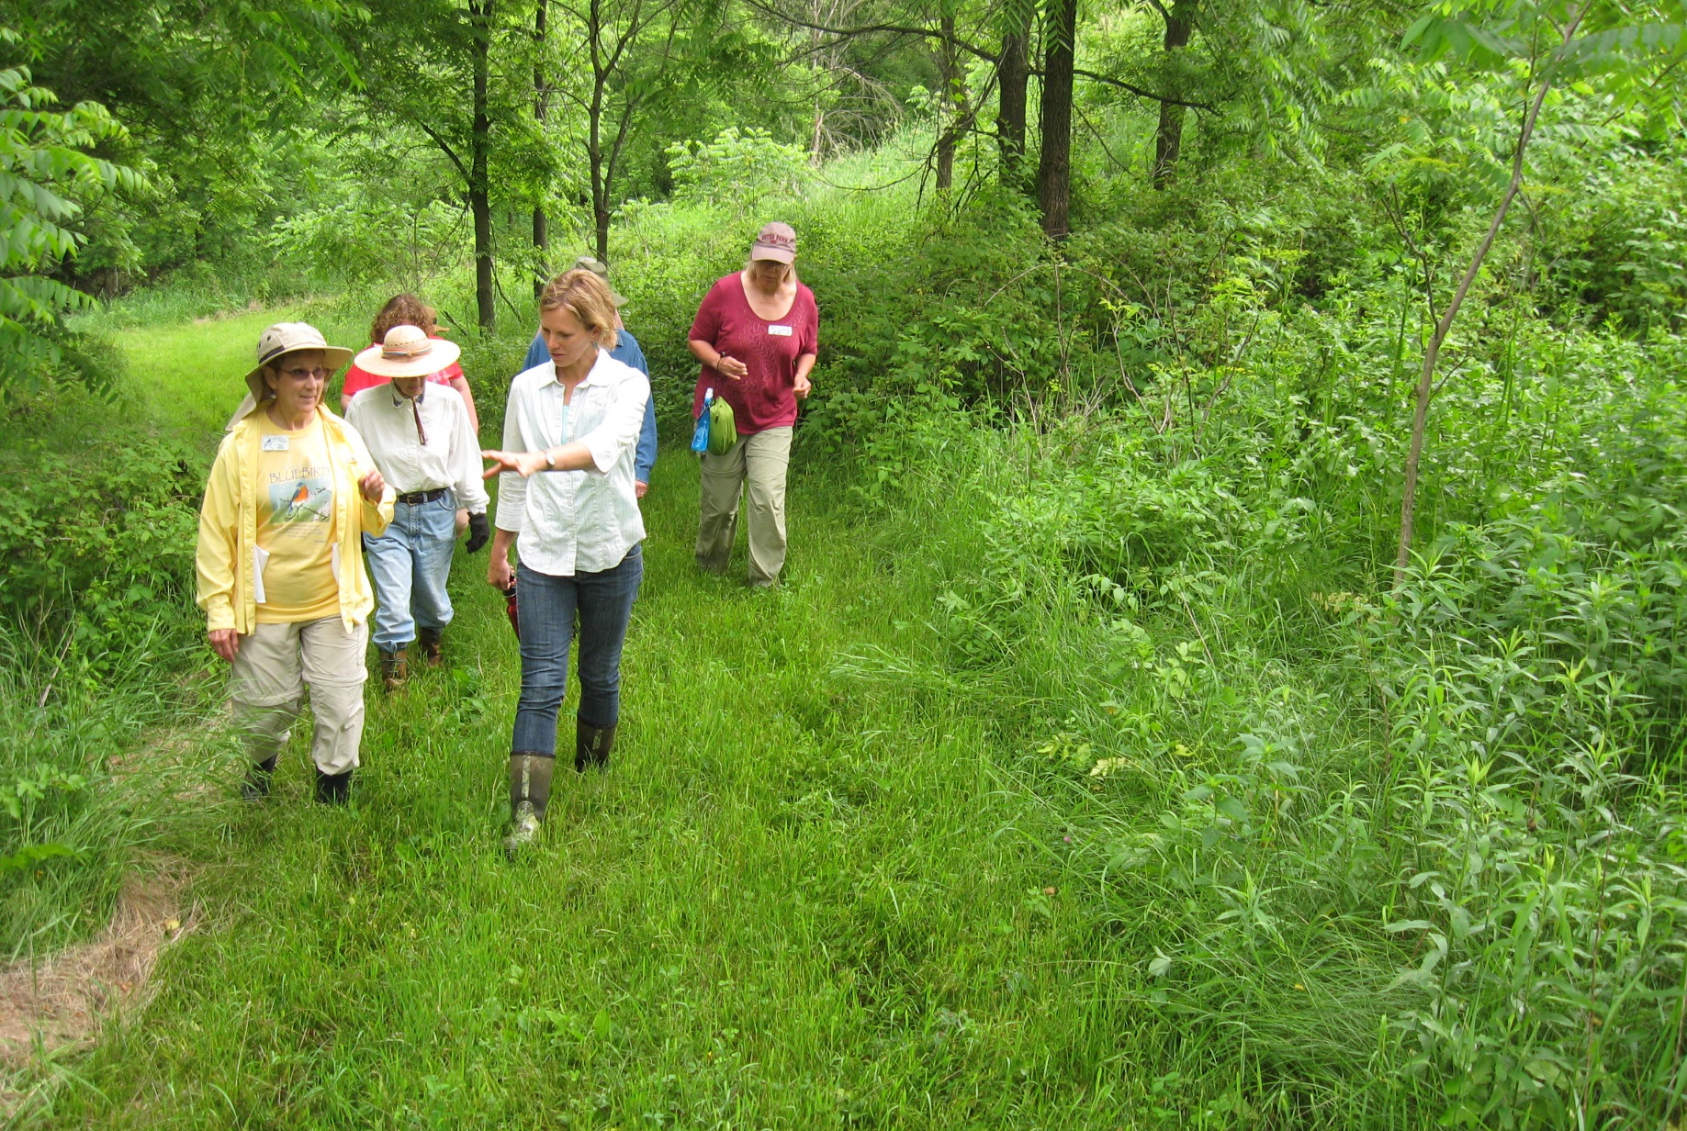
Slide Source: Caroline van Schaik
Notes:
And as have many of you, we have found a ready audience in women farmers and landowners …
Who own plenty of land just prime for active conservation and good farming.

