Slide 1
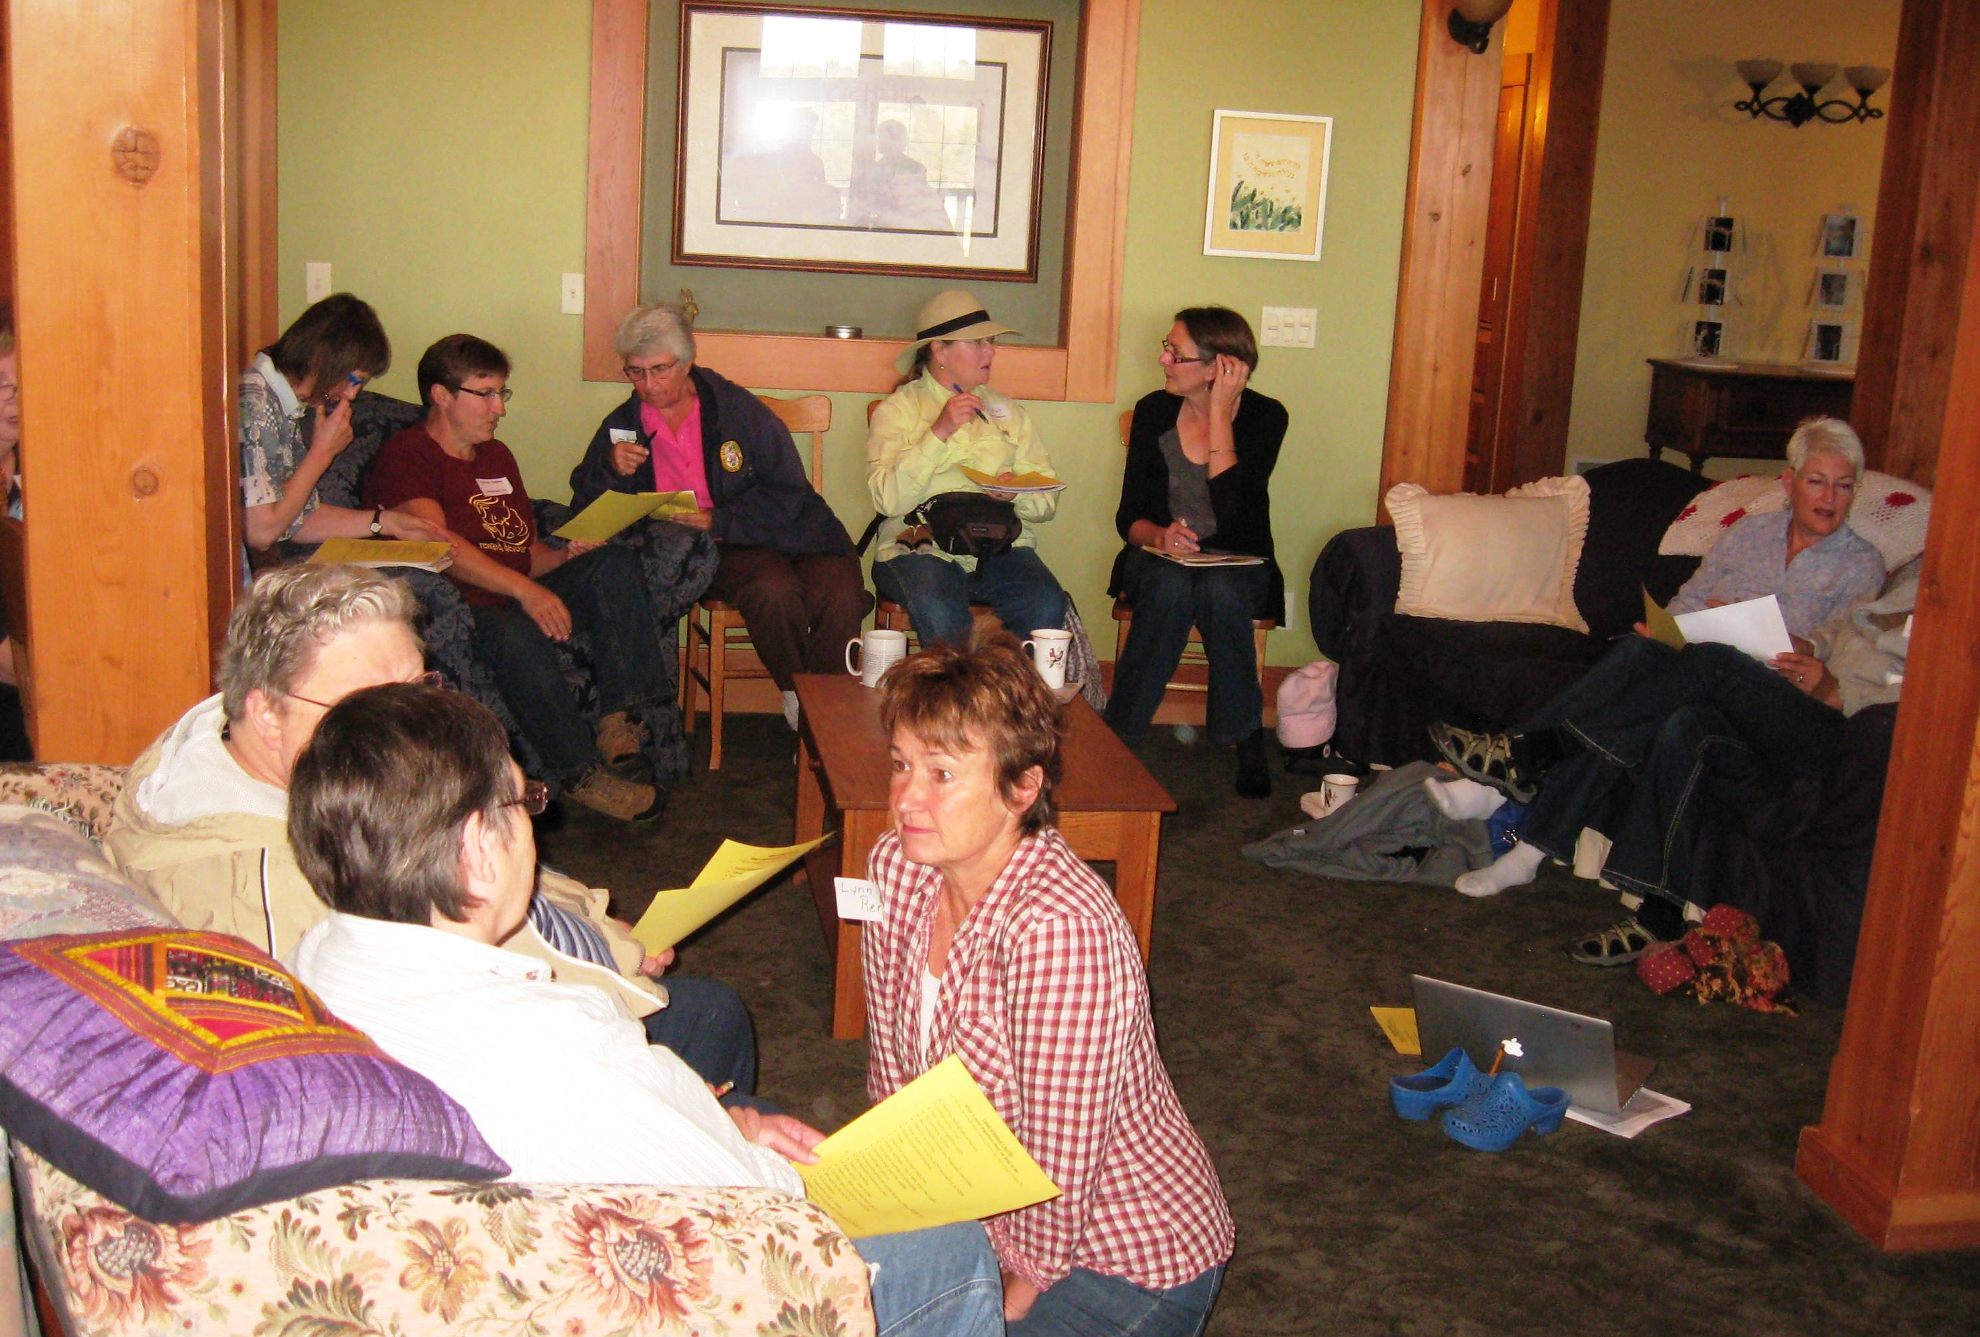
Slide Source: Caroline van Schaik
Notes:
We’ve hosted meetings with women farmers and landowners…
On some of those issues and many others - agronomic, soil science, conservation, and stewardship.
They tend to have these characteristics:
…Start with values exercise as the foundation for the day’s work
…often on a farm, almost always a pretty site
…indoors and outside
…women only, at least at first: morning women, afternoon public field event; lawyer and soil scientist after women discussed their farms and values
Opportunities for women to think silently by themselves and then to work together
Very practical, what-next-oriented with a constant check-back to personal values as the guiding decision-maker.
By virtue of your interest in managed grazing, you’re standing up for more cover…
And more living roots in the ground.
Women farmers and landowners are a source of these landscape features…
IF we acknowledge that we’ll get their attention in different ways…
Apart from the familiar farm meetings delivered by men.
They could use our collective help –
and in turn, this group of farmers and landowners
could provide significant landscape change.

