Slide 1
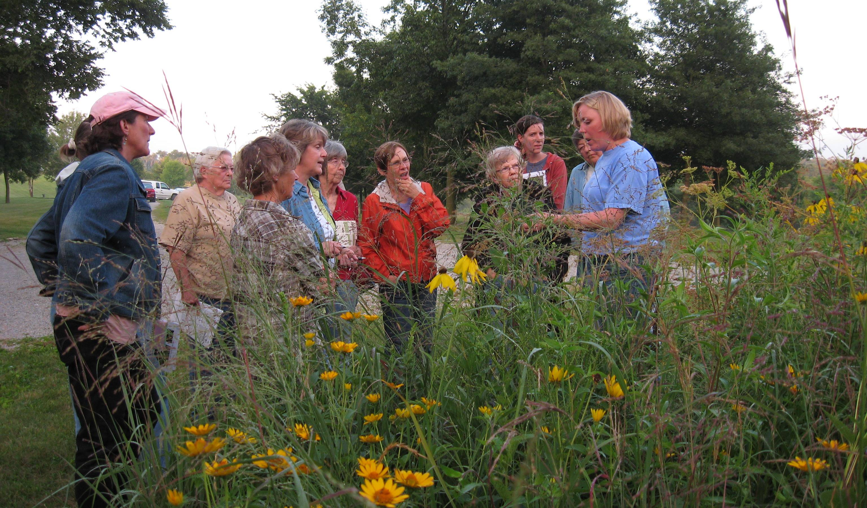
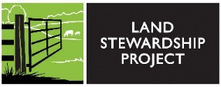
Slide Source: Caroline van Schaik
Notes:
And many of them really enjoy learning in the comfort of other women.
We credit Iowa’s Women, Food and Agriculture Network for raising up the learning circle method of conservation outreach to women…
And for designing an effective curriculum presented as a series of lessons (reference at end).
Like WFAN, LSP has noted the willingness of women to verbalize stewardship values …
And also their unique needs when it comes to learning and asserting their preferences for the land.
We started with the WFAN curriculum and although we’ve largely moved on from it,
We are clear about our shared goals: to help women move figuratively from the back of the room …
To articulate what’s most important to them about their land and …
And do something about it…
That looks closer to more farmers growing crops & livestock, good fishing, and plenty of songbirds.

