Slide 1
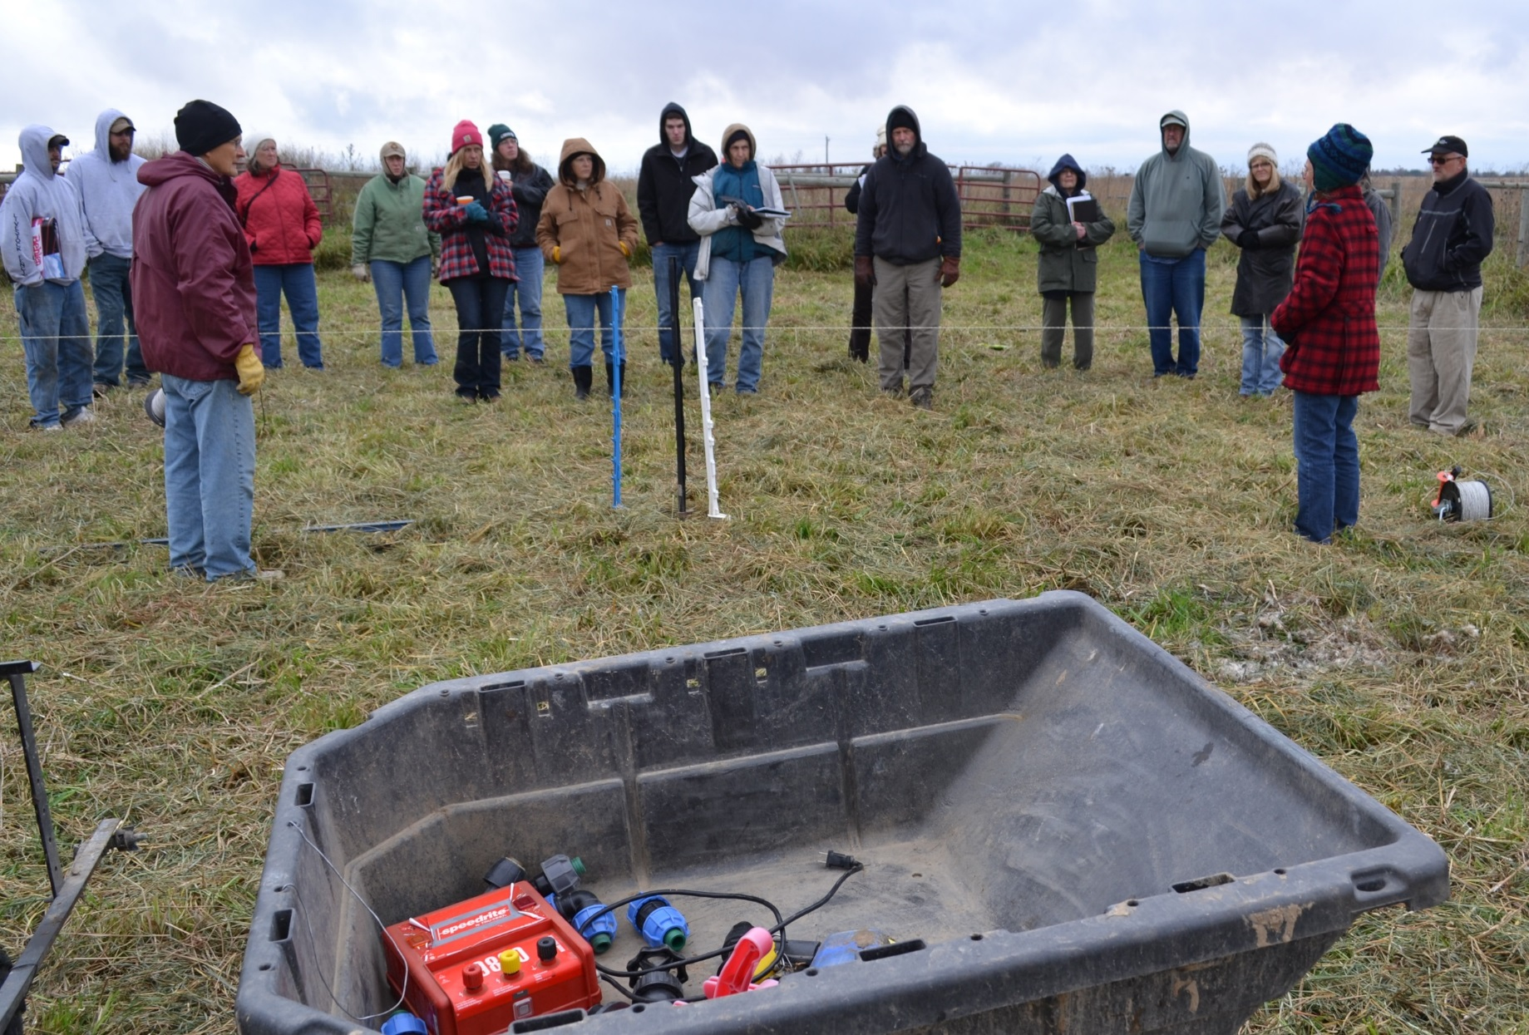
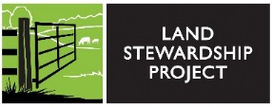
Slide Source: Caroline van Schaik
Notes:
Let me turn specifically to the issues that especially bring us together, those related to grazing.
When you bring up livestock in a group of these women,
it typically elicits head shaking and mutterings of “fences,” “winter,” “bulls.”
These are not issues unique to women who own land!
Plenty of women grew up within this context so that though they may not be raising animals now, they know the value of pasture and livestock for erosion control, stream health, aesthetics, wildlife habitat, and more.
But if they are renting out their land …

