Slide 1
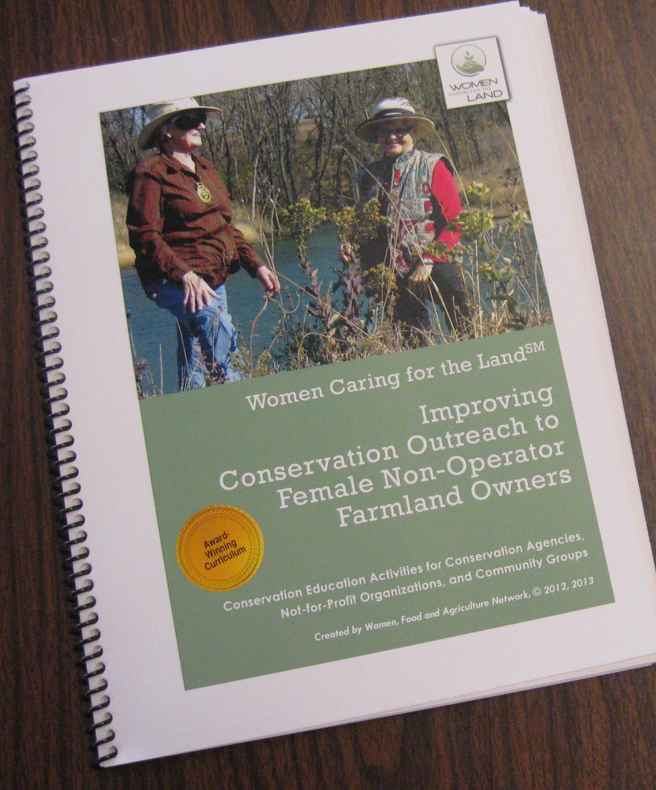
Women, Food and Agriculture Network
info@wfan.org
515-460-2477
www.womencaringfortheland.org
Slide Source: Caroline van Schaik
Notes:
For the curriculum designed and used regularly by WFAN.

