Slide 1
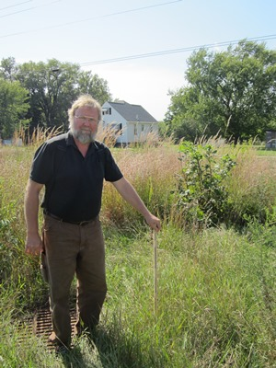
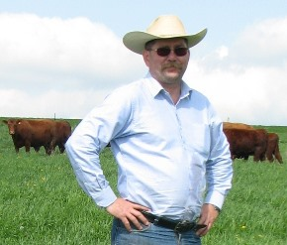
Gene Schriefer has been the Agriculture Agent with the University of Wisconsin – Extension for the past 6 years working primarily in Iowa County in the Driftless Region.
He organizes and leads the Southwest Wisconsin grazing network which hosts a dozen pasture walks a season and the spring and fall grazing workshops.
Prior to his extension position, he was the Grazing Specialist for Southwest Badger RC&D developing grazing management plans and grazing education for farmers and land owners in the seven southwestern counties of the Driftless region.
Gene owns and manages a small farm in Dodgeville, WI grazing a white faced, commercial flock and crossbred beef herd focused on grass finished beef.
Vance J. Haugen is a University of Wisconsin Agriculture Extension Agent (since 1985) and is currently a county based faculty member located in Crawford County, Wisconsin.
Vance was raised on a dairy farm near Thief River Falls, Minnesota and earned both his B.S. (1979) and M.S. (1984) degrees from the Ag. Engineering Department at North Dakota State University, Fargo, North Dakota.
For the last 25 years pasture education has been the main focus of his extension work. In addition, since 1993 Vance, with his wife, Bonnie and three children, Inga, Olaf and Thor has operated a 230 acre, grass based dairy near Canton,Minnesota

