Slide 1
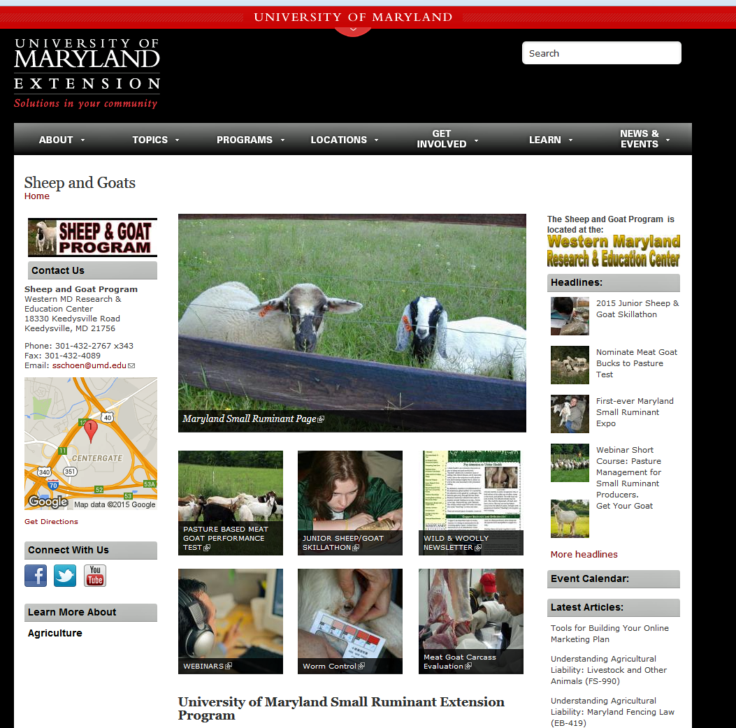
Small Ruminants
Susan Schoenian, Sheep and Goat specialist, Western Maryland Research & Education Center
Slide Source: Doug Gucker
Notes:
https://extension.umd.edu/sheep-goats

