Slide 1
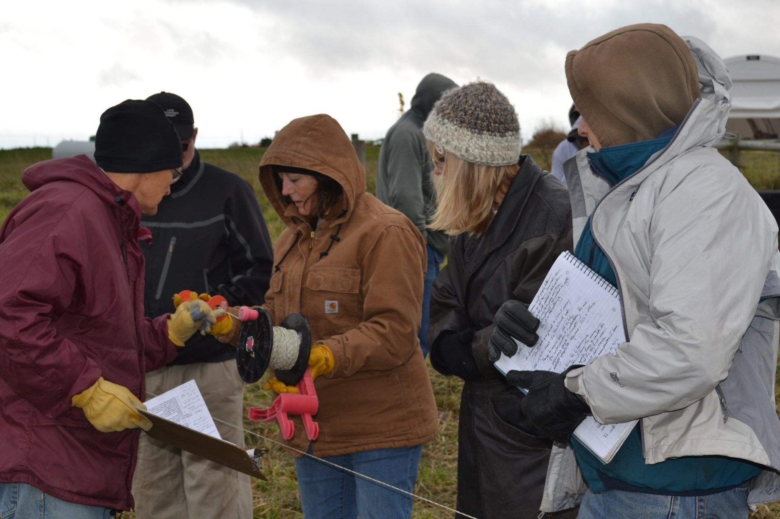
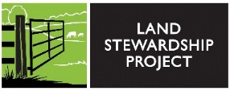
Slide Source: Caroline van Schaik
Notes:
It hasn’t necessarily occurred to them that someone else could pasture animals there…
Either to start grazing or\to expand an operation.
And as with many male landowners, a good signed lease is often little more than a good idea.
So there is plenty of room to reach out with grazing expertise in non-Farm-Guy-ese language.
I find women very responsive to some important first questions:
How do livestock and pasture and grazing
Address her stewardship priorities?
What else is inspiring her:
Is there a neighbor or a beginning farmer she hopes to help?
Are there income needs?
Does she want more songbirds, better hunting, a cleaner stream?
And also: what about calving on pasture, or having a stranger on her farm, and yes, the snow plow option?
How engaged does she want to be day to day?

