Slide 1
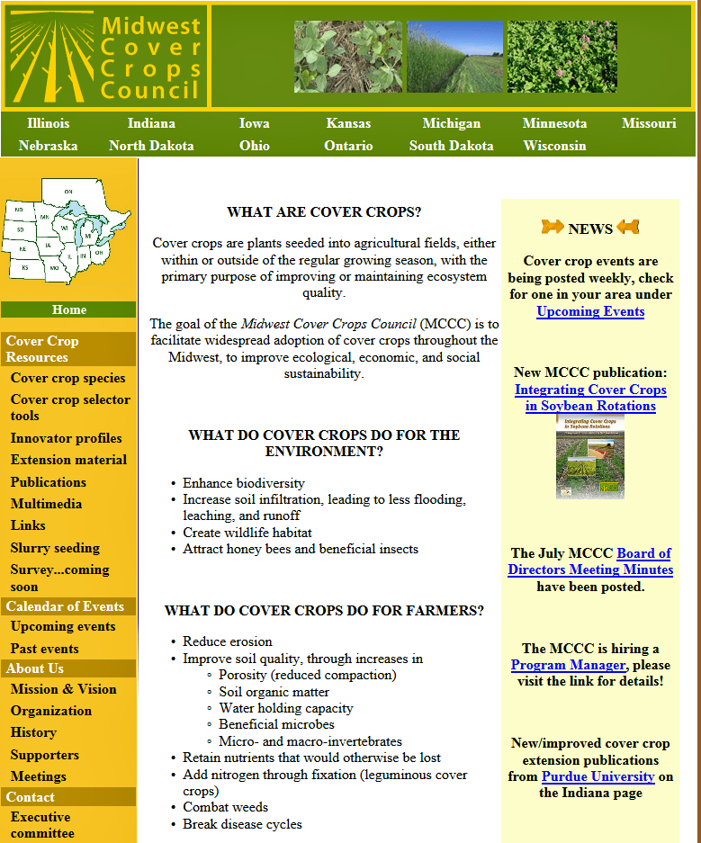
Cover Crop Selector
Cover Crop Species
Publications
Extension Materials
Slide Source: Doug Gucker
Notes:
http://www.mccc.msu.edu/

