Slide 1
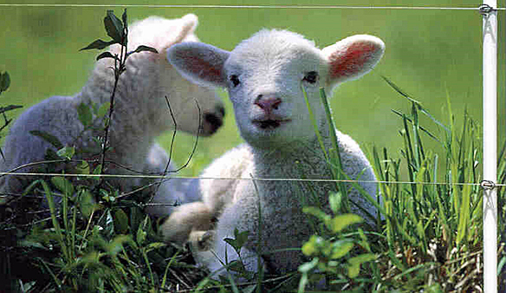
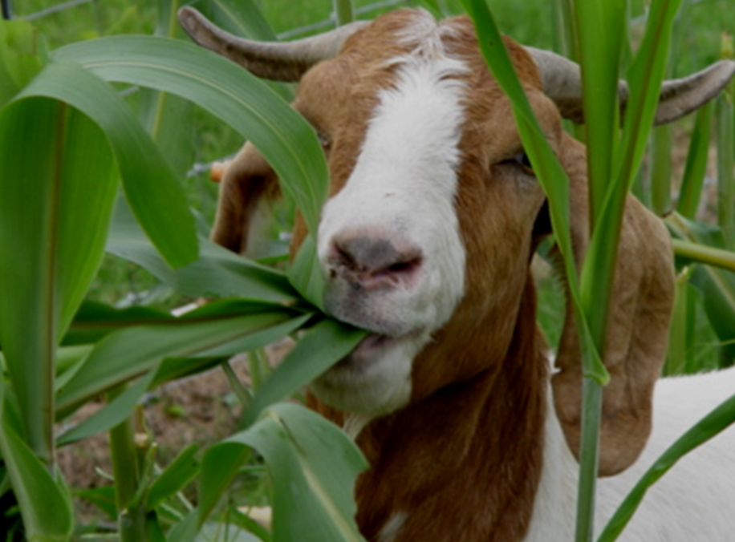
Slide Source: Doug Gucker
Notes:
Welcome! This is a quick overview of the basic features of the cluster call software.

