Slide 1
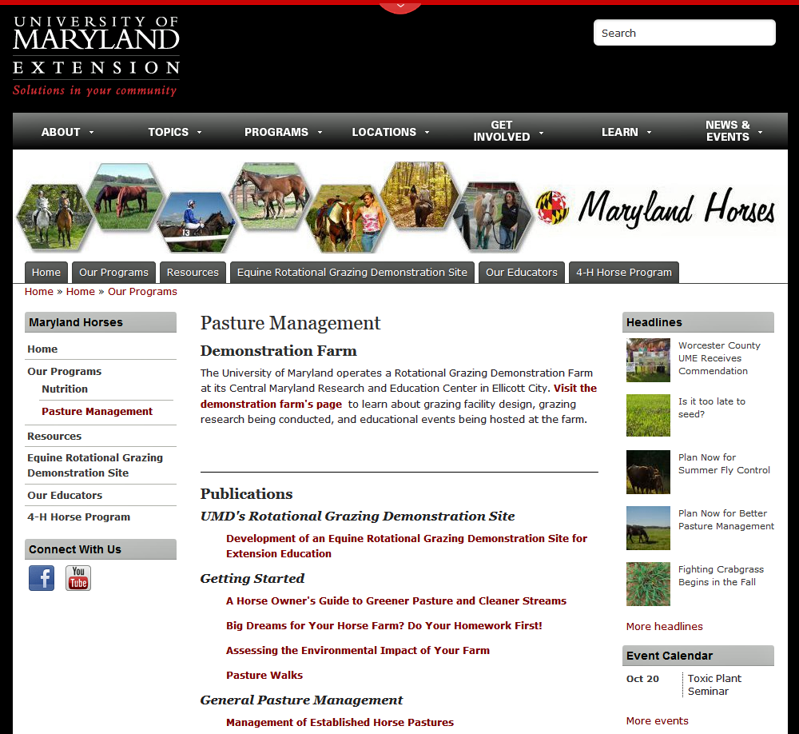
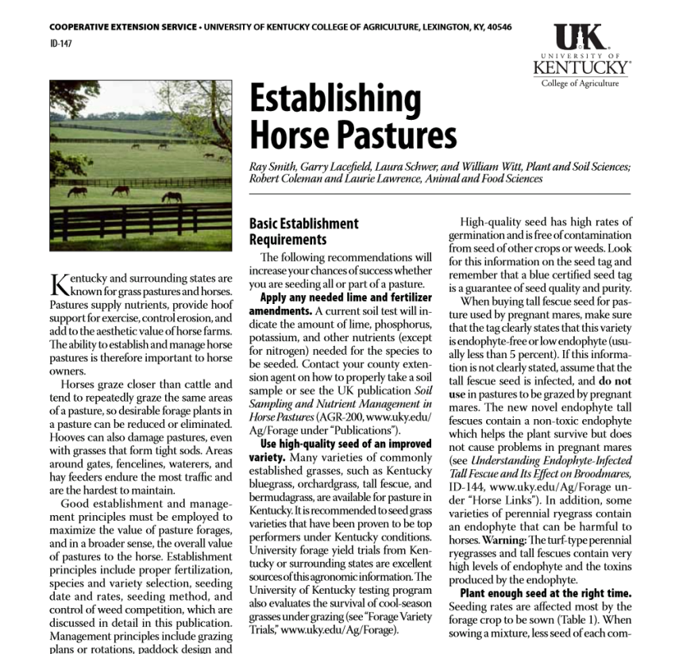
Horses and Pastures
Grazing or Exercise Yard?
Information
Horse States: Maryland & Kentucky
Slide Source: Doug Gucker
Notes:
http://extension.umd.edu/horses/our-programs/pasture-management
http://www2.ca.uky.edu/agc/pubs/id/id147/id147.pdf

