Slide 1
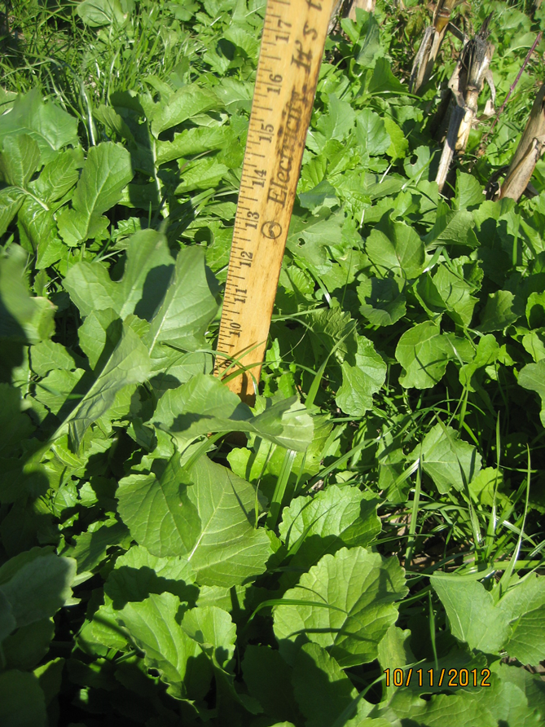
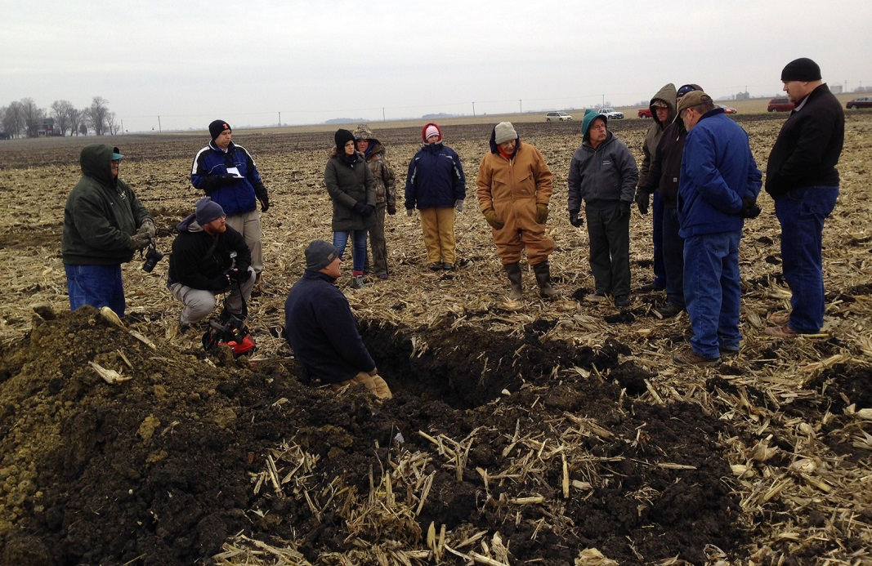
Early Harvested Corn – Seeded Sept. 5
Generating Interest among our few cow-calf producers
Slide Source: Doug Gucker
Notes:
Welcome! This is a quick overview of the basic features of the cluster call software.

