Slide 1
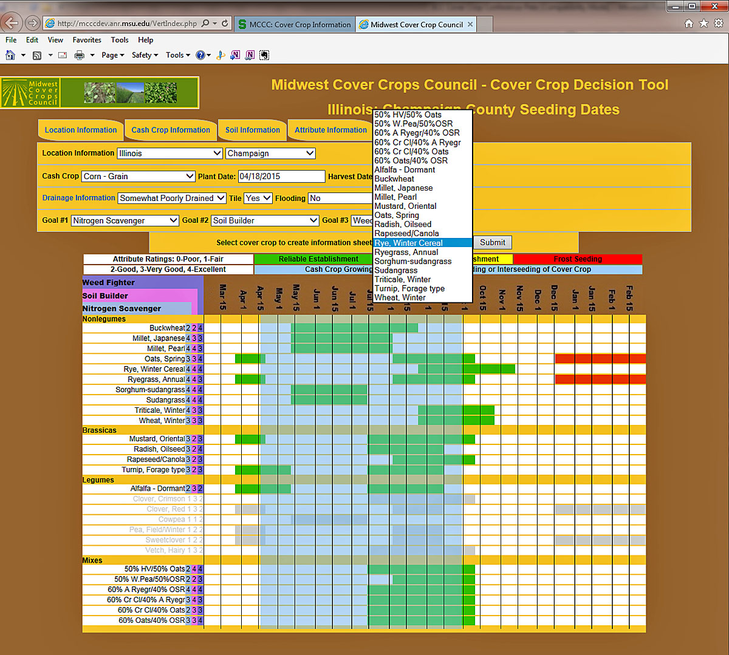
Slide Source: Doug Gucker
Notes:
http://mcccdev.anr.msu.edu/VertIndex.php

