Slide 1
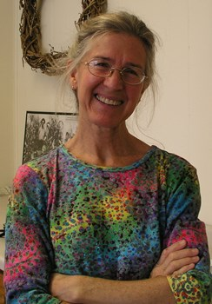
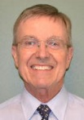
Doug Gucker is a Local Food Systems and Small Farms Extension educator with University of Illinois Extension.
He works with local producers and consumers to increase the availability of locally grown foods. In addition, his duties include being a local resource for agricultural issues within the DeWitt, Macon, & Piatt County unit.
Doug has bachelor degrees in biology and agronomy and a master's degree in agronomy. He is an Illinois Certified Crop Adviser (CCA)
His professional affiliations include the American Society of Agronomy and the Soil and Water Conservation Society.
Caroline van Schaik works with farmers and landowners in the Root River watershed of southeast Minnesota as an organizer with the Land Stewardship Project.
While cover crops, field research, conservation leases, healthy soil, custom grazing, and other aspects of agriculture occupy her with both men and women, part of her time is focused specifically on the needs of women and their expressions of land management.
She and her family run sheep on an intensely managed grazing farm near the Mississippi River.

