Slide 1
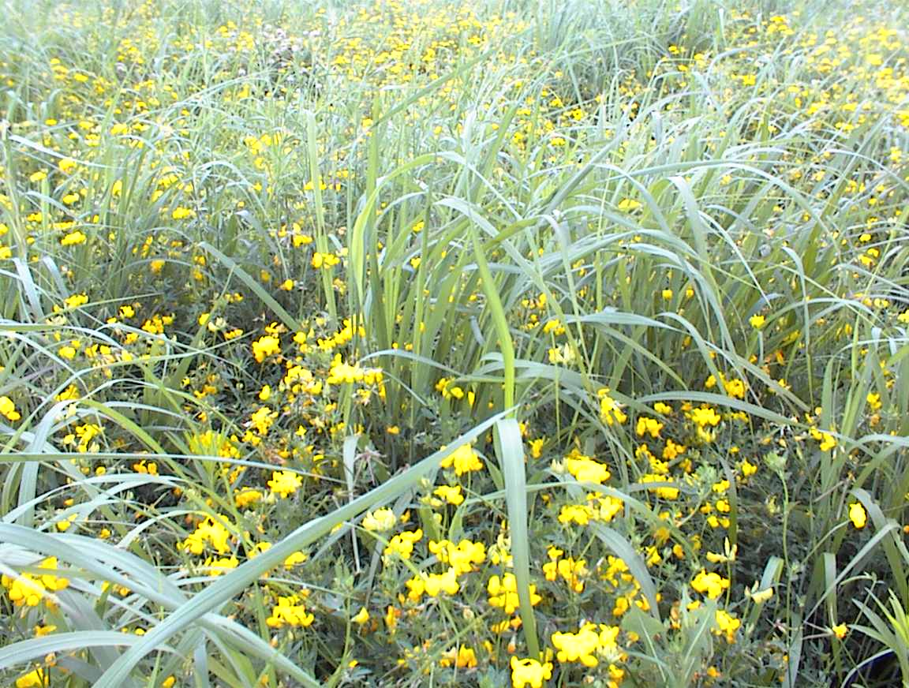
Where has all the pasture gone?
Notes:
Diverse mix of grasses and legumes

