Slide 1
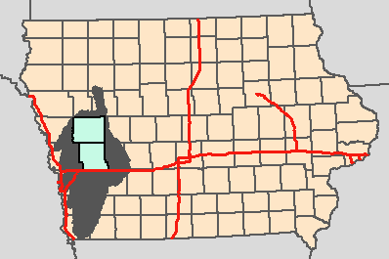
Watersheds with headwaters in Crawford and Shelby Counties, IA
Burkart et al. (2005)
Journal of Geophysical Research-Biogeosciences 110:
G01009, doi:10.1029/2004JG000008

