Slide 1
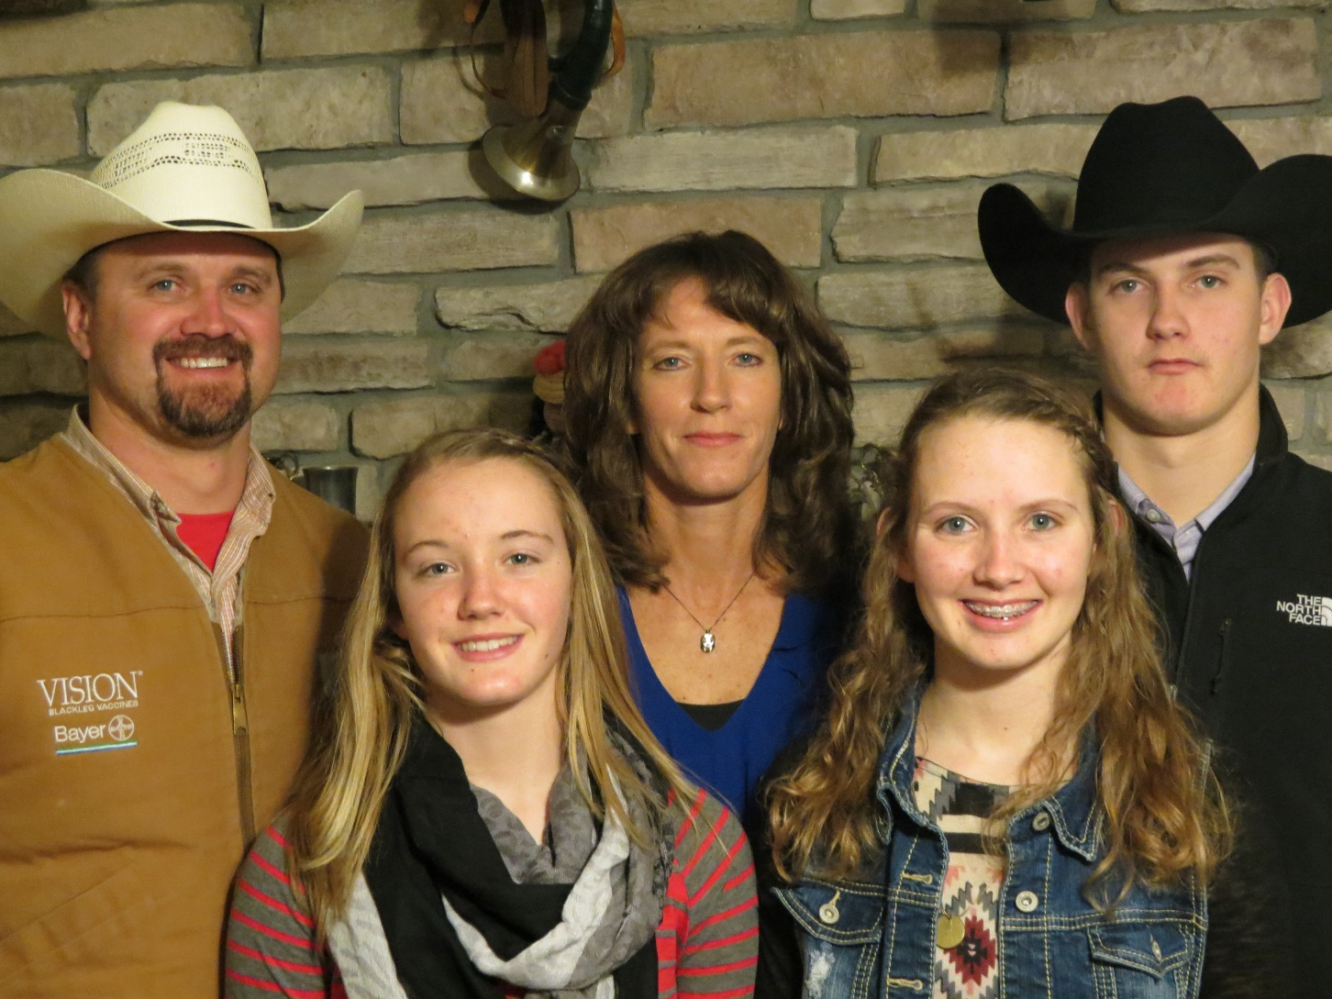
Steenhoek Farms – Duane, Jodi, Sawyer, Sydney and Blair

