Slide 1
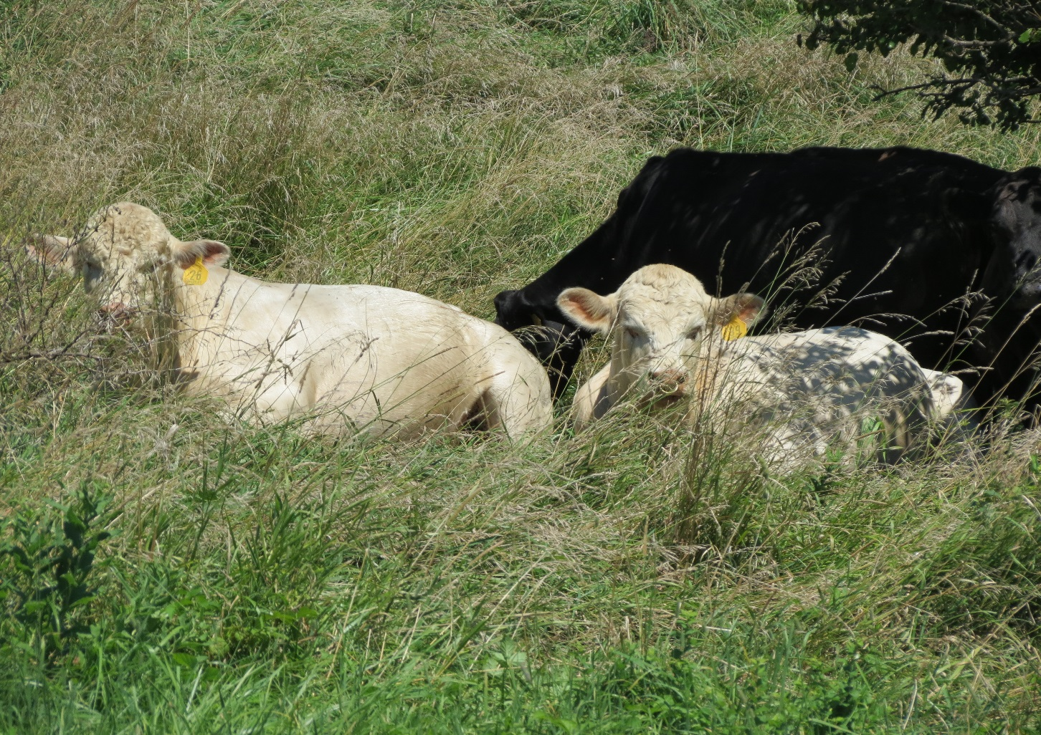


Rotate pastures, fertilize with manure – nearly double stocking rate

