Slide 1
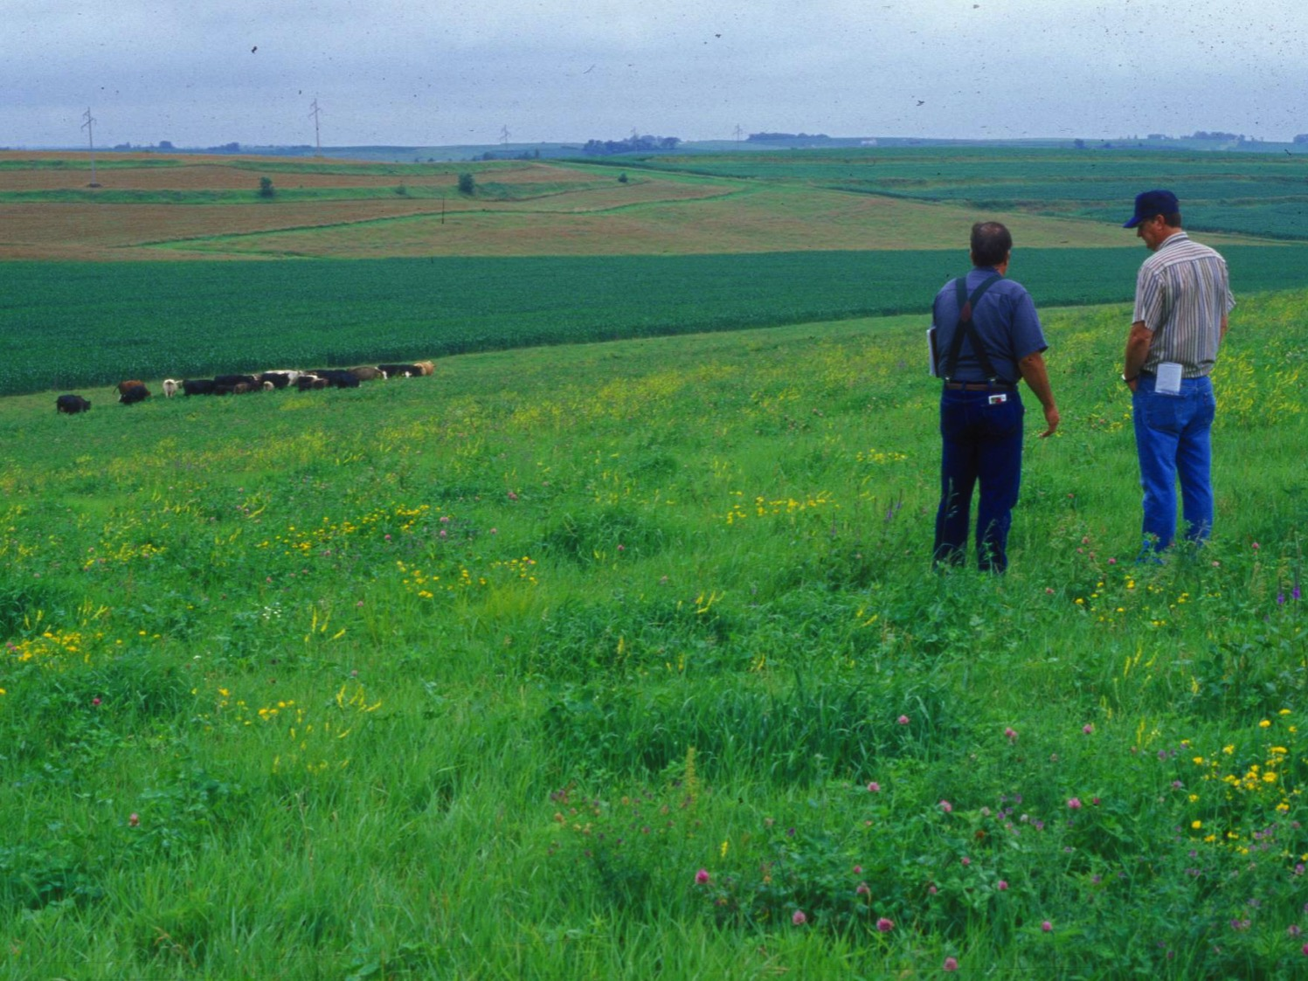
How do diversified crop/livestock systems affect soil erosion and leachable nitrogen at a landscape scale?
Shelby County, Iowa

