Slide 1
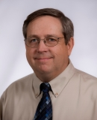
H. Joe Sellers is an ISU Extension beef specialist working in Lucas County where he also is co-owner and partner in a farm operation.
Since 1987 he’s advised extension clients on grazing and beef and sheep management in southern Iowa.
He led the Chariton Valley Beef value-added beef initiative and several other custom grazing and forage demonstration projects supported by the Leopold Center.
His contributions have been recognized by county, state and national organizations. He served on the board of directors of the Iowa Forage and Grasslands Council and the South Central Iowa Area Partnership.
He has degrees in animal science and agricultural education and studies from Iowa State University.

