Slide 1
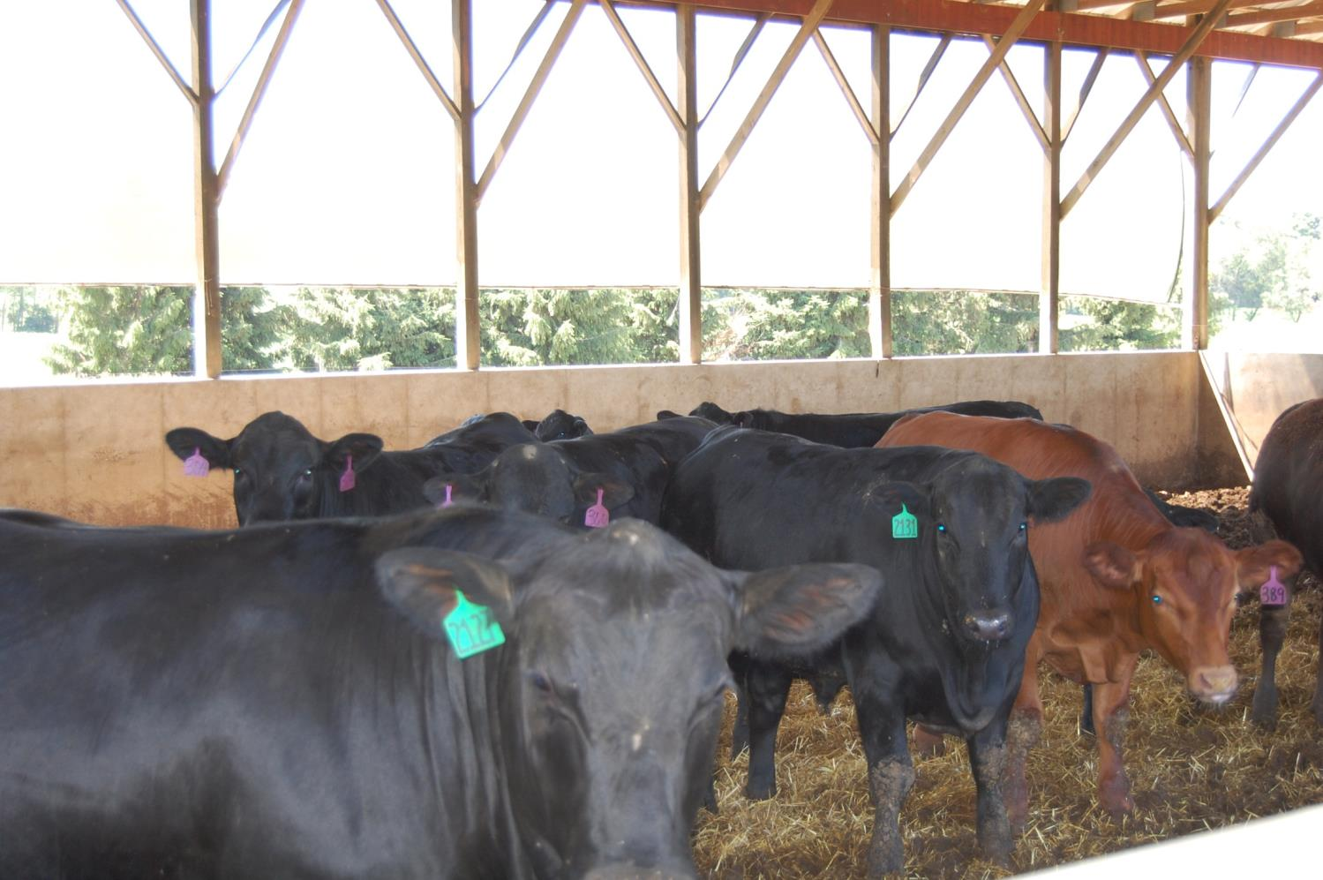
Growth in deep bedded and pitted cattle feeding barns

