Slide 1
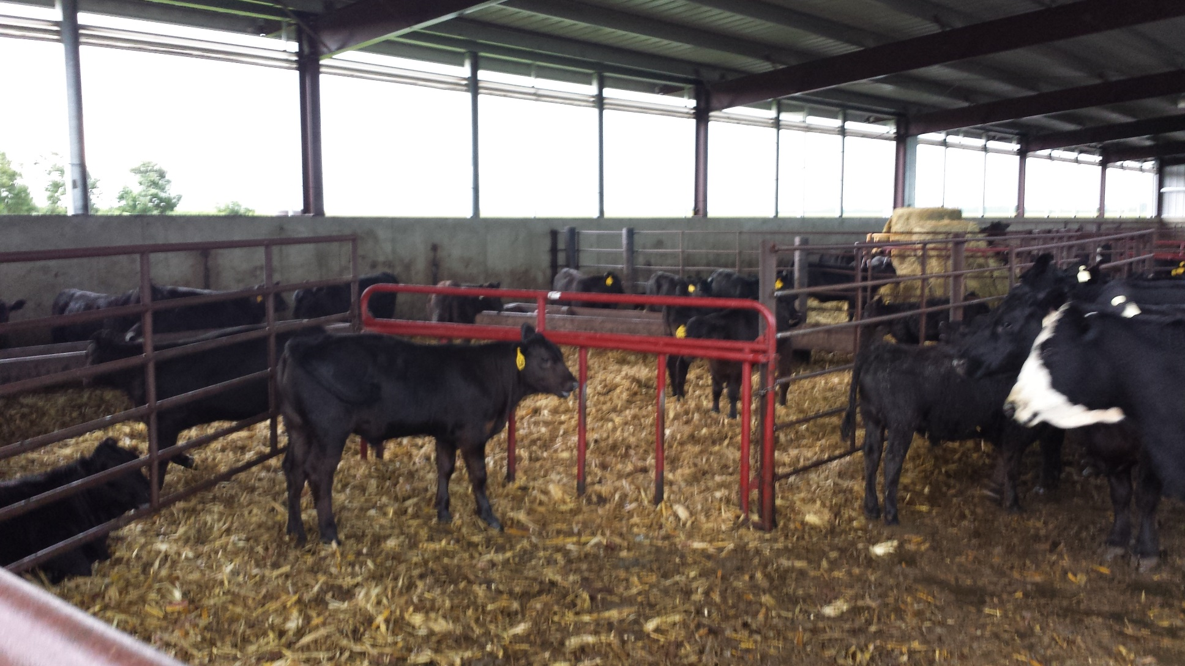
Good environment for cows and calves

