Slide 1
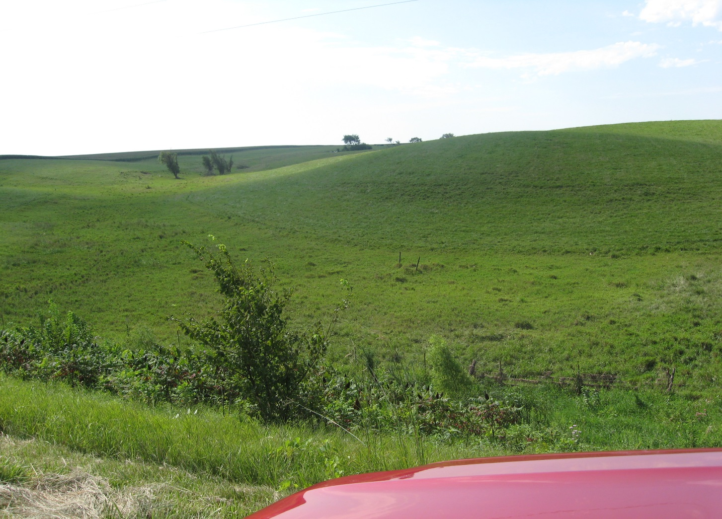
Forage on the side hills, crops on the ridge

