Slide 1
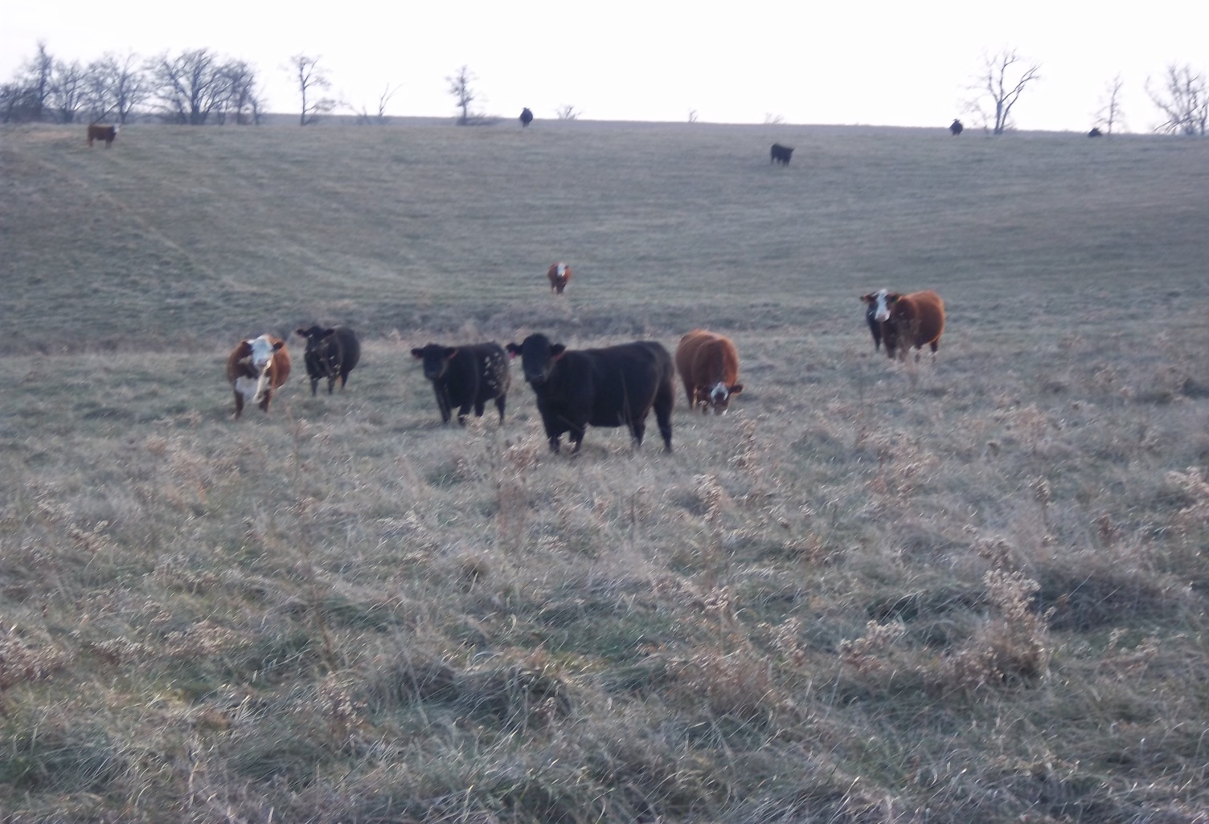
Cows can graze high quality stockpile

