Slide 1
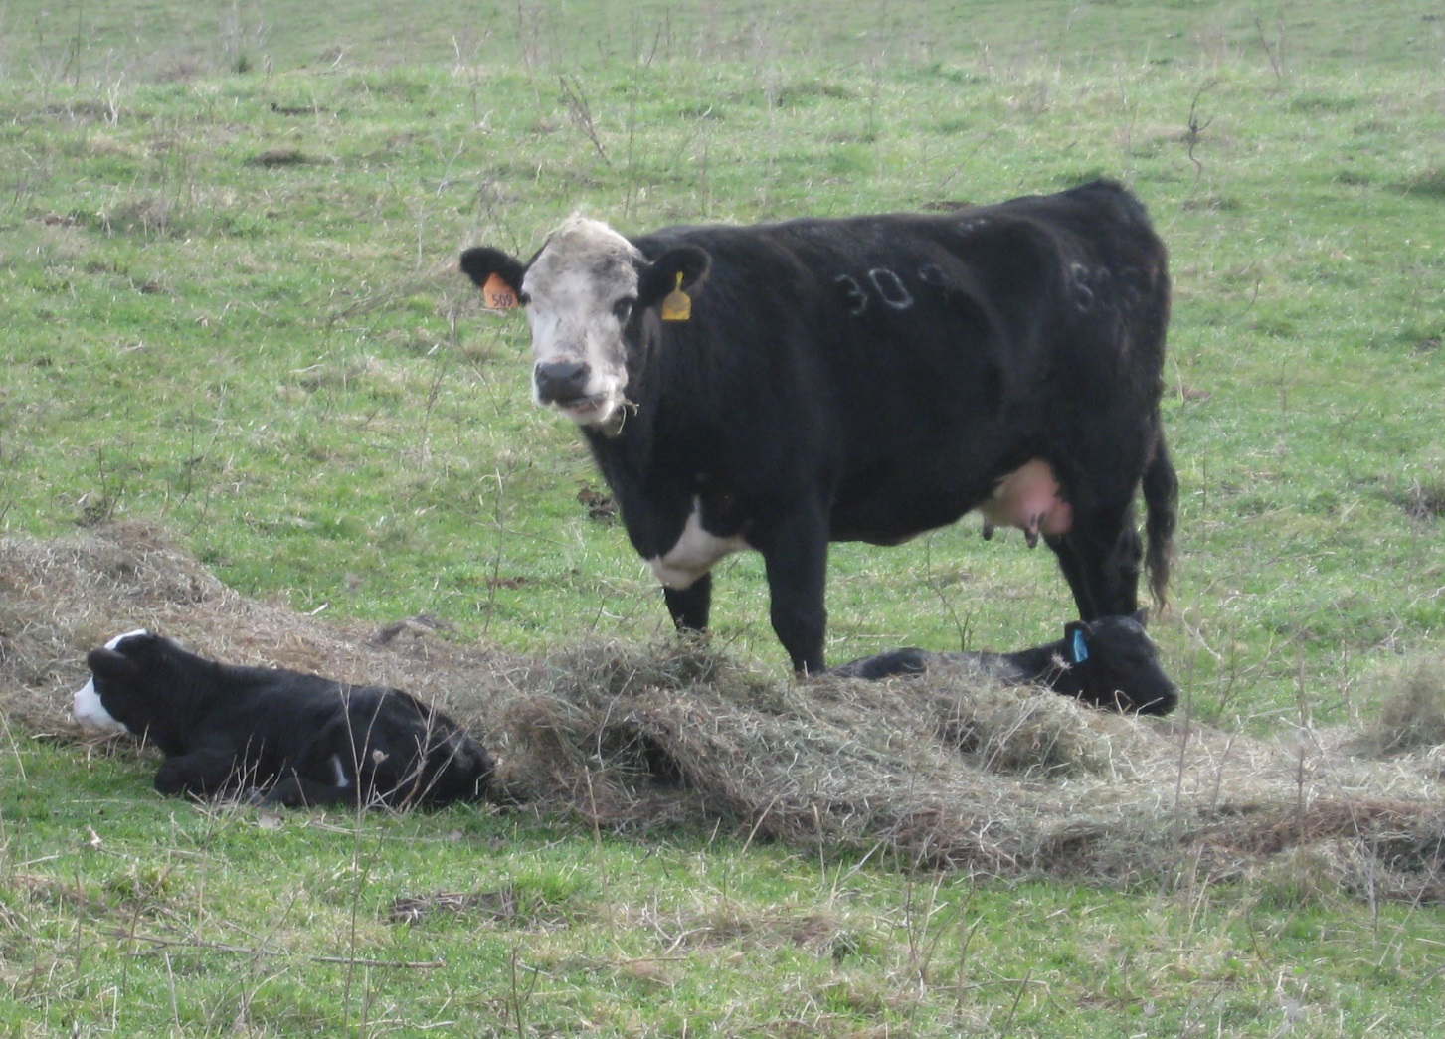
Cow herd is expanding – how do we keep profitable?

