Slide 1
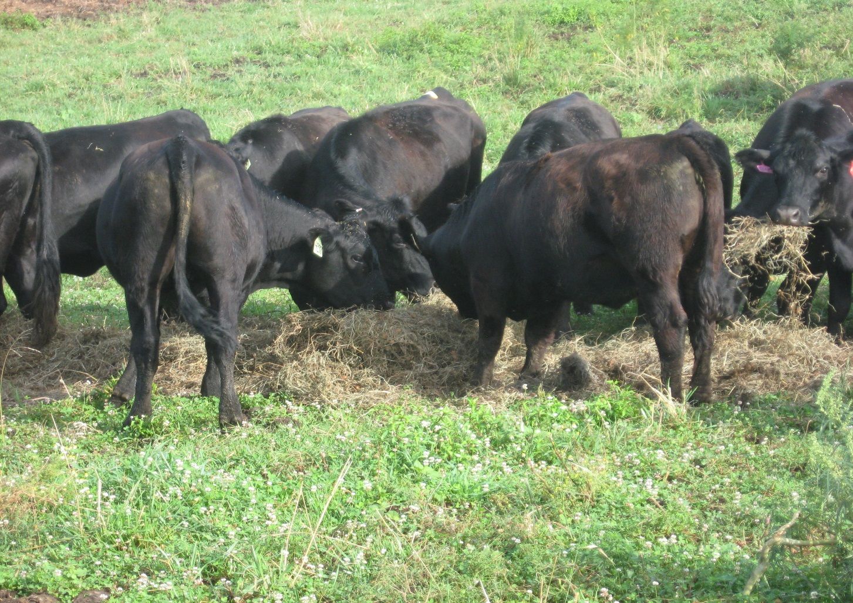
Combination of stored feed and grazing

