Slide 1
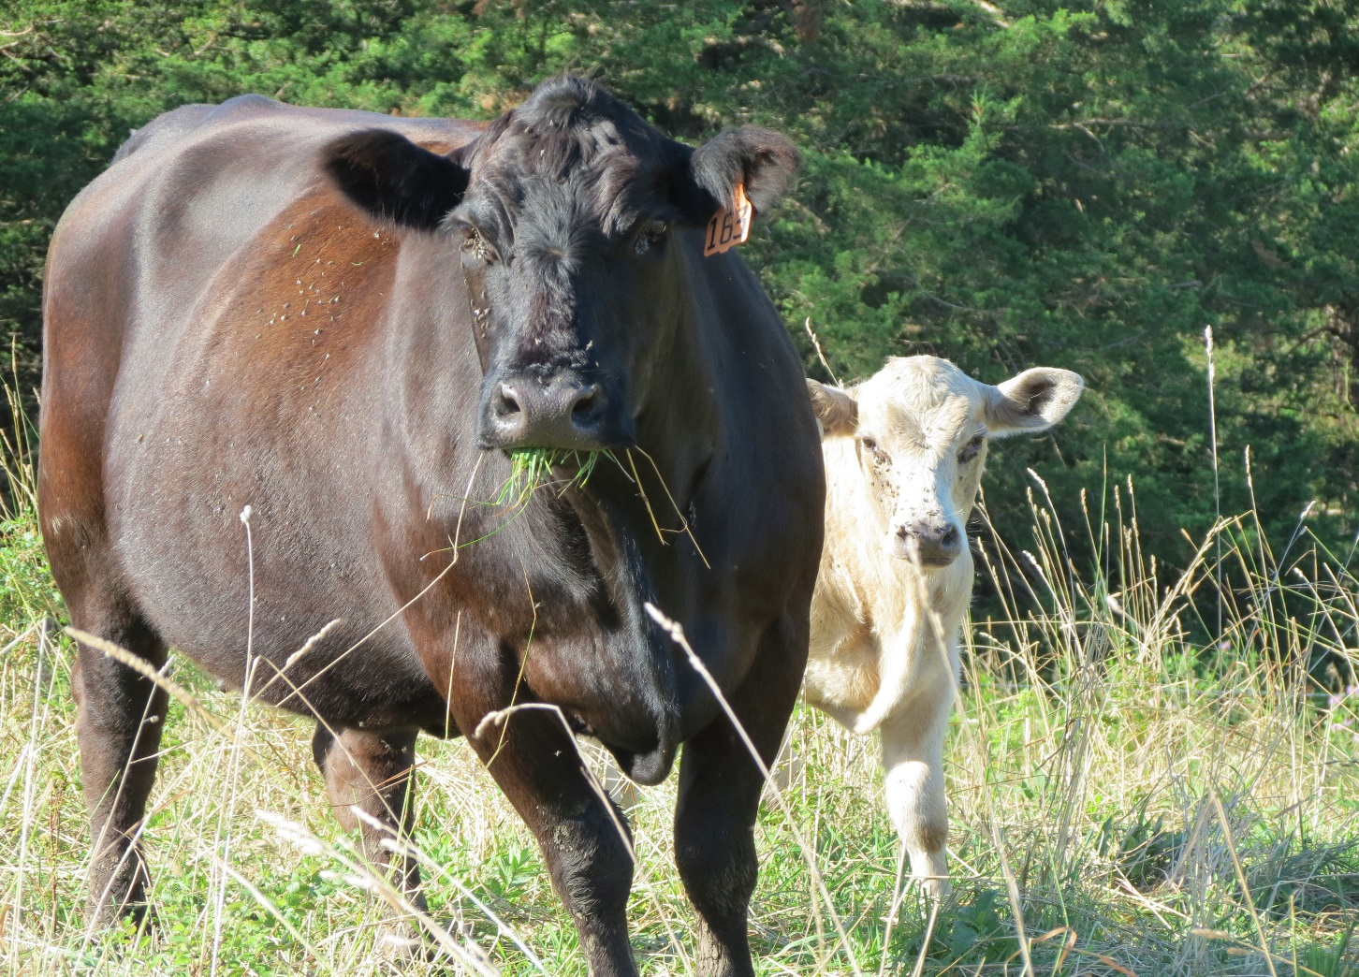
Charolais-cross calves deal with the fescue better

