Slide 1
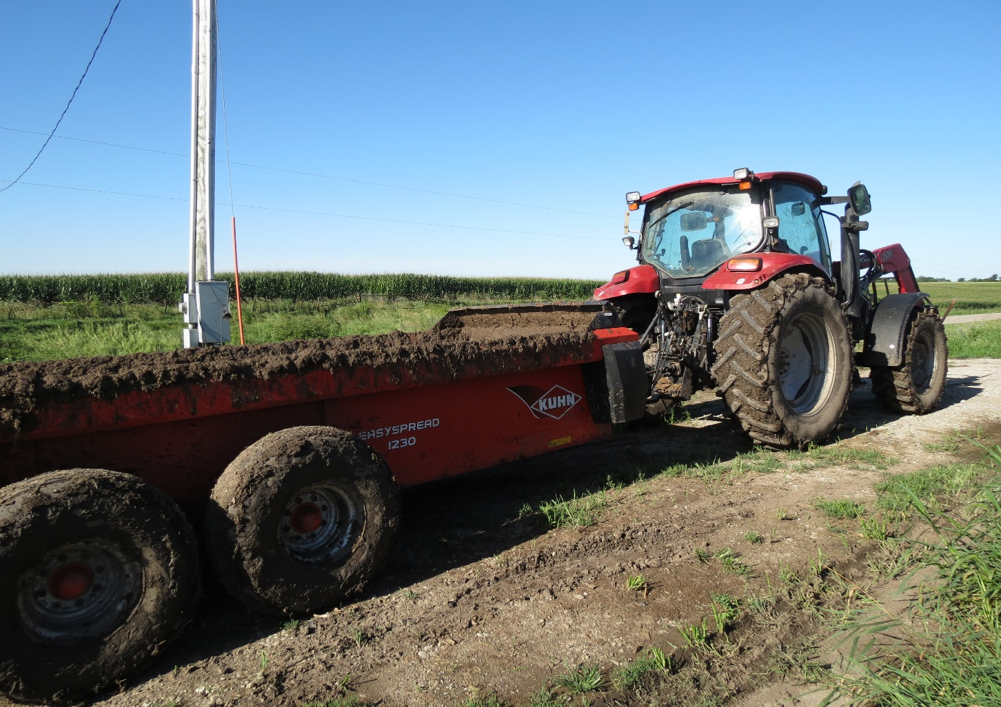
Cattle and swine manure key to success

