Slide 1
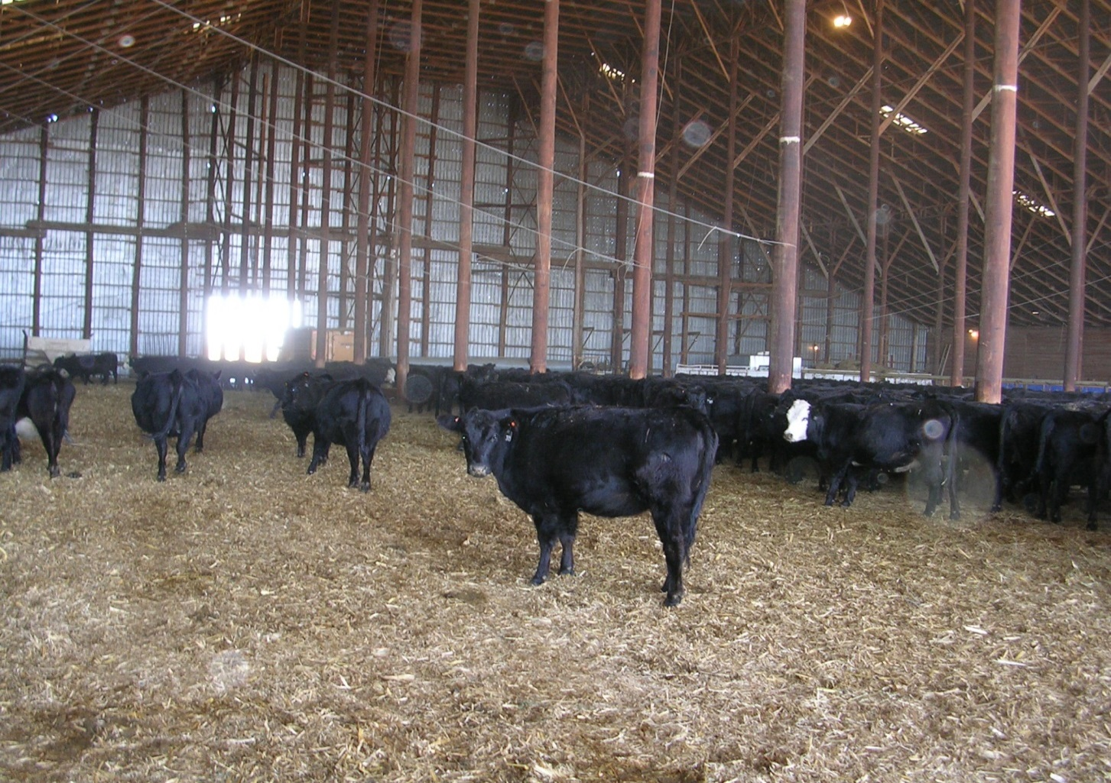
Calving and rearing calves inside

