Slide 1
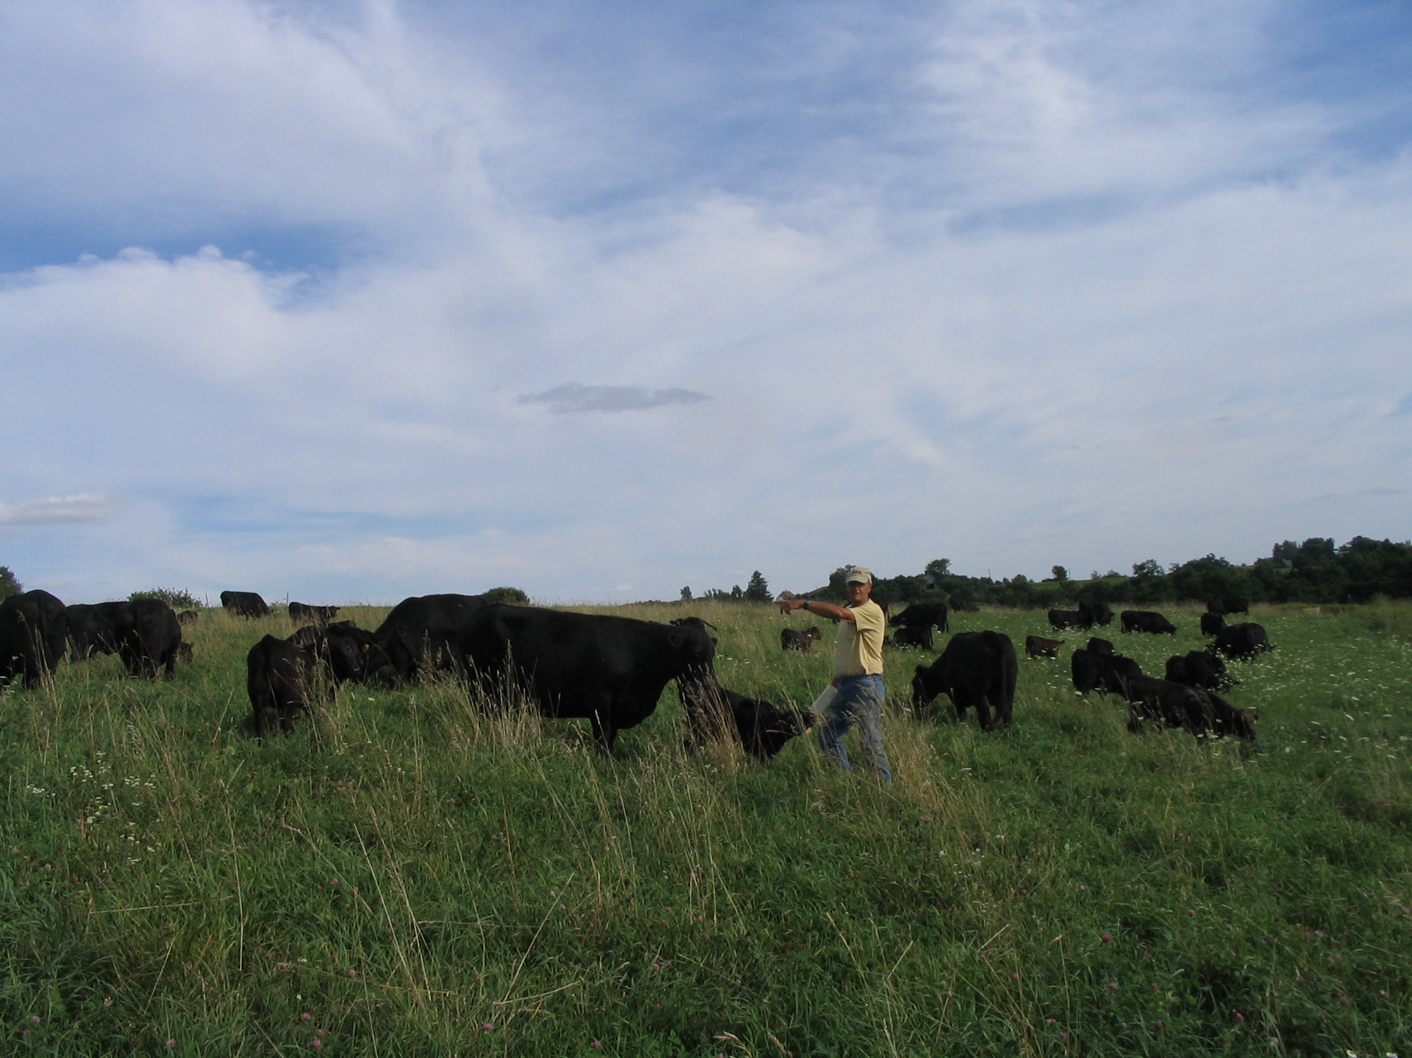
Working Landscapes
Agricultural
Goals:
Incorporating
habitat value
into profitable
agricultural
systems
Conservation
Goals:
Utilizing
livestock
grazing as
a tool for
habitat
restoration
Landowner
Goals:
Income
Aesthetics
Conservation
Avocation
Other?
Slide Source: Laura Paine
Notes:
A large majority of the land in the region is owned by non-farming landowners. The Broker project focuses on the notion that non-farming landowners may have a variety of goals. In most cases, they will have economic goals—needing to at least cover the property taxes on the land, or maintain use-value assessment. Beyond that, they may have conservation goals or aesthetic interests that they’d like to meet. Their motivations for owning land may be very different from those of a traditional farmer. But they may not have the opportunity to consider options other than renting to the neighbor who comes and knocks on their door.

