Slide 1
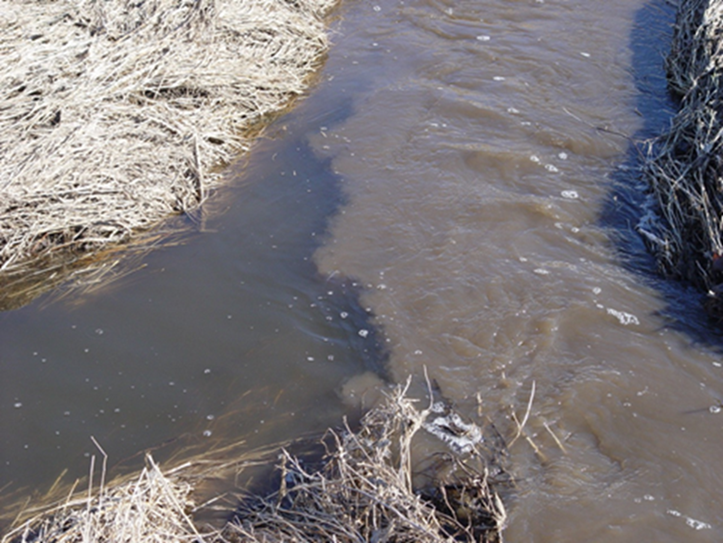
Why continuous living cover? Land….Water…Wildlife
Laura Paine
Program Director
Dairy Grazing Apprenticeship
608-338-9039
lkpaine@gmail.com
Notes:
By promoting continuous living cover, we can achieve the goals of improving soil health and productivity, protecting water quality, and providing high quality habitat. By doing this we can also promote a culture of land stewardship was once strong, and needs to be revived.

