Slide 1
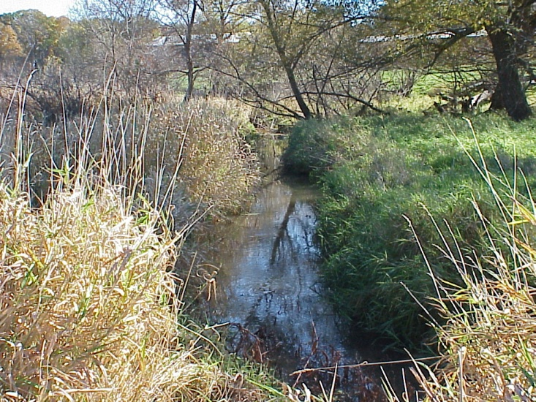
Vegetation management goals: Improve habitat structure? Control invasives?
Grazed sites had more native grasses and sedges and less reed canarygrass, an invasive species in riparian areas and wetlands.
Paine, L.K. and C.A. Ribic. 2002. Comparison of riparian plant communities under four land management systems in southwestern Wisconsin. Agriculture, Ecosystems, and Environment. 92: 93 105.
Slide Source: Laura Paine
Notes:
There’s also a large and growing body of information on using grazing to manage vegetation. We’ll start with controlling invasives. These are some data from the riparian grazing study I referenced earlier. Although many of us use improved reed canarygrass in pasture mixes, it is an invasive in wetlands and wildlife areas. What we found in our research was that the lowest proportions of reed canary were found in the grazed riparian areas. And as you can see on the right, native grasses and sedges were more prevalent in those areas.

