Slide 1
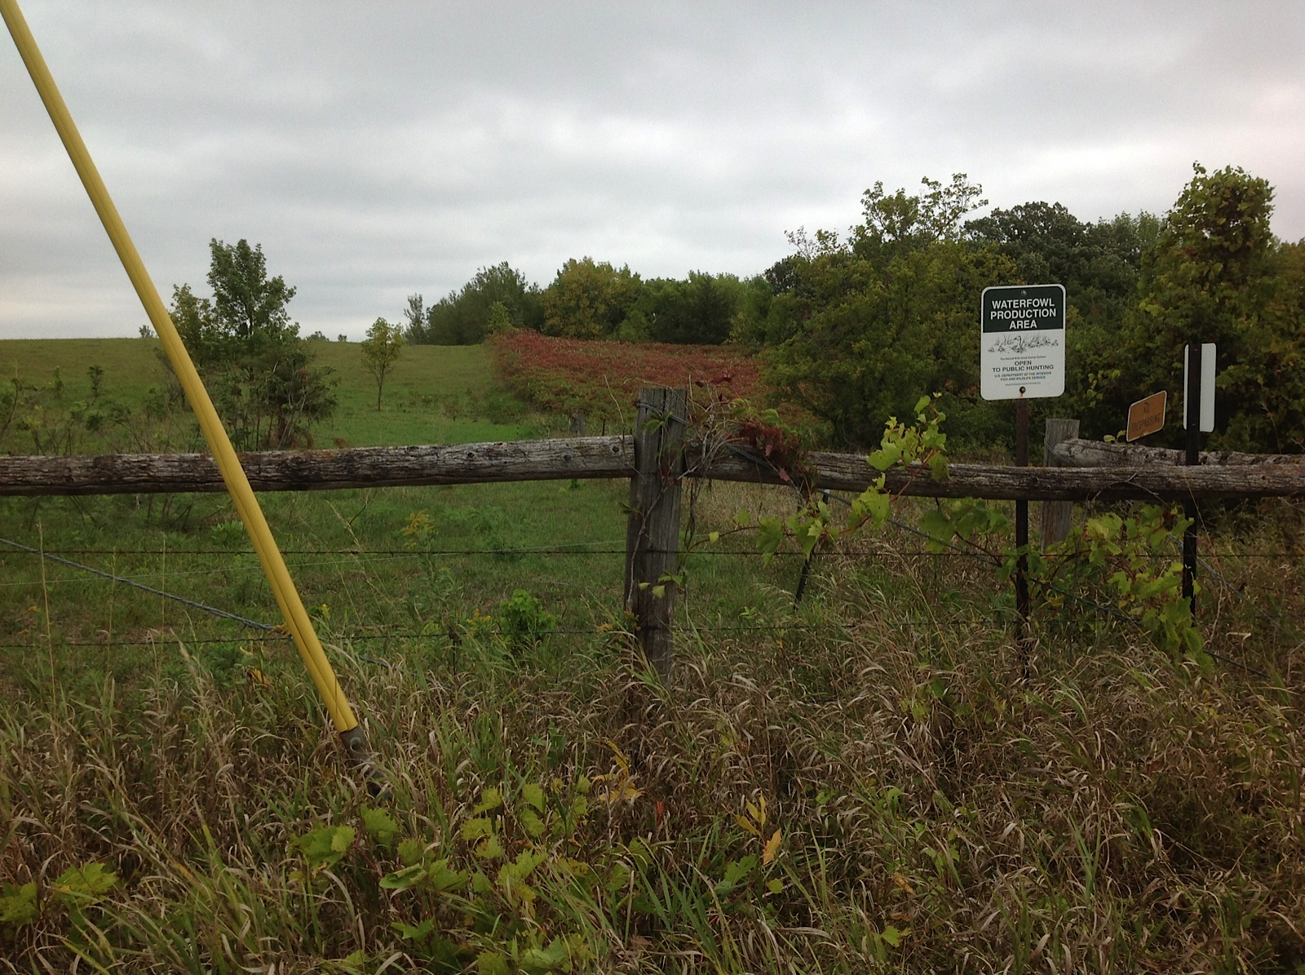
Vegetation difference: grazing vs. no grazing
Slide source:
Andy Marcum

