Slide 1
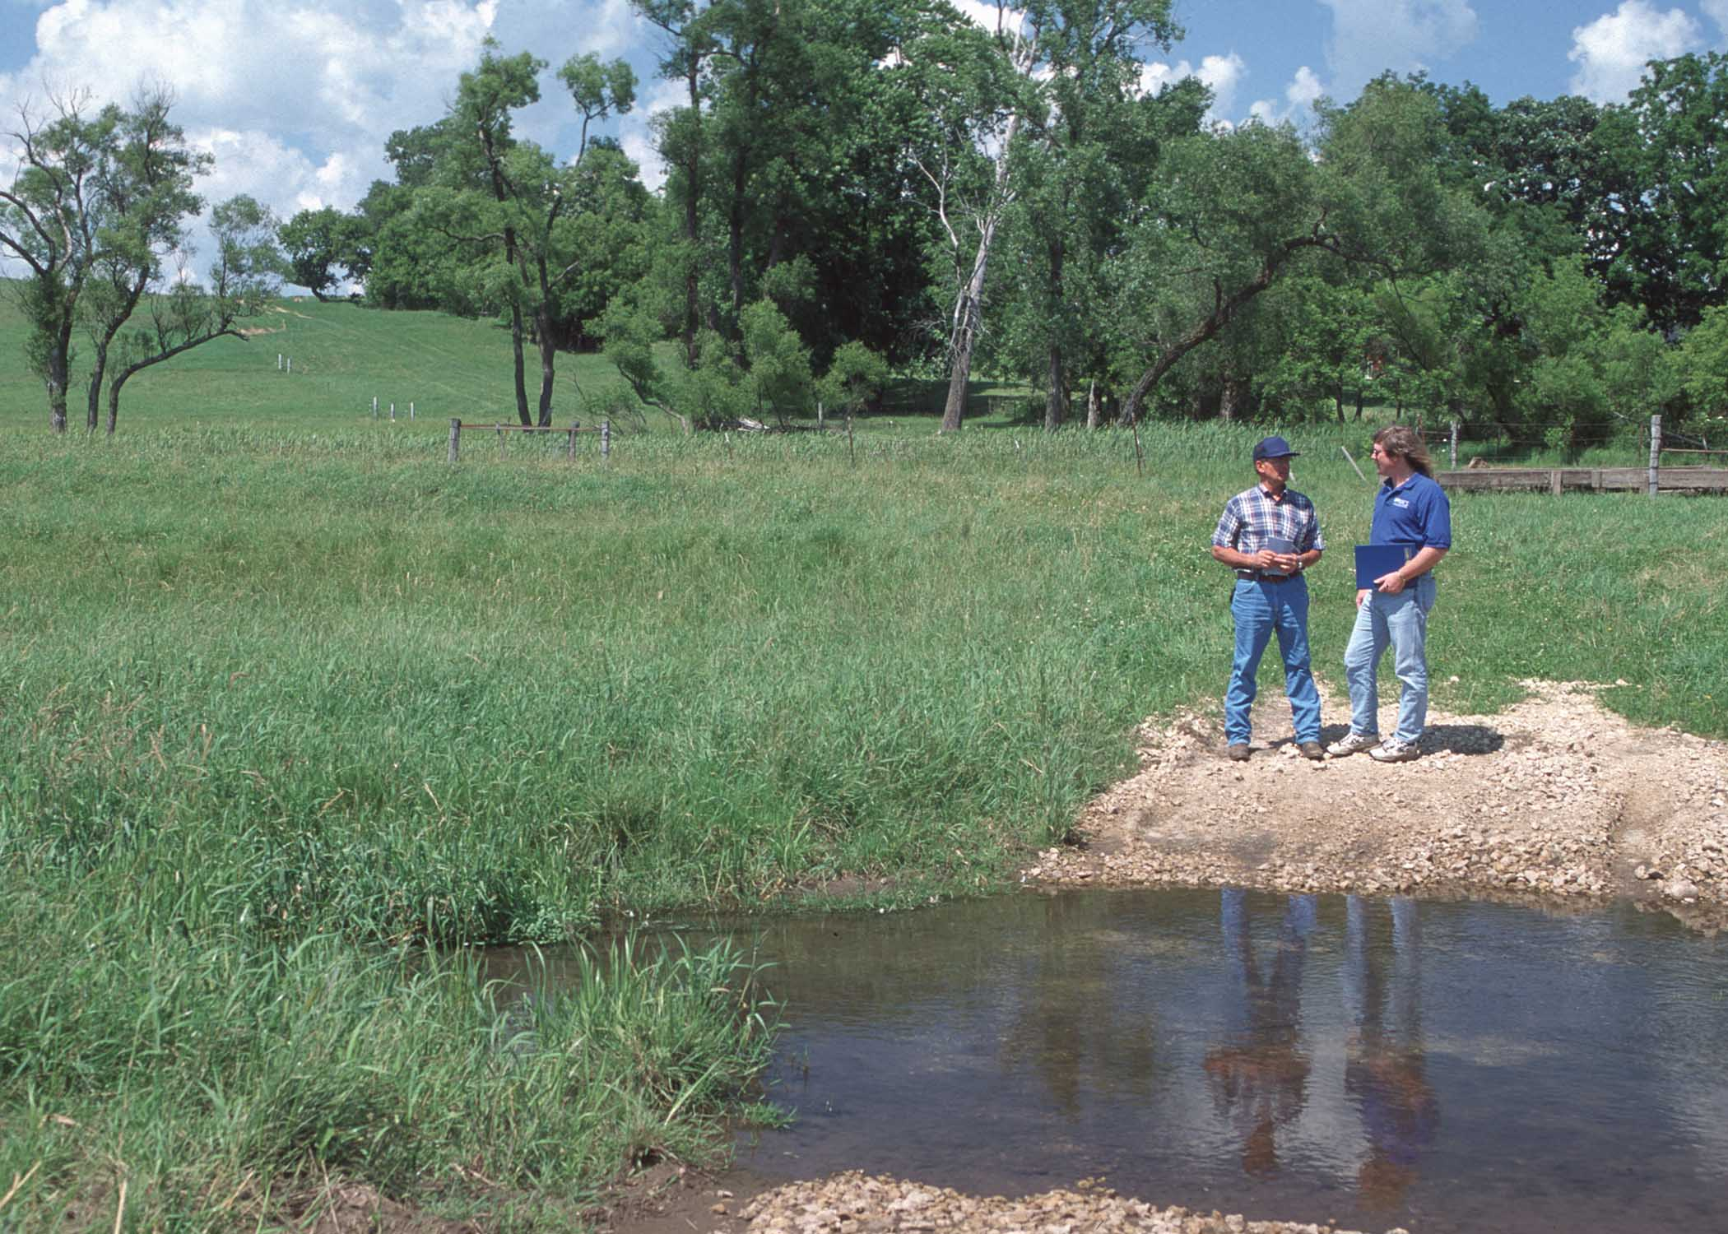
STREAM CROSSINGS
Constructed crossings allow animals safe access to water and protect streambanks
Place where animals like to cross.
Use gravel, geotextile, or cement, depending on conditions.
Use 1.5” rock.
Slide source: Laura Paine
Notes:
We can go further in managing grazing along the streams to reduce the risk of damage. Identifying places where the animals are likely to cross and improving those places reduces the potential for streambank damage elsewhere. One grazier I know uses larger rock in his stream crossing. This makes it a little uncomfortable under foot, so the cattle get their drink and don’t linger in the water.

