Slide 1
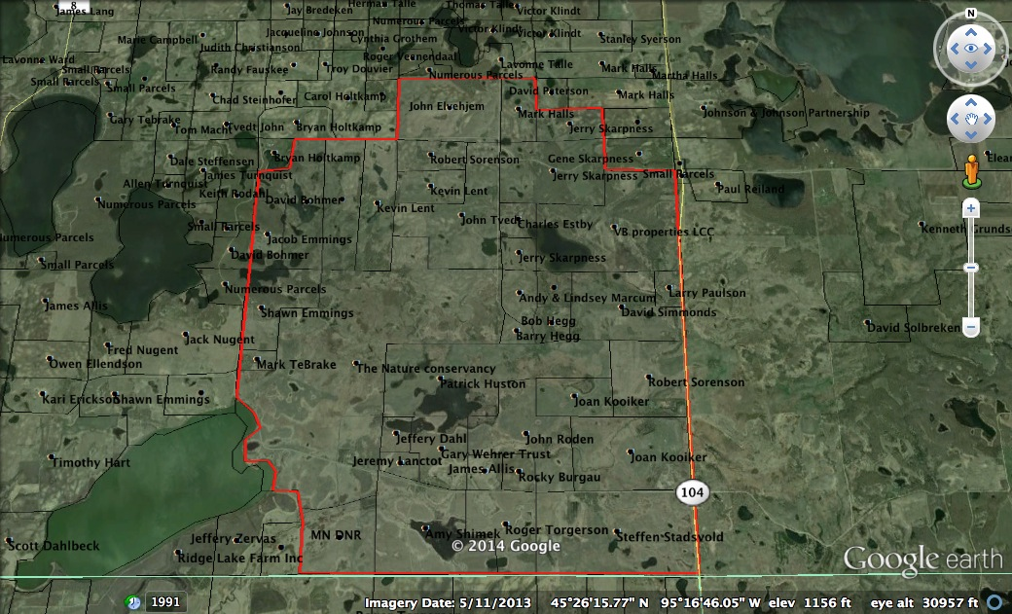
Slide source: Andy Marcum

